Slide 1
The Thessalonians
For our gospel did not come to you in word only, but also in power, and in the Holy Spirit and in much assurance, as you know what kind of men we were among you for your sake. And you became followers of us and of the Lord, having received the word in much affliction, with joy of the Holy Spirit, ….For this reason we also thank God without ceasing, because when you received the word of God which you heard from us, you welcomed it not as the word of men, but as it is in truth, the word of God, which also effectively works in you who believe.
1 Thessalonians 1:5-6; 2:13b
Richard Thetford www.thetfordcountry.com

Slide 2
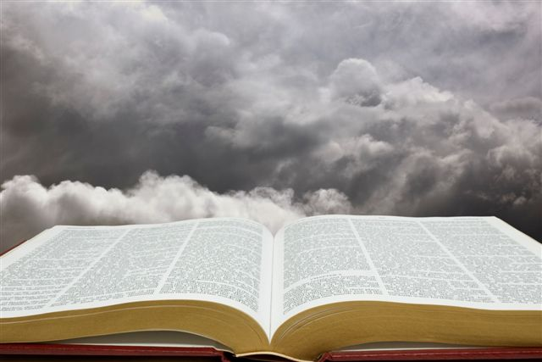
Background
Church at Thessalonica established during 2nd Journey
  Acts 15:40-18:22
1 & 2 Thessalonians written from Corinth (51-52 A.D.)
Richard Thetford www.thetfordcountry.com

Slide 3
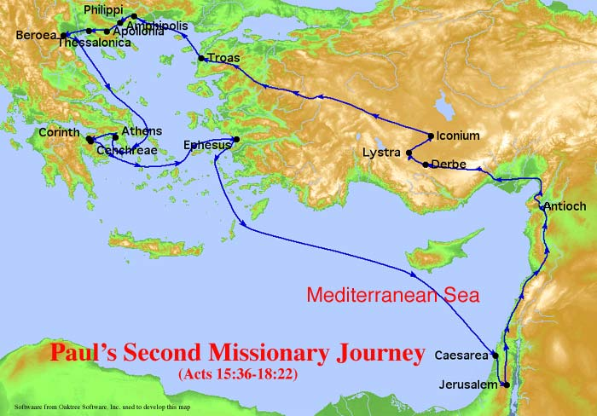
Background
Richard Thetford www.thetfordcountry.com

Slide 4
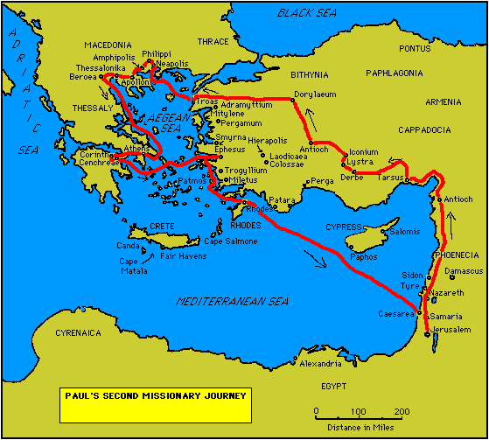
Thessalonica
  200,000 People
  Chief Seaport of Macedonia on Aegean Sea
  Founded by Cassander
  (315 B.C.)
  Named after Cassander’s wife, Thessalonica – sister of Alexander the Great
  Located on the Egnatian Way land route from Rome to East
  Church Established
  (Acts 17:1-9)
  Second Missionary Journey
  (Acts 15:40-18:22)
1st Journey – Acts 13:4-14:26
2nd Journey – Acts 15:40-18:22
3rd Journey – Acts 18:23-21:16
Richard Thetford www.thetfordcountry.com

Slide 5
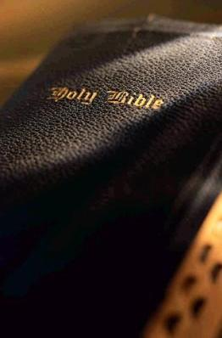
Background
Thessalonica
  Paul reasoned with the Jews
    Acts 17:2
  Explained that Christ had to suffer and die
    Acts 17:3
  Some believed
    Acts 17:4
  Unbelieving Jews stirred up the people
    Acts 17:5-9
Richard Thetford www.thetfordcountry.com

Slide 6
Background
Richard Thetford www.thetfordcountry.com

Slide 7
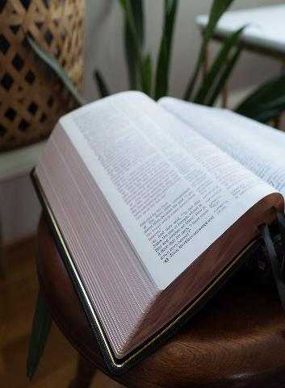
Commendation
Thessalonica (1 Thessalonians)
  Turned from idols (1:9)
  Commended for their works (1:3; 4:10)
  Faithfully endured under trial (1:6; 2:15)
  Examples to other churches (1:7)
  Imitators of churches in Judea (2:14)
  Welcomed the word (2:13)
Richard Thetford www.thetfordcountry.com

Slide 8
Condemnation
Thessalonica
  Some brethren not holding to the word
  Paul condemns those walking disorderly
    2 Thessalonians 3:6-15
The tradition of God establishes orderliness
2 Thessalonians 2:15
Richard Thetford www.thetfordcountry.com

Slide 9
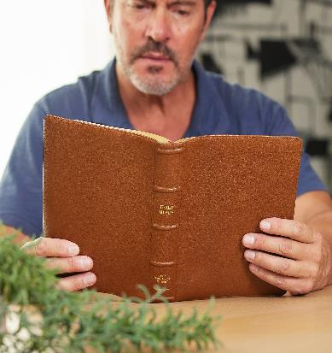
Clarification
Thessalonica
  Some things Paul needed to clarify:
    Concerning those who had died
    (1 Thessalonians 4:13-18)
      Do not be sorrowful
      When Jesus comes – He will bring them
      Dead in Christ will arise first
Richard Thetford www.thetfordcountry.com

Slide 10
Clarification
Thessalonica
  Some things Paul needed to clarify:
    Concerning the second coming (2 Thessalonians 2)
      Some thought Jesus was coming soon
        1 Thessalonians 3:13; 5:1-11
      Paul told them:
        “falling away” must come first (2 Thessalonians 2:3)
        They must stand fast (2 Thessalonians 2:13-15)
        Idleness not acceptable (2 Thessalonians 3:6-15)
Richard Thetford www.thetfordcountry.com

Slide 11
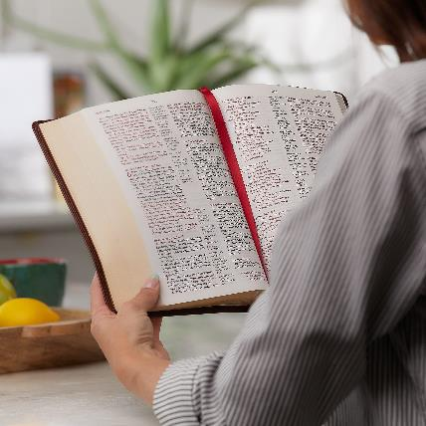
Exhortation
Thessalonians exhorted to “keep on”
  Holy living
    1 Thessalonians 4:3-8
  Preparedness
    1 Thessalonians 5:1-10
  Recognition of those who labor
    1 Thessalonians 5:12-13
  Peace
    1 Thessalonians 5:13
Richard Thetford www.thetfordcountry.com

Slide 12
Exhortation
Thessalonians exhorted to “keep on”
  Concern for others
    1 Thessalonians 5:14
  Prayer and giving thanks
    1 Thessalonians 5:17-18
  Not to quench the spirit
    1 Thessalonians 5:12-13
Quench the spirit:
“Likened to putting
out a hot fire.”
Richard Thetford www.thetfordcountry.com

Slide 13

Exhortation
Thessalonians exhorted to “keep on”
  Test all things
    1 Thessalonians 5:21-22
  Warnings about deception
    2 Thessalonians 2
  Withdraw from the disorderly
    2 Thessalonians 3:6-15
Richard Thetford www.thetfordcountry.com

Slide 14
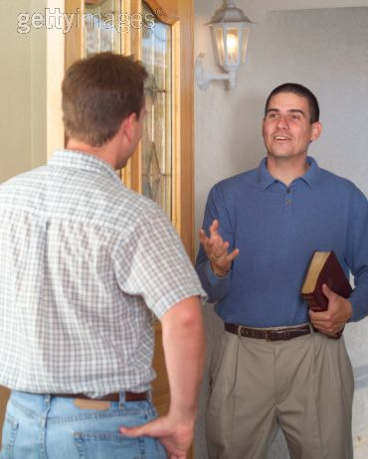
Principles
Put away our own idols
Endure persecutions and trials
Churches example is important
Must respect the word of God
Christ’s enemies will be condemned
Disorderly cannot be tolerated
Richard Thetford www.thetfordcountry.com

Slide 15
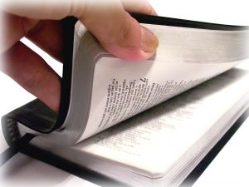
Principles
We don’t know when the Lord will return
It is possible to believe a lie
Pray without ceasing
Richard Thetford www.thetfordcountry.com

