Slide 1
Authority in Religion
What is used as the standard
in the realm of religion today
?
Richie Thetford www.thetfordcountry.com

Slide 2
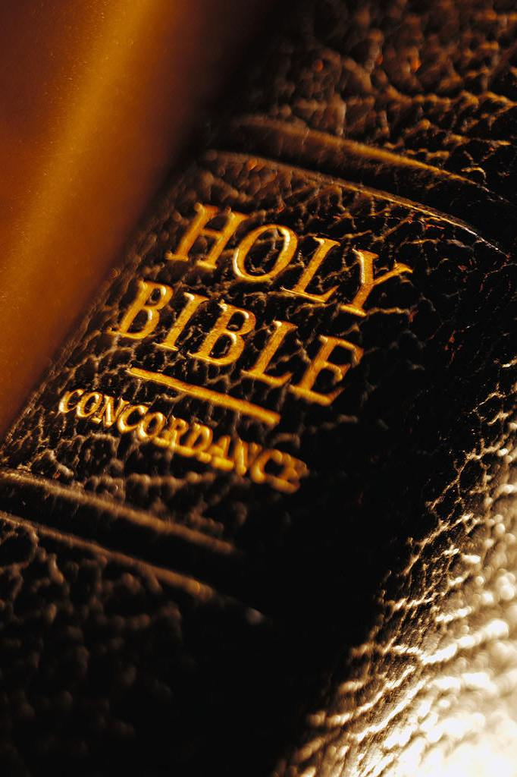
Shall We Rely Upon the Religion of Our Fathers?
Paul learned religion of his fathers was wrong
Galatians 1:13-14
We have been redeemed from our former ways
1 Peter 1:18
Richie Thetford www.thetfordcountry.com

Slide 3
Shall We Rely Upon the Religion of Our Fathers?
Jews of Jerusalem were wrong in following in the footsteps of their fathers
Acts 7:51-52
Loving parents more than Christ makes one unworthy to follow Him
Matthew 10:34-37
This means that I better do what I know is right!
Richie Thetford www.thetfordcountry.com

Slide 4
Shall We Rely On Our Conscience as a Safe Guide?
Solomon warned:
Proverbs 16:25
Many today say “let your conscience be your guide”
Acts 23:1
Richie Thetford www.thetfordcountry.com

Slide 5
Shall We Rely On Our Conscience as a Safe Guide?
What did Paul do in “good conscience?”
Galatians 1:13
Paul was honest and sincere when he led the persecution against the church
Acts 26:9-11
If Paul’s conscience was wrong – so can ours!
Richie Thetford www.thetfordcountry.com

Slide 6
Shall We Follow the Decision of the Majority?
The majority will be lost
Matthew 7:13-14
God’s way has never been popular with the majority of the world
Acts 4:19-20
Paul’s encouraging words say:
Romans 8:31
That statement means we MUST obey!
Richie Thetford www.thetfordcountry.com

Slide 7
Shall We Submit to the Creeds of Men?
No man can direct his own ways
Jeremiah 10:23
When following doctrines and creeds of men, then one’s religion is in vain
Matthew 15:8-9; 1 Corinthians 2:5
Only the gospel is God’s power to save
Romans 1:16; Galatians 1:8
Richie Thetford www.thetfordcountry.com

Slide 8
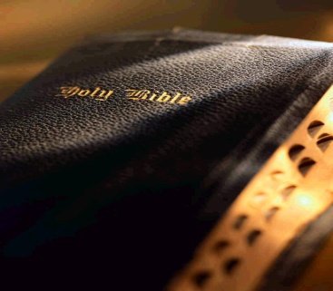
Shall We Accept Only the Bible as Our Authority?
The Bible is divine
2 Peter 1:21
Every good work that pleases God is furnished by the Bible
2 Timothy 3:16-17
Richie Thetford www.thetfordcountry.com

Slide 9
Shall We Accept Only the Bible as Our Authority?
The Bible is our “road map” to heaven
Acts 20:32
The Bible is THE standard used in judgment
“He who rejects Me, and does not receive My words, has that which judges him — the word that I have spoken will judge him in the last day.” (John 12:48)
Richie Thetford www.thetfordcountry.com

Slide 10
We All Have Freedom of Choice in Religious Matters!
WE CAN
Rely upon the religion of our fathers
Rely upon our conscience as a safe guide
Follow the decision of the majority
Submit to the creeds of men in religion
Accept the Bible as our authority in religion
What is TRUE authority? GOD’S HOLY WORD!
Richie Thetford www.thetfordcountry.com

Slide 11
LUKE 6:46
“But why do you call Me 'Lord, Lord,' and not do the things which I say?”
Richie Thetford www.thetfordcountry.com

