Slide 1
We Are The Children of God
Romans 8:14-16
Song #434
“All Hail the Power of Jesus’ Name”
Opening Prayer

Slide 2
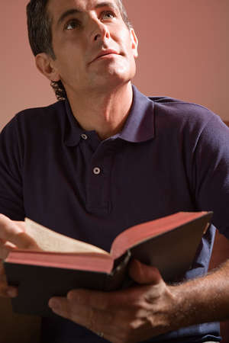
We Are The Children of God
His Children
ARE LOVED BY THE FATHER
Psalm 8:4-9; John 3:16; 1 John 3:1-3
Song #647
“The Way That He Loves”
Ephesians 1:15-2:7
Song #412
“God Is Love”

Slide 3
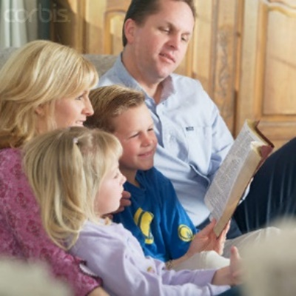
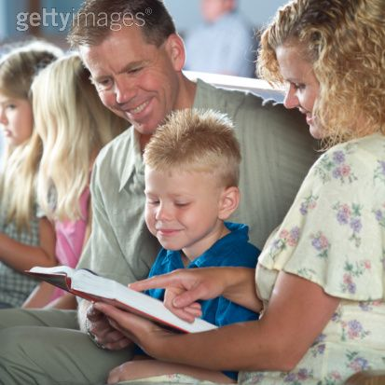
We Are The Children of God
His Children
PRACTICE RIGHTEOUSNESS
1 John 3:4-10
Song #118
“Take Time To Be Holy”
Psalm 24:1-5; 1 Corinthians 6:9-11
Song #150
“Purer In Heart, O God”

Slide 4
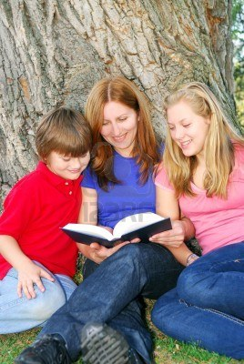
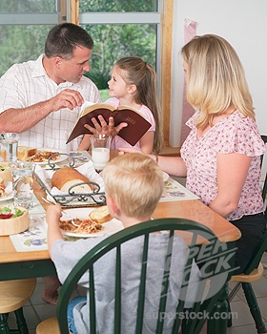
We Are The Children of God
His Children
LOVE ONE ANOTHER
1 John 3:11-24
Song #302
“Blest Be the Tie”
1 John 4:7-21
Song #394
“Love One Another”

Slide 5
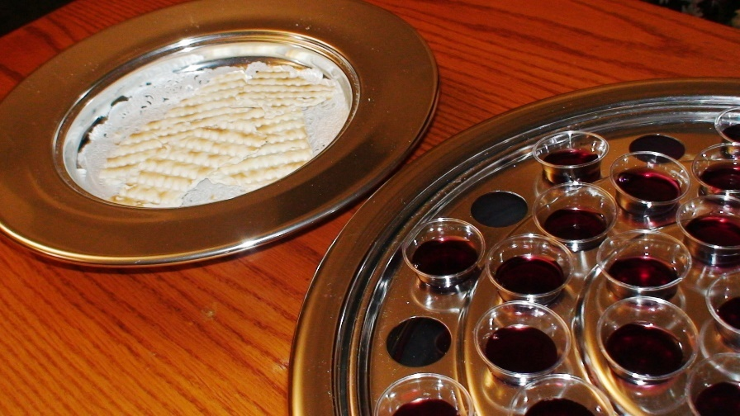
We Are The Children of God
LORD’S SUPPER OFFERED
Hebrews 9:24-28
Song #183
“Tis Midnight; And On Olive’s Brow”

Slide 6
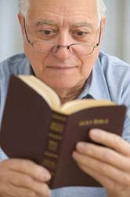
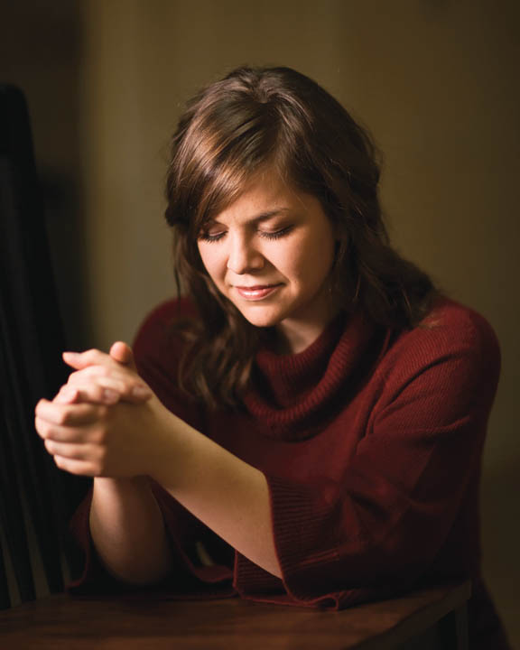
We Are The Children of God
His Children
DO NOT DIE
Luke 20:34-38; John 6:47-51
Song #662
“I’ll Live In Glory”

Slide 7
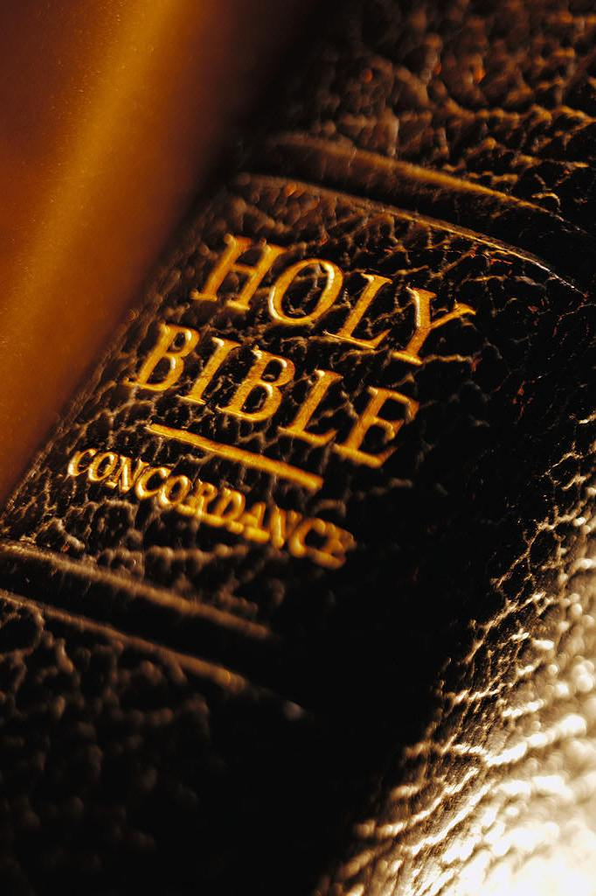
We Are The Children of God
GOSPEL INVITATION
Invitation Song #268
“Hark, The Gentle Voice”
Closing Song #105
“I Am Thine, O Lord”
Closing Prayer

