Slide 1

John 14:1-6
Song #417 “The Providence of God”
(Verses 1-2) – ‘From the Handout’
Opening Prayer
Richard Thetford www.thetfordcountry.com

Slide 2

Jesus is the Way
Matthew 7:13-14; Jeremiah 10:23
Song #295 “Christ Receiveth Sinful Men”
Hebrews 10:1-22
Song #341 “The Way of the Cross Leads Home”
John 10:1-14
Song #391 “Savior, Like a Shepherd Lead Us”
Richard Thetford www.thetfordcountry.com

Slide 3
Jesus is the Truth
John 18:28-38
Song #180 “Wonderful Story of Love”
John 1:1-14
Song #296 “How Firm a Foundation”
Richard Thetford www.thetfordcountry.com

Slide 4

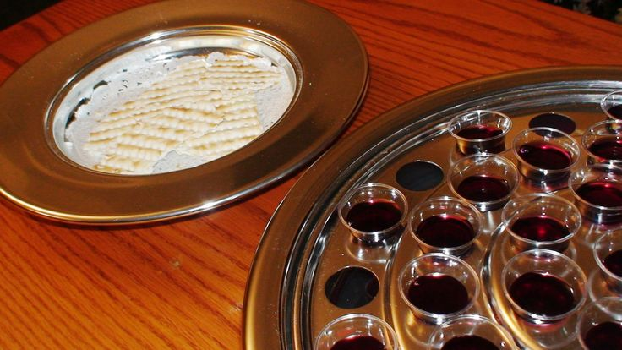
COLLECTION
Song #392 “Count Your Blessings”
Song #604 “I’m the One”
Luke 22:54-71
Serving of the Lord’s Supper
LORD’S SUPPER
Richard Thetford www.thetfordcountry.com

Slide 5
Jesus is the Life
John 11:11-44; 14:15-19
Song #355 “Break Thou the Bread of Life”
1 John 5:1-13
Song #360 “Standing on the Promises”
Richard Thetford www.thetfordcountry.com

Slide 6
INVITATION
Invitation Lesson
Invitation Song #335 “Live For Jesus”
Closing Song #417 “The Providence of God”
(Verses 3-4) – ‘From the Handout’
Closing Prayer
Richard Thetford www.thetfordcountry.com

Slide 7
Richard Thetford www.thetfordcountry.com

