Slide 1
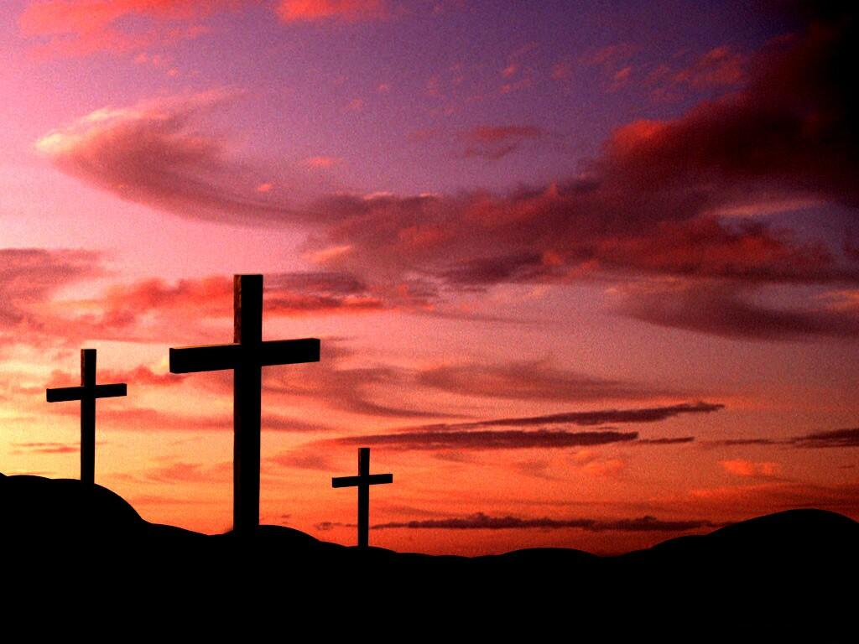
Our Relationship with Jesus
“Jesus Is All the World to Me”
451
Prayer

Slide 2
Our Relationship with Jesus
To Remember Him
“Faith is the Victory”
576
Hebrews 11:1
Hebrews 10:22
John 20:30-31

Slide 3
Our Relationship with Jesus
To Remember Him
“The Lord’s Supper”
171
John 3:16
Matthew 26:26-29

Slide 4
Our Relationship with Jesus
To Follow After Him
“Trust and Obey”
326
Matthew 7:21; 17:5
Mark 16:15-16
John 14:15

Slide 5
Our Relationship with Jesus
To Follow After Him
“Where He Leads I’ll Follow”
498
Mark 10:17-21
Matthew 8:19-21
2 Timothy 2:15

Slide 6
Our Relationship with Jesus
To Be Like Him
“Angry Words”
394
Colossians 3:8
James 3:1-10

Slide 7
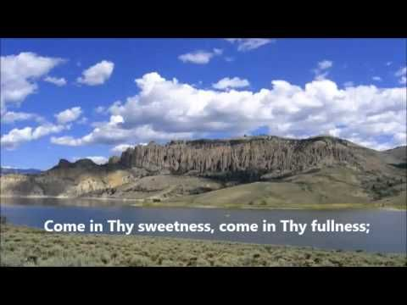
Our Relationship with Jesus
To Be Like Him
“O To Be Like Thee”
97
1 John 3:1-4
Prayer

Slide 8
Our Relationship with Jesus
To See Him Again
“On Jordan’s Stormy Banks I Stand”
254
John 14:1-3
Revelation 21:21

Slide 9
Our Relationship with Jesus
To See Him Again
“We Shall See the King Someday”
532
1 Timothy 6:7-19
Philippians 2:9-11

Slide 10
Our Relationship with Jesus
Invitation
“Almost Persuaded”
348
Closing Song
“My Jesus I Love Thee”
110
Prayer

