Slide 1
JESUS Is Coming Again!
1 Thessalonians 4:13-18
Song #750
We Shall See The King Some Day

Slide 2
JESUS Is Coming Again!
Opening Prayer

Slide 3
He Promised That He Would
John 14:1-7
Song #244
I Stand Amazed

Slide 4
He Promised That He Would
Acts 1:1-11
Song #590
We’ll Work Till Jesus Comes

Slide 5
He Will Come to Judge All Men
Matthew 25:31-46
Song #753
When the Roll is Called Up Yonder

Slide 6
He Will Come to Judge All Men
Matthew 12:36
2 Corinthians 5:8-10
Romans 2:5-9
Song #829
Prepare to Meet Thy God

Slide 7
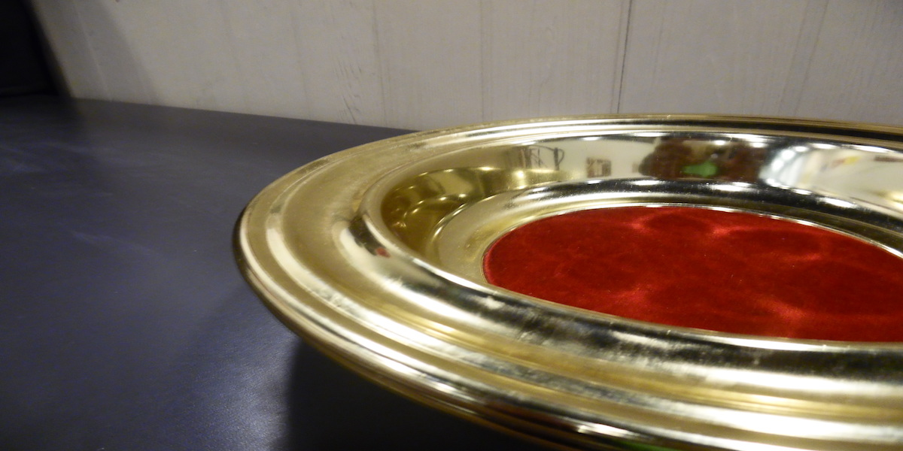
Collection
Song #235
I Gave My Life for Thee

Slide 8
Collection

Slide 9
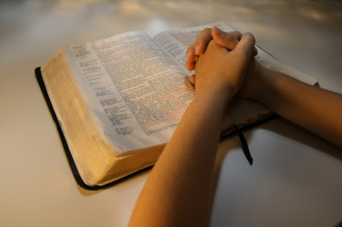
LORD’S SUPPER OFFERED
Song #352
When We Meet in Sweet Communion

Slide 10
LORD’S SUPPER OFFERED
Acts 10:34-43

Slide 11
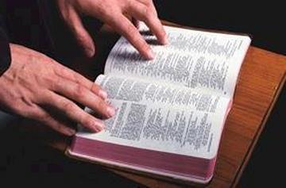
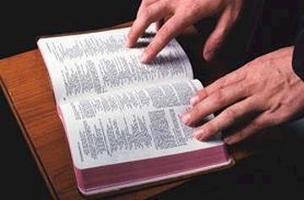
We Must Be Ready
Mark 13:33-37
Song #508
Will Jesus Find Us Watching?

Slide 12
We Must Be Ready
2 Timothy 4:6-8
Song #719
There’s A Great Day Coming

Slide 13
Gospel INVITATION Offered
Invitation
Invitation Song #837
What Will Your Answer Be?

Slide 14
JESUS Is Coming Again!
Closing Prayer

