Slide 2
Song #2: Hallelujah Praise Jehovah!
Psalm 148:1-14
Song #21: Praise The Lord
Opening Prayer
Richie Thetford www.thetfordcountry.com

Slide 3
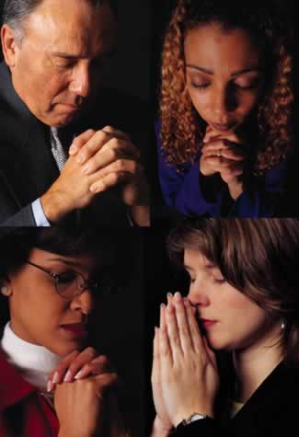
All People Should Praise Him
Psalm 100:1-5
Song #434: All Hail The Power Of Jesus’ Name
Psalm 145:1-21
Song #13: Alleluia
Richie Thetford www.thetfordcountry.com

Slide 4
Praise Him, For He Is Our Creator
Psalm 19:1-4
Song #45: Come, Thou Almighty King
Romans 1:16-20
Song #34: Worthy Art Thou
Richie Thetford www.thetfordcountry.com

Slide 5
Praise Him For His Excellence
Psalm 99:1-9
Song #1: Holy, Holy, Holy
Revelation 15:1-4
Song #48: On Zion’s Glorious Summit
Richie Thetford www.thetfordcountry.com

Slide 6
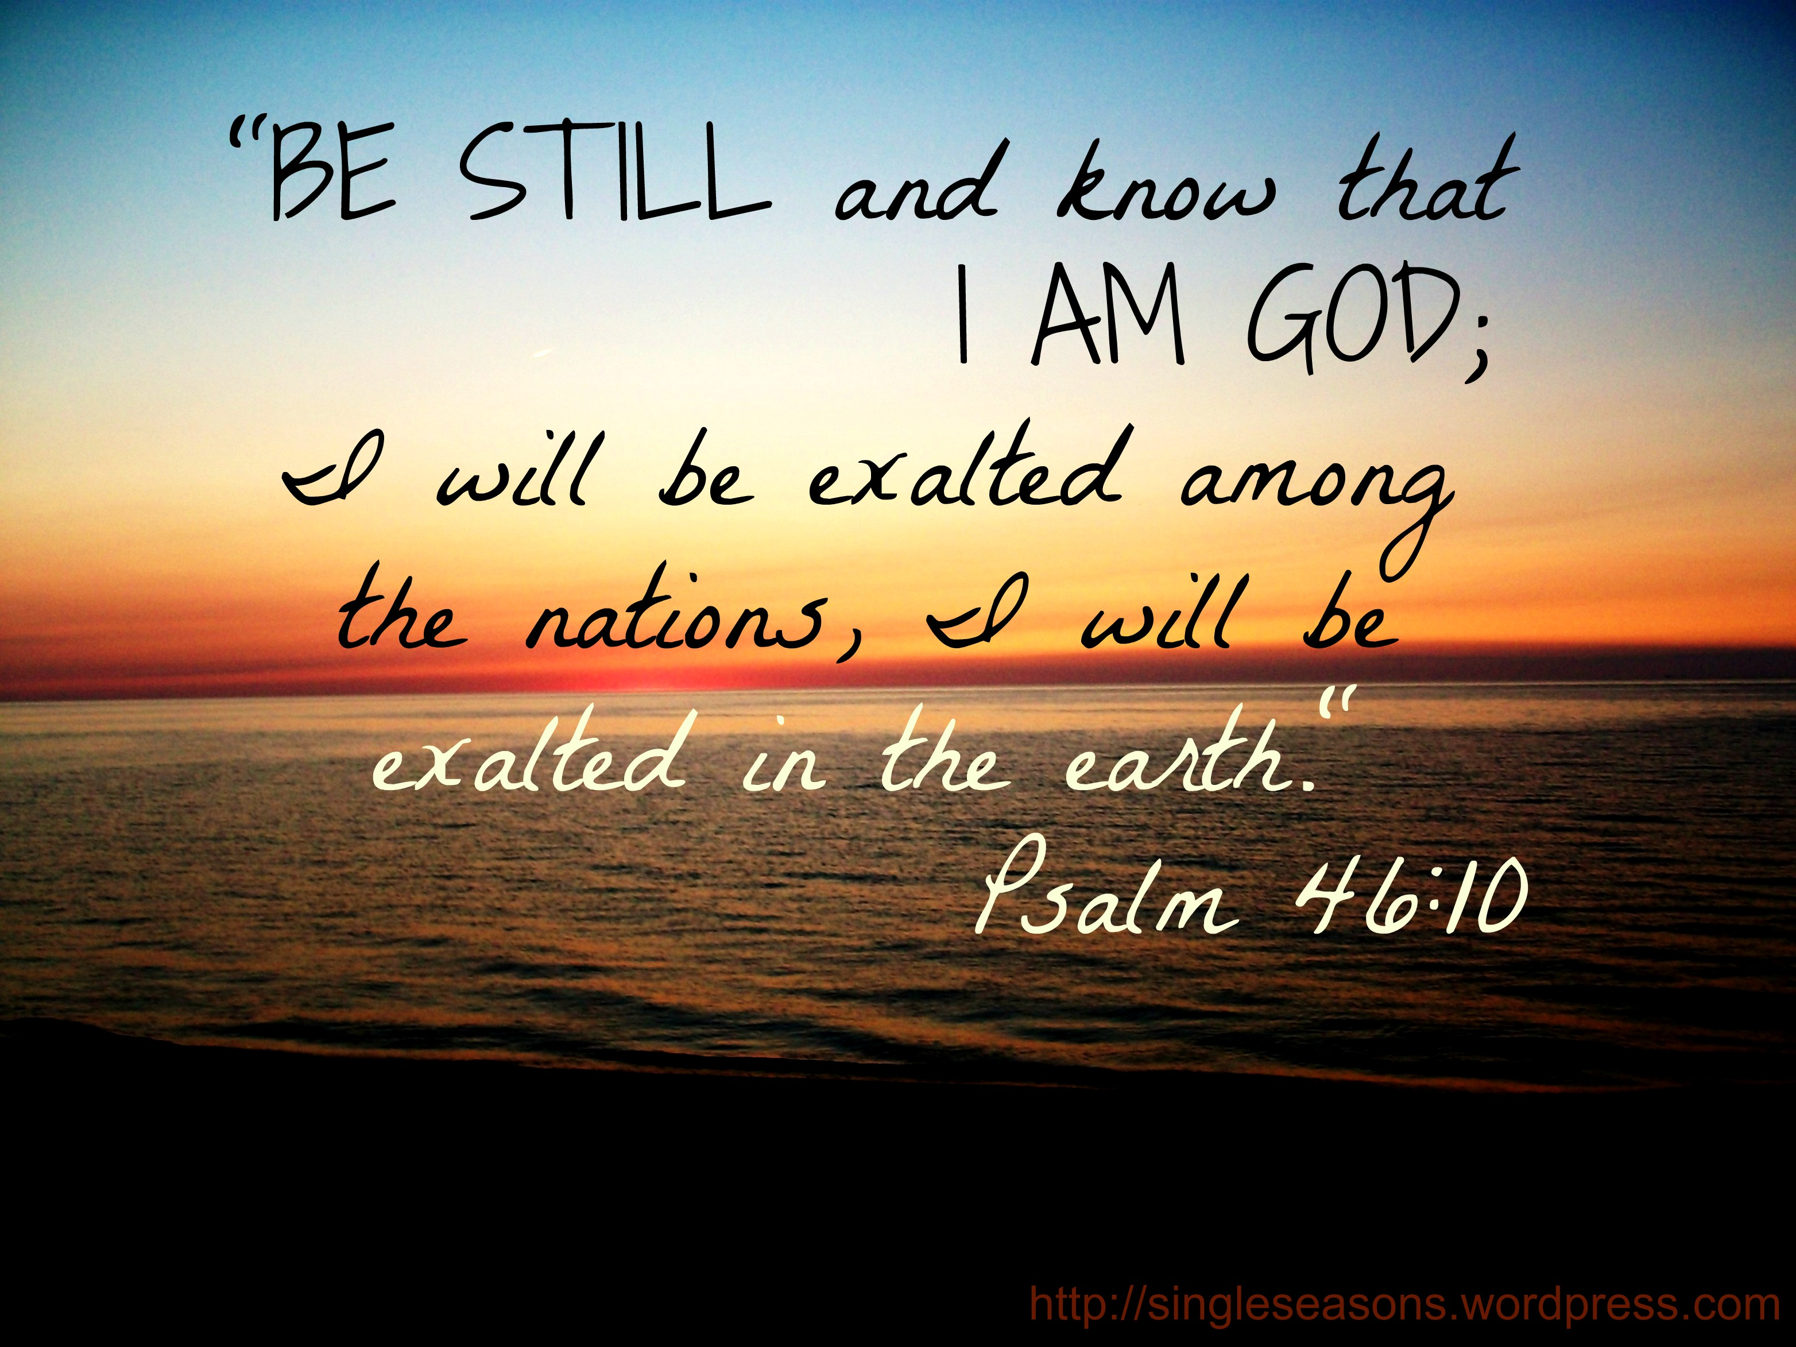
Praise Him For His Presence
Psalm 46:1-11
Song #12: He’s My King
Lord’s Supper Offered
Isaiah 53:1-12
Song #35: O Worship The King
Richie Thetford www.thetfordcountry.com

Slide 7
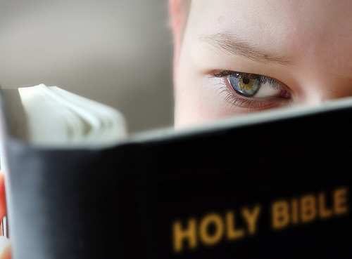
INVITATION
1 Peter 1:3-9
Song #28: Is It For Me?
Closing Song
Song #9: Our God, He Is Alive
Closing Prayer
Richie Thetford www.thetfordcountry.com

