Slide 2

God Is Mindful of Me
“What is man that You are mindful of him,
And the son of man that You visit him?”
Psalm 8:4
Song #478: The Lord Has Been Mindful of Me
Opening Prayer
Richie Thetford www.thetfordcountry.com

Slide 3

He Is Mindful of Our Physical Needs
Matthew 6:24-34
1 Timothy 6:6-8
Song #392: Count Your Blessings
Matthew 14:14-21
Matthew 15:32-39
Song #462: God Will Take Care of You
Richie Thetford www.thetfordcountry.com

Slide 4

He Is Mindful of Our Social Needs
Genesis 2:18-25
Psalm 127:3
Song #472: God Give Us Christian Homes
1 Corinthians 12:13-26
Song #302: Blest Be The Tie
Richie Thetford www.thetfordcountry.com

Slide 5

He Is Mindful of Our Spiritual Needs
Jeremiah 10:23
Romans 1:15-16
1 Peter 1:10-25
Song #581: O For A Faith That Will Not Shrink
Richie Thetford www.thetfordcountry.com

Slide 6

LORD’S SUPPER OFFERED
Matthew 26:17-25
Song #175: The Breaking of Bread
Richie Thetford www.thetfordcountry.com

Slide 7
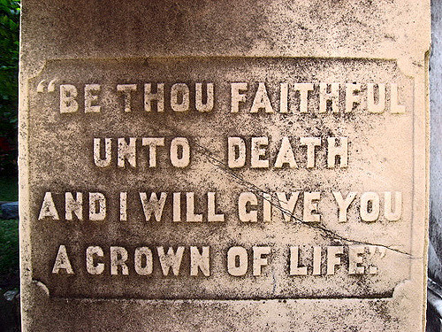
He Is Mindful of Our Eternal Needs
John 13:36-14:4
Song #208: Sing To Me Of Heaven
Hebrews 11:8-16
Song #218: Just Over In The Glory Land
Richie Thetford www.thetfordcountry.com

Slide 8
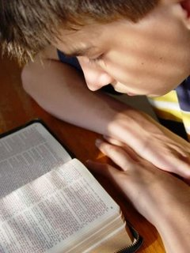
God Is Mindful of Me
INVITATION
Song #272: Jesus, The Loving Shepherd
Song #194: When We All Get To Heaven
Closing Prayer
Richie Thetford www.thetfordcountry.com

