Slide 1
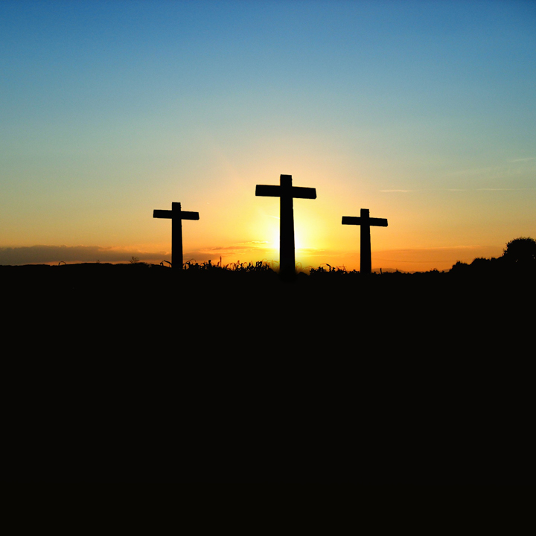
The death of christ
Richie Thetford www.thetfordcountry.com

Slide 2
Introduction
Matthew 20:17-19
2 Corinthians 5:14-15
Song #340
“I Gave My Life For Thee”
Prayer
THE DEATH OF CHRIST
Richie Thetford www.thetfordcountry.com

Slide 3
He Was Abandoned
Mark 14:26-50
Song #170
“In Gethsemane Alone”
Matthew 26:51-75
Song #580
“Ten Thousand Angels”
Matthew 27:1-26
Song #604
“I’m The One”
THE DEATH OF CHRIST
Richie Thetford www.thetfordcountry.com

Slide 4
He Was Crucified
Isaiah 53:1-12
Song #164
“The Depth of God’s Love”
Psalm 22:1-18
Song #176
“In The Glory Of His Cross”
Matthew 27:27-50
Song #182
“I Believe In Mount Calvary”
THE DEATH OF CHRIST
Richie Thetford www.thetfordcountry.com

Slide 5
Lord’s Supper Offered
Mark 14:12-25
Song #175
“The Breaking Of Bread”
THE DEATH OF CHRIST
Richie Thetford www.thetfordcountry.com

Slide 6
He Was Resurrected
Mark 9:1-10
Song #174
“Christ Arose”
Luke 24:1-12
Song #160
“One Day”
THE DEATH OF CHRIST
Richie Thetford www.thetfordcountry.com

Slide 7
Invitation
Invitation Song #297
“Prepare To Meet Thy God”
Closing Song #385
“What Did He Do?”
Closing Prayer
THE DEATH OF CHRIST
Richie Thetford www.thetfordcountry.com

