Slide 1
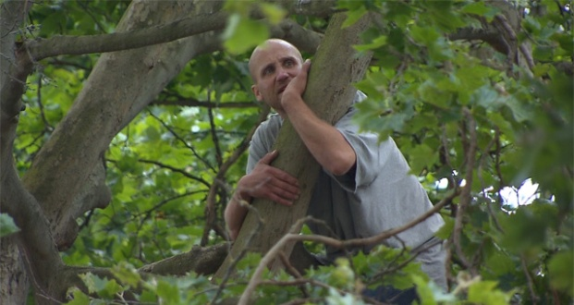
Zacchaeus
Luke 19:1-10
Richie Thetford www.thetfordcountry.com

Slide 2

His Need of Salvation
Sin is the common curse
  Romans 3:23
  Jude 3
The words of Christ
  Luke 19:10
Richie Thetford www.thetfordcountry.com

Slide 3

Hindrances He Overcame
Wealth
  Luke 18:24-26
  1 Timothy 6:10
Occupation
Physical limitations
Richie Thetford www.thetfordcountry.com

Slide 4

Blessings He Received
Salvation
Fellowship with the Lord
  1 Timothy 2:3-4
  2 John 9-10
Richie Thetford www.thetfordcountry.com

Slide 5

The Response He Made
Giving
“Restore fourfold”
  Numbers 5:7
Richie Thetford www.thetfordcountry.com

Slide 6
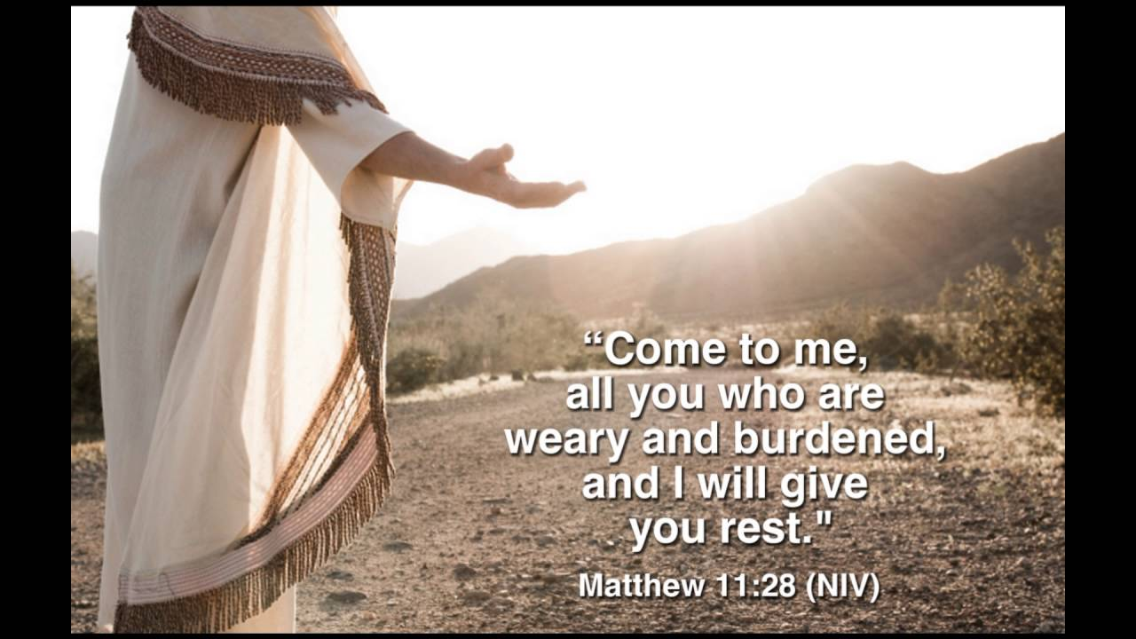
Conclusion
Publicans excommunicated
  Matthew 18:17
Earnestness of spirit will prevail
Right Attitude
  Luke 18:9-14
Eternity
  Matthew 11:28-30
Richie Thetford www.thetfordcountry.com

