Slide 1
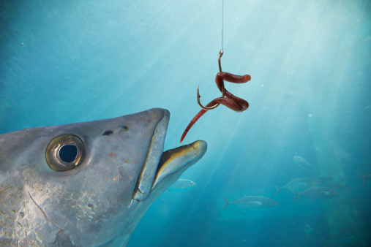
Yield Not to Temptation
“lest Satan should take advantage of us; for we are not ignorant of his devices”
2 Corinthians 2:11
Richard Thetford www.thetfordcountry.com

Slide 2
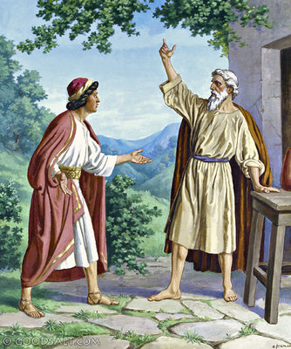
Micaiah Did Not Yield
1 Kings 22:1-28
Richard Thetford www.thetfordcountry.com

Slide 3
Satan Tempts Us
Appealing bait is dangled before us
Satan tempted Eve
Satan tempted Jesus
Good for food Lust of the flesh
Delight to the eyes Lust of the eyes
Make one wise Pride of life
Richard Thetford www.thetfordcountry.com

Slide 4
Satan Tempts Us
Uses people and things
Temptation is not from God
James 1:13
From Satan
1 Corinthians 7:5; Matthew 4:1
Proverbs 1:10; 4:14-15; 6:24-29
Our lust tempts us
James 1:14-15; Romans 6:12-13
Richard Thetford www.thetfordcountry.com

Slide 5
We Can Overcome Temptation
Jesus Knows about temptation
2 Peter 2:9; Hebrews 2:18; 4:15
Prayer
Matthew 26:41
Matthew 6:13
God’s Word
Psalms 119:11
Matthew 4:1-11
1 Corinthians 10:12-13
Richard Thetford www.thetfordcountry.com

Slide 6
Conclusion
Satan wants us to sin
1 Peter 5:8
We must NOT yield to temptation
1 John 2:1-2
1 John 1:9
Richard Thetford www.thetfordcountry.com

