Slide 1

Worship – Its Affect on My Salvation
Malachi 3:7
Richie Thetford www.thetfordcountry.com

Slide 2
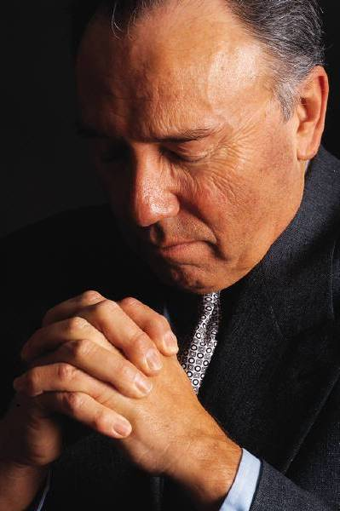
Worship Defined
“Showing reverence for a deity; to have intense love or admiration for”
(Webster’s New World Dictionary)
How to worship God
  John 4:20-24
What is the “Spirit?”
  Related to the spiritual
  Romans 14:17
What is the “Truth?”
  John 17:17; 1 Peter 4:11
Richie Thetford www.thetfordcountry.com

Slide 3
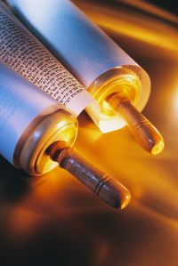

Commanded to Worship God
Old Testament
  1 Chronicles 16:29
  Exodus 34:14
  2 Kings 17:36
Must worship today
  Luke 4:8
Richie Thetford www.thetfordcountry.com

Slide 4

Worship Can Be Corrupted
Old Testament examples
  Nadab and Abihu - Leviticus 10:1-2
  Manasseh and Amon - 2 Kings 21:3, 21
  Moses’ expectation - Deuteronomy 12:2-4
Paul’s Instruction
  Romans 1:25
Obey Jesus – Not Man
  Matthew 15:8-9
Richie Thetford www.thetfordcountry.com

Slide 5
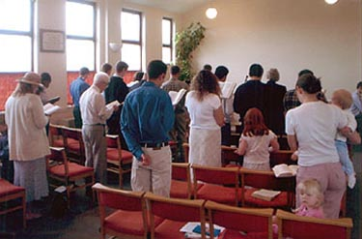
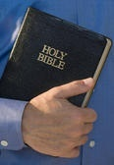
Must Have the Right Attitude
Must be reverent
Must be attentive
Joyfully worship Him
  Psalms 95:1-8
Always come to worship God with the right attitude
Richie Thetford www.thetfordcountry.com

Slide 6

The worship we offer must please God or else we stand to lose our home in heaven
Have we determined to worship God as He has directed?
In the proper “Spirit” and in “Truth?”
Our worship will affect our soul’s eternal destiny!
Richie Thetford www.thetfordcountry.com

