Slide 1
Worldliness
Smoking and Tobacco
Is it a sin to smoke or use tobacco products?
Richie Thetford www.thetfordcountry.com

Slide 2


Smoking and Tobacco
Should a mature, faithful child of God be included
among the number of those who smoke?
CAN WE SEE THE DIFFERENCE?
Richie Thetford www.thetfordcountry.com

Slide 3

Smoking and Tobacco
Things to consider
  Bible does not mention tobacco
Christians must deny self and seek God
  Matthew 16:24-27
  Romans 12:1-2
Christians must desire to be like Jesus
  1 Peter 2:21
  1 Corinthians 11:1
Richie Thetford www.thetfordcountry.com

Slide 4

Trends and Statistics
430,000 Americans die each year
  From diseases related to smoking and tobacco
27% of Americans smoke (44% in 1964)
80% start before age 21
3,000 teens start smoking each day
3% of Americans use snuff/chewing tobacco
100% of all humans begin life as non-smokers!
Richie Thetford www.thetfordcountry.com

Slide 5
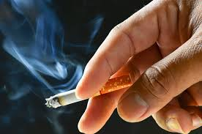
Smoking is Harmful to the Body
Every time a cigarette is smoked, it is like putting a clamp on the blood vessels. It has been shown that smoking even one cigarette will constrict the arteries, veins, and capillaries, and to that extent will slow down the blood circulation in all parts of the body, including the brain.
- Alton Oshsner, MD
International Society of Surgery
Richie Thetford www.thetfordcountry.com

Slide 6
Smoking is Harmful to the Body
“Cigarette smoking is now as an important cause of death as the great past epidemics of typhoid, cholera and tuberculosis.”
- British Royal College of Physicians
Richie Thetford www.thetfordcountry.com

Slide 7
Smoking is Harmful to the Body
“The good news is that we know the cause of at least 80% of the cases of this leading cancer killer -- cigarettes.”
-Harvard Medical School Health Letter
(Vol. III, No. 6, April 1978)
Richie Thetford www.thetfordcountry.com

Slide 8
Smoking is Harmful to the Body
“Cigarette smoking is a major cause of emphysema, chronic bronchitis, lung cancer, heart disease….Just one cigarette speeds up your heartbeat, increases your blood pressure, upsets the flow of blood and air in your lungs, causes a drop in the skin temperature of your fingers and toes.”
- American Lung Association
Richie Thetford www.thetfordcountry.com

Slide 9
Smoking is Harmful to the Body
“Nicotine raises the smoker’s blood pressure and speeds up his pulse.”
- Dr. Authur H. Cain
“Smoking one pack or more a day will shorten one’s life on the average by 12 years.”
- Curtis Torno, MD (Christian)
Richie Thetford www.thetfordcountry.com

Slide 10
Smoking is Harmful to the Body
“Smoking is the predominant cause of bronchitis and emphysema.”
T. Mark Lloyd, MD (Christian)
“Both Nicotine and carbon monoxide contribute significant increase in heart attacks and in sudden death from coronary heart disease in cigarette smokers.”
Dr. Wilbert S. Aronow
Richie Thetford www.thetfordcountry.com

Slide 11
Smoking is Harmful to the Body
Survey of 10,000 physicians:
Question: “Do you consider cigarette smoking
as hazardous to your health?”
98% - Yes!
2% - Weren’t sure
0% - No!
Richie Thetford www.thetfordcountry.com

Slide 12
Smoking is Harmful to the Body
Warning Labels on Package:
“The Surgeon General has determined that cigarette smoking is dangerous to your health.”
- May cause birth defects.
Health & Life Insurance Rates: Higher for smokers
Richie Thetford www.thetfordcountry.com

Slide 13

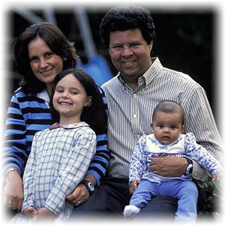
Smoking is Harmful to the Body
Nicotine dependence
A sin to deliberately harm the body
  1 Corinthians 6:19-20
  1 Corinthians 3:17
Present our bodies as a living sacrifice
  Romans 12:1-2
Richie Thetford www.thetfordcountry.com

Slide 14
Smoking is Addictive
Very difficult to quit
  2 Peter 2:19
Addiction is a sin
  1 Corinthians 6:12
Violates self-control
  2 Peter 1:5-10
Addiction is not a habit
Richie Thetford www.thetfordcountry.com

Slide 15
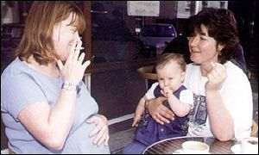
Smoking Affects Others
Affects others around the smoker
Treat others respectfully
  Matthew 7:12
  Philippians 2:4
There’s a reason for “NO SMOKING”
Richie Thetford www.thetfordcountry.com

Slide 16

Smoking Ruins a Christian’s Influence
Set a good example
  1 Timothy 4:12
  Philippians 2:15
  Matthew 5:13-16
God’s instruction
  Romans 13:14
Richie Thetford www.thetfordcountry.com

Slide 17
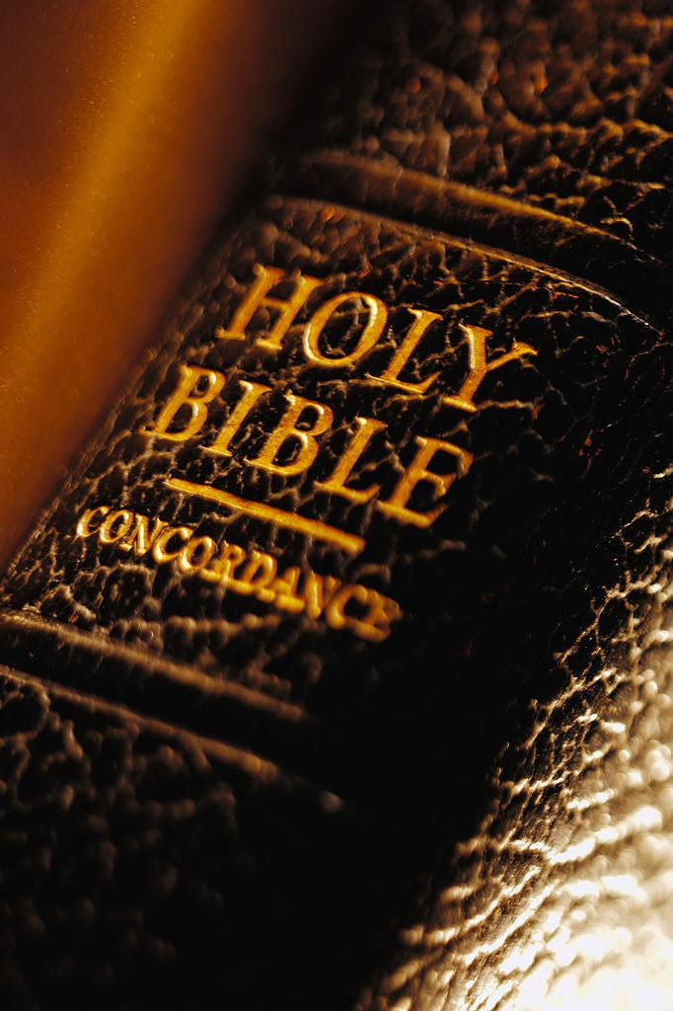
Important Questions
Would smoking….
  Help or hinder your service to God?
  Show proper appreciation for the blessing of life?
  Harmonize or conflict with Christian worship?
    Can you thank God for the privilege of smoking?
  Show you being a faithful steward of your body?
Richie Thetford www.thetfordcountry.com

Slide 18
Important Questions
Would smoking….
  Cause you to be pleased:
    To have your children imitate your example?
    To recommend other people begin smoking?
      1 Corinthians 11:1
  Help or hinder your efforts to teach others?
Richie Thetford www.thetfordcountry.com

Slide 19
Important Questions
Would you be.…
  Willing to accept elders and preacher who smoke?
    Should they smoke or not?
    Romans 2:1-3, 21-24
  Be able to smoke in all good conscience?
    Romans 14:23
Richie Thetford www.thetfordcountry.com

Slide 20
Important Questions
Would.…
  Jesus smoke?
  You smoke in Jesus’ presence?
  You offer Jesus a cigarette?
    Would you expect Him to accept it?
    1 Peter 2:21-22
James 4:17
Richie Thetford www.thetfordcountry.com

Slide 21

Conclusion
Biblical principles of God’s Word
shows that for one to be in the proper
fellowship with God – then one can not
smoke or use tobacco
One must first admit it is a sin
  Then QUIT the SIN!
Richie Thetford www.thetfordcountry.com

