Slide 1
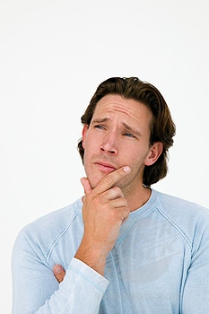

Worldliness
Immodesty
“I could be wrong. Some of my clothing could be immodest.”
Richie Thetford www.thetfordcountry.com

Slide 2
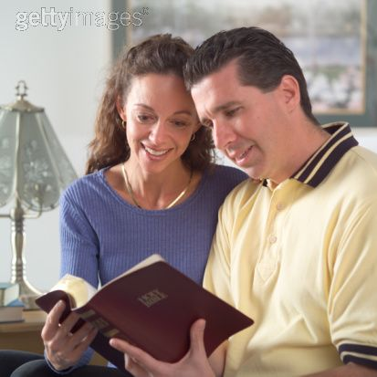
Immodesty
Must consider two things:
  The Bible sets the guidelines
  about our dress
    A violation of God’s guidelines is sin
  We must want to dress in harmony
  with the Bible
    James 1:21-22
    John 12:48
Richie Thetford www.thetfordcountry.com

Slide 3
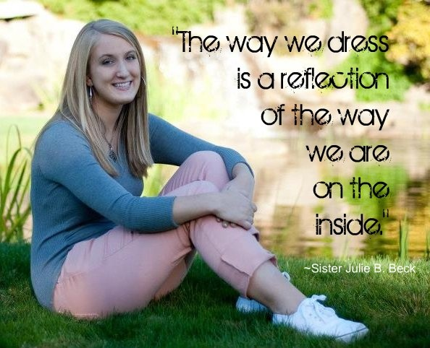
Reasons People Dress Immodestly
Ignorant and untaught
Want to “fit in” with their friends
Want to be “bold” and turn heads
Careless
Don’t realize how they really look
Richie Thetford www.thetfordcountry.com

Slide 4
The First Clothing
Genesis 3
Covering
Tunic
V. 7
Naked
(Nude)
V. 11
Naked
(Relatively)
V. 21
Clothed
& Modest
Richie Thetford www.thetfordcountry.com

Slide 5
The Tunic
Hebrew: KUTTONET – “a tunic...; generally with sleeves, coming down to the knees, rarely to the ankles” (Gesenius, 420; cf. Harris, 1:459; Brown, Driver, Briggs, 509).
Tunic
Richie Thetford www.thetfordcountry.com

Slide 6
The Tunic
Fred H. Wright, Manners and Customs of Bible Lands, 91 says: “The Tunic (inappropriately translated ‘coat’) was a shirt which was worn next to the skin. It was made of leather, hair-cloth, wool, linen, or in modern times, usually of cotton. The simplest form of it was without sleeves and reached to the knees or sometimes to the ankles. The well-to-do wore it with sleeves and extending to the ankles. Women as well as men wore it. Although there was no doubt a difference in style and pattern in what was worn by the two.”
Tunic
Richie Thetford www.thetfordcountry.com

Slide 7
Modest
1 Timothy 2:9-10
“in like manner also, that the women adorn themselves in modest apparel, with propriety and moderation, not with braided hair or gold or pearls or costly clothing, but, which is proper for women professing godliness, with good works.”
Richie Thetford www.thetfordcountry.com

Slide 8
Modest
Dictionary
1) “having or showing a moderate estimation of one’s own talents, abilities, and value.” 2) “Having a shy or retiring nature; reserved.” 3) “Observing conventional proprieties in speech, behavior, or dress.” 4) “Quiet and humble in appearance; unpretentious; a modest house.” 5) Moderate; not extreme: a modest charge.”
(American Heritage Dictionary, p. 806)
Richie Thetford www.thetfordcountry.com

Slide 9
Modest
Lexicon
W.E. Vine: “orderly, well-arranged, decent,...The well-ordering is not of dress and demeanor only, but of the
inner life, uttering indeed and expressing itself in the outward conversation.” (Vol. III, p. 79).
Richie Thetford www.thetfordcountry.com

Slide 10
Modest
Lexicon
Strongs: “orderly, i.e. decorous: – of good behavior” (#2887). From kosmos (#2889) which means orderly or well arranged.
Thayer: “well-arranged, seemly, modest” (p.356).
Bauer: “respectable, honorable” (p.445).
Richie Thetford www.thetfordcountry.com

Slide 11
Modest
Lexicon/Concordance
Englishman’s Greek Concordance shows that this word is only used two times in the New Testament. It is translated
“modest” in 1 Timothy 2:9 and “of good behavior” in
1 Timothy 3:2.
Richie Thetford www.thetfordcountry.com

Slide 12
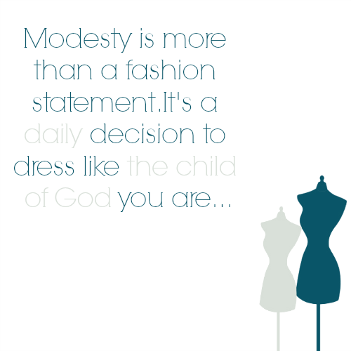
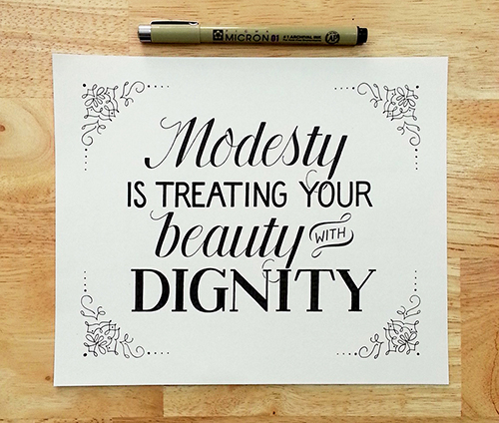
Modest
Summary
Reserved
Humble
Respectable
Decent
Orderly
Richie Thetford www.thetfordcountry.com

Slide 13
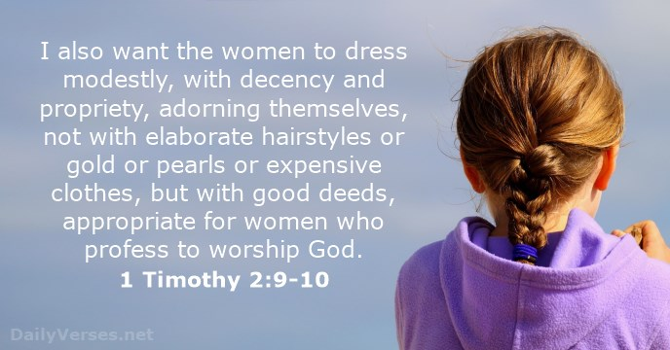
Related Principles
Shame (1 Timothy 2:9)
  KJV – “shamefacedness”
  NKJV – “propriety”
    That which would
    restrain a good man
    from an unworthy act
  “downcast eyes” – “bashfulness”
Richie Thetford www.thetfordcountry.com

Slide 14
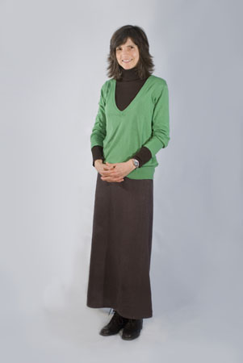
Related Principles
Good Judgment (1 Timothy 2:9)
  KJV – “sobriety”
  NKJV – “moderation”
    Soundness of mind – sound judgment
  Self-control
Richie Thetford www.thetfordcountry.com

Slide 15
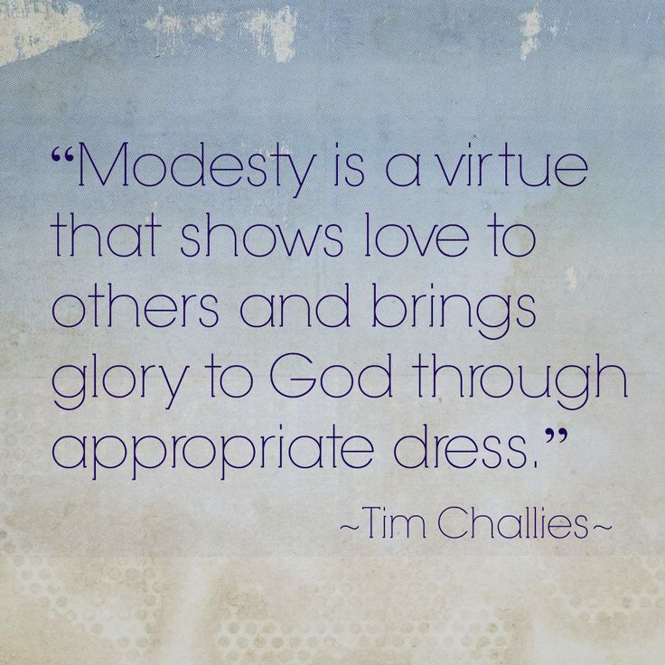
Related Principles
Godliness (1 Timothy 2:10)
  “profession of the fear of God”
  Denotes the fear or reverence of God
Nakedness
  Complete nudity: “unclad, without clothing”
  Partial nudity: “ill-clad” “clad in undergarment only” “lightly clad”
One can have some clothing on
and still be “naked”
Richie Thetford www.thetfordcountry.com

Slide 16
Nakedness
Exposing the thigh = exposing one’s nakedness
Gen 3:7 Then the eyes of both of them were opened, and they knew that they were naked; and they sewed fig leaves together and made themselves coverings.
Gen 3:10-11 So he said, "I heard Your voice in the garden, and I was afraid because I was naked; and I hid myself." And He said, "Who told you that you were naked? Have you eaten from the tree of which I commanded you that you should not eat?"
Ex 28:42 And you shall make for them linen trousers to cover their nakedness; they shall reach from the waist to the thighs.
Isa 47:2-3 Take the millstones and grind meal. Remove your veil, Take off the skirt, Uncover the thigh, Pass through the rivers. Your nakedness shall be uncovered, Yes, your shame will be seen; I will take vengeance, And I will not arbitrate with a man."
Richie Thetford www.thetfordcountry.com

Slide 17
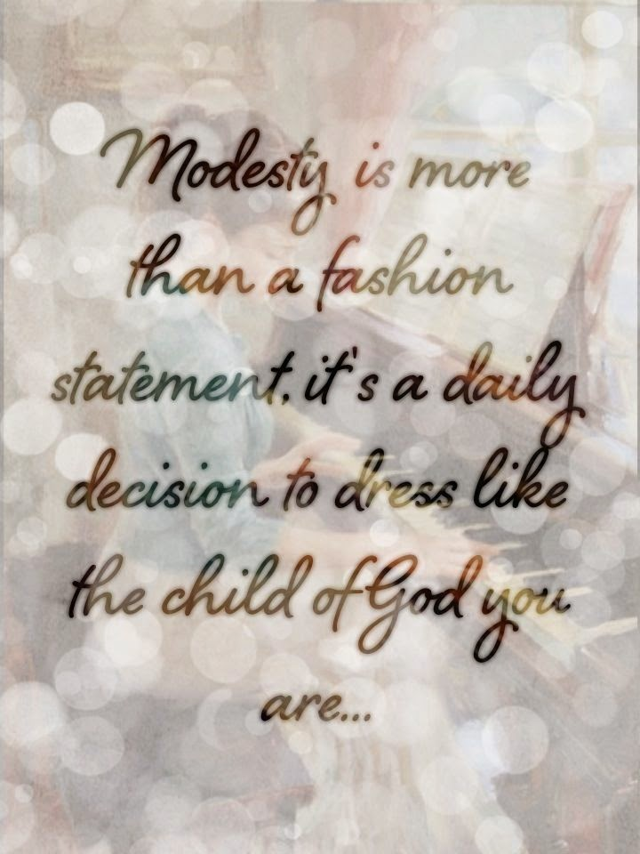
Dress and Actions Affects Others
Attire of a harlot
  Proverbs 7:10
Man can easily lust
  Matthew 5:28
  Proverbs 6:25
Mary Quant – the designer of the mini-skirt: “mini-clothes are symbolic of those women who want to seduce a man.”
Richie Thetford www.thetfordcountry.com

Slide 18
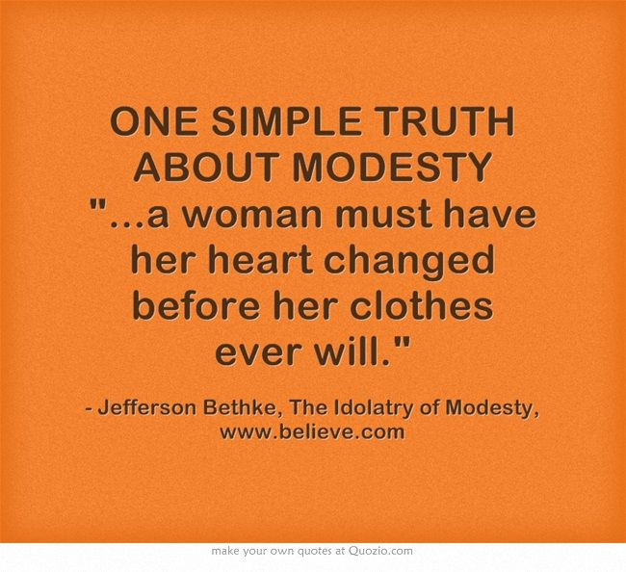
Our Clothes Should…
Be modest
Show shame
Show good judgment
Show godliness
Respect others
Cover our nakedness
Ways that one
can be immodest:
Too short
Too tight
Too thin
Too low
Too loose
Richie Thetford www.thetfordcountry.com

Slide 19

Sports
Does Modesty Apply When We Participate?
Weddings
Yard Work
Richie Thetford www.thetfordcountry.com

Slide 20
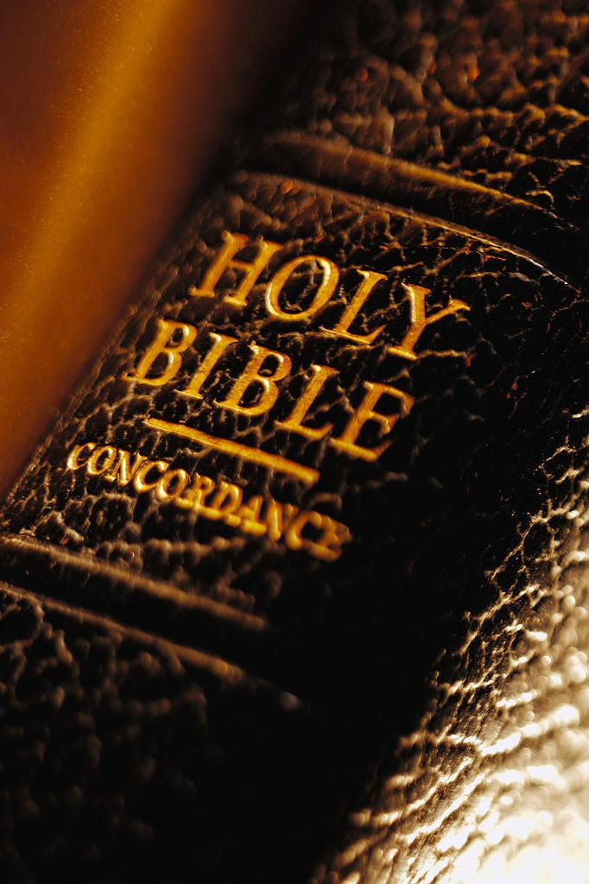
Modesty versus Immodesty
MODEST
Shame
Good judgment
Godliness
Careful toward others
IMMODEST
No shame
Poor judgment
Don’t fear God
May cause lust
Richie Thetford www.thetfordcountry.com

Slide 21
Things Considered Immodest
Swimsuits
Cheerleading outfits
Short dresses
Split dresses
Tight/formfitting
Sun dresses
Low-cut blouses
Low-cut dresses
Shorts (revealing thigh)
Jogging shorts
Strapless dresses
Swimming trunks
See-through styles
Majorette uniforms
Richie Thetford www.thetfordcountry.com

Slide 22
State Prison Bans Shorts
From the Brushy Mountain State Penitentiary Visitation Handbook:
“All visitors shall dress in an appropriate manner...halter tops, tank tops, sun dresses, shorts and other revealing attire shall not be acceptable on persons age 10 or above.”
Richie Thetford www.thetfordcountry.com

Slide 23
Conclusion
Immodesty applies to both men and women
  Genesis 3:21
Immodesty applies when we stand, sit, bend, or lean
Immodesty applies to more than length of clothing
  Tight
  Form fitting
  See through
Richie Thetford www.thetfordcountry.com

