Slide 1
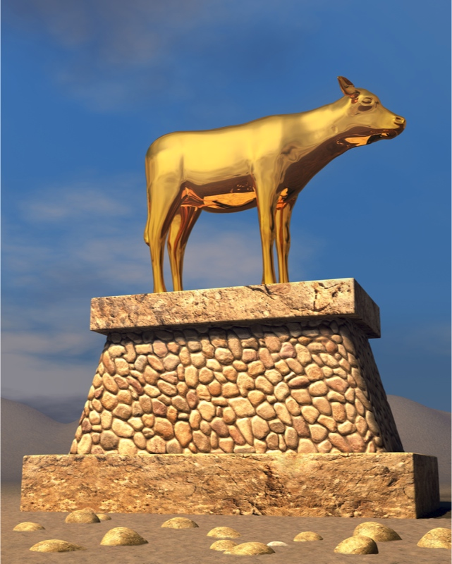
Worldliness
Materialism
Exodus 24:12-18
Lessons learned from Moses and the Israelites
Richie Thetford www.thetfordcountry.com

Slide 2

The Golden Calf
Exodus 32:1-6
  Recognize when it comes (v. 1)
  Recognize where it comes from (v. 1)
  Recognize who wants it (vs. 2-4)
  Recognize what it is (v. 4)
  Recognize how it changes your life (v. 6)
Man’s desire for fun and frolic!
Richie Thetford www.thetfordcountry.com

Slide 3

Financial Treasure Key
Matthew 6:19-21
“Do not lay up for yourselves treasures on earth, where moth and rust destroy and where thieves break in and steal; but lay up for yourselves treasures in heaven, where neither moth nor rust destroys and where thieves do not break in and steal. For where your treasure is, there your heart will be also.”
Richie Thetford www.thetfordcountry.com

Slide 4
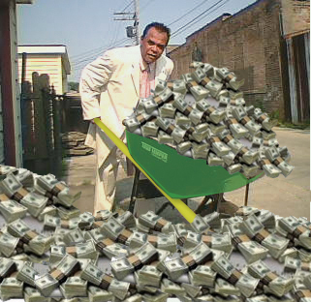
Materialism – The Rich Fool
Luke 12:13-21
Our problem
  Want more than we have
Warning
  Fight against greed is a constant struggle
The truth
  Who we are is more important than what we have
STUFF will not make us happy
Richie Thetford www.thetfordcountry.com

Slide 5


Materialism – Application
We already have more than we think we do
  Luke 12:16
Greed will never allow us to be satisfied
  Luke 12:17-19
Once greed has a grip, it is difficult to escape!
Richie Thetford www.thetfordcountry.com

Slide 6


Materialism – Application
We can’t take it with us
  Luke 12:20
God has a better
investment plan
  Luke 12:21
Replace selfishness with selflessness
Richie Thetford www.thetfordcountry.com

Slide 7

Conclusion
1 Timothy 6:6-8
When we are contented Christians then…
  We will grow
  Our family will grow
  The church will grow
Don’t let MATERIALISM keep us out of heaven!
Richie Thetford www.thetfordcountry.com

