Slide 1
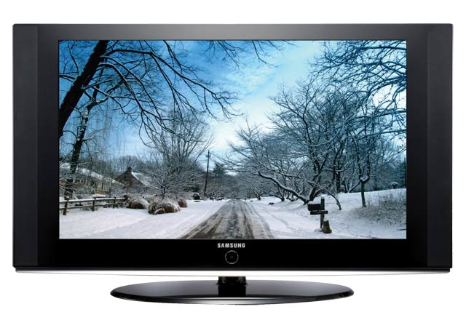
Worldliness TV, Movies and Music
The Devil is cunning and is winning the battle with many Christians in the realm of TV, Movies and Music
Richie Thetford www.thetfordcountry.com

Slide 2
TV and Movies – Rating System
1930’s to 1960 – very strict TV code
Brutal killings could not be shown in detail
Crime could not be glamorized
Obscenity forbidden
Reference to deity was not to be irreverent
Nudity was not permitted
Sanctity of marriage and the home was to be upheld
Richie Thetford www.thetfordcountry.com

Slide 3
TV and Movies – Rating System
Current ratings:
G – General
PG – Parental Guidance
PG13 – Under the age of 13 not allowed w/o an adult
R – Restricted (under 17 must have a parent)
X – No one under 17 permitted
Most movies today are inappropriate to watch
Richie Thetford www.thetfordcountry.com

Slide 4
TV and Movies – Influence Us
Media has power in reaching billions of people
Television is the most powerful
Businesses pay millions to advertise
Why?
Billions watch – a great influence!
How much time do we spend watching TV and movies?
Richie Thetford www.thetfordcountry.com

Slide 5
TV and Movies – Influence Us
Statistics:
98% of homes have at TV (most have 2-3)
Typical American views over 5 hours of TV daily
Children (ages 2-5) watch 32 hours of TV per week
One fourth of children’s waking hours are watching TV
Hear more than 400 commercials per week
22 million attend movies each week
Only 4% in the movie business attend any kind of worship
Richie Thetford www.thetfordcountry.com

Slide 6
TV, Movies, Music – God’s Warning
Evaluate what we allow in our hearts
Psalms 139:23-24
Immoral language
Exodus 20:7
Ephesians 4:29
Revelation 21:8
Colossians 3:9
Matthew 12:34-37
Richie Thetford www.thetfordcountry.com

Slide 7
TV, Movies, Music – God’s Warning
Sexual immorality
Galatians 5:19-21
1 Corinthians 6:9
Profanity
Extreme Violence
Sex
Immodesty
Nakedness
Subtle Messages
Desensitizes us to SIN!
Richie Thetford www.thetfordcountry.com

Slide 8
Examine Everything
Don’t make excuses
They are misgiven priorities of life
Doesn’t bother me
Only had a few bad scenes
I’m not actually doing those things
There’s nothing else to watch
My friends watch it – I don’t want to offend them
2 Corinthians 5:10
Richie Thetford www.thetfordcountry.com

Slide 9
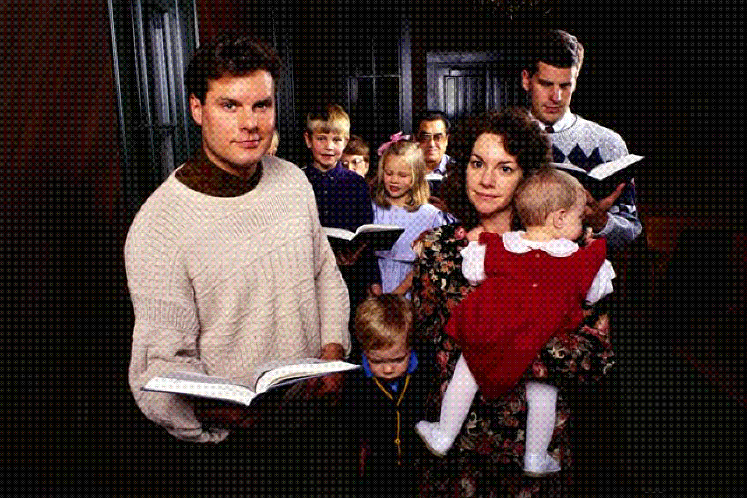
Conclusion
We are influenced by what we expose our mind to
Be aware of how God wants our mind to be
Proverbs 4:23
Proverbs 23:7
Matthew 5:8
Titus 1:15-16
Philippians 4:8
Richie Thetford www.thetfordcountry.com

Slide 10
Conclusion
Close our eyes to evil and open them to God’s word
Psalms 119:18
“AND YOU SHALL LOVE THE LORD YOUR GOD WITH ALL YOUR HEART, WITH ALL YOUR SOUL, WITH ALL YOUR MIND, AND WITH ALL YOUR STRENGTH….”
Mark 12:30
Richie Thetford www.thetfordcountry.com

