Slide 1
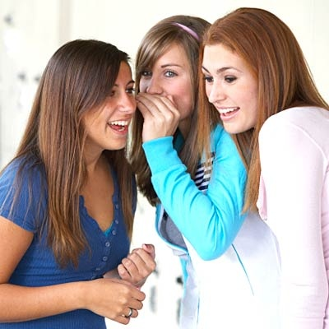
Worldliness
The Tongue
Being a Christian affects the way one talks
Psalms 39:1
Richie Thetford www.thetfordcountry.com

Slide 2
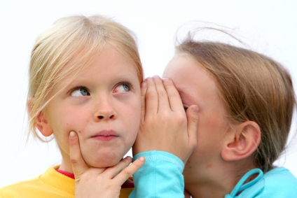
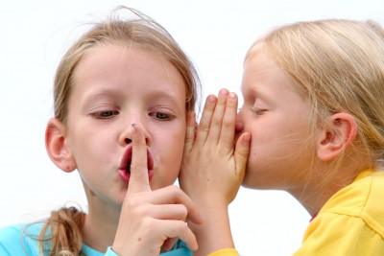
Many Misuses of the Tongue
Lying
Cursing
Making casual oaths
Angry words
Gossip
Flattery
Grumbling
Complaining
Richie Thetford www.thetfordcountry.com

Slide 3
Gossip (idle talk)
“Now the purpose of the commandment is love from a pure heart, from a good conscience, and from sincere faith, from which some, having strayed, have turned aside to idle talk, desiring to be teachers of the law, understanding neither what they say nor the things which they affirm.”
1 Timothy 1:5-7
Richie Thetford www.thetfordcountry.com

Slide 4

Telling or Hearing Something NEW can be GOOD or BAD
Good
  Good news of Christ
  Joyful news about others
  Sad news when helpful
Bad
  News of a personal nature
  Not validated or does not have a need to know
Richie Thetford www.thetfordcountry.com

Slide 5
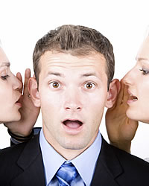
Sin of Gossip
Gossip defined:
  “idle talk, not always true about
  people and their affairs”
Gossip is a sin
  Romans 1:29-32
  2 Corinthians 12:20
  1 Timothy 5:13
Richie Thetford www.thetfordcountry.com

Slide 6
Sin of Gossip
Participating in gossip is easy to do
  Before relating news to others, ask:
    Will it build up the body of Christ?
    Will it promote peace and harmony in the church?
    Is it necessary to tell?
    Will it help?
    Are we sure it is the truth?
Richie Thetford www.thetfordcountry.com

Slide 7
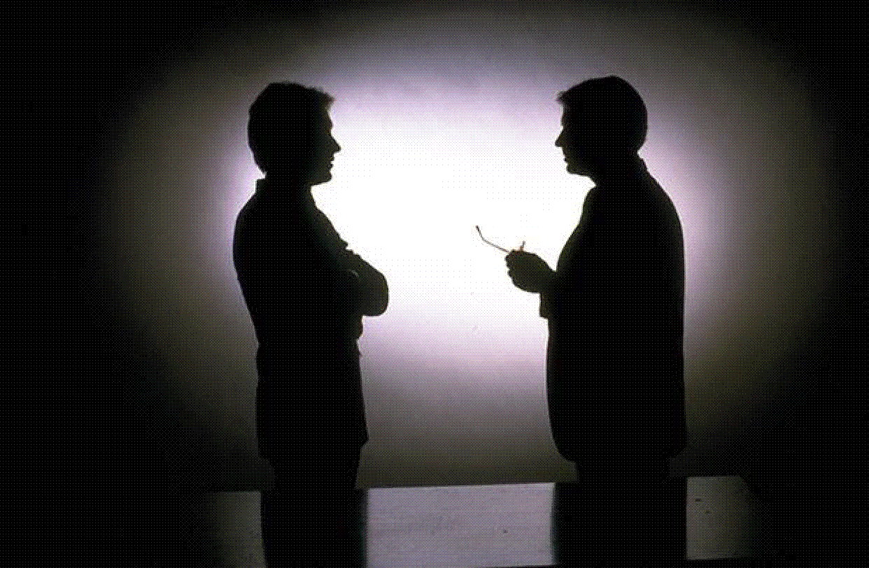
Sin of Gossip
We’re responsible for our words
  Matthew 12:36-37
Reason explained:
  Matthew 12:34-35
The consequences of gossip can be as far reaching
as a forest destroyed by fire by one match!
Richie Thetford www.thetfordcountry.com

Slide 8

Strive to Build Up
Striving for peace is required of Christians
  Philippians 2:1-2
  Ephesians 4:1-3
Think before speaking
  James 1:26
  Proverbs 4:23-24
  Matthew 7:12; Philippians 2:3-4
Richie Thetford www.thetfordcountry.com

Slide 9
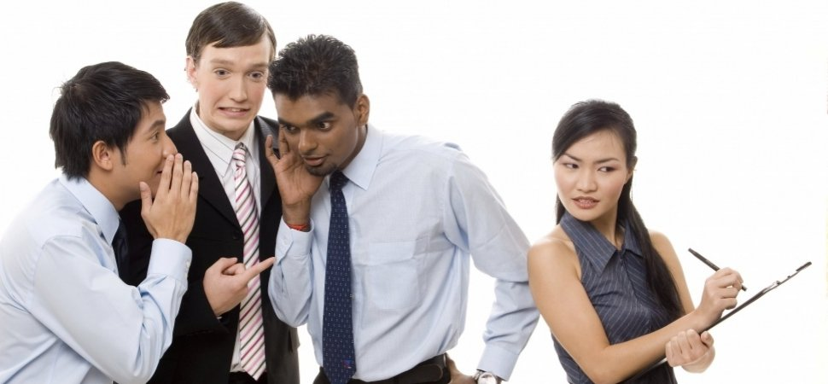
Strive to Build Up
Gossip can come upon one suddenly
Heed the words of Paul
  1 Thessalonians 4:11
No one benefits from gossip!
Richie Thetford www.thetfordcountry.com

Slide 10
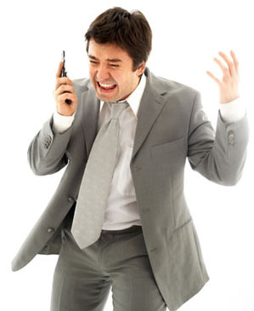
Cursing or Euphemisms
Matthew 12:34-37
“We are the only Bible the careless world will read. We are the sinner's gospel.
We are the scoffer's creed. We are the Lord's last message given in deed and word. What if the type is crooked?
What if the print is blurred?”
Richie Thetford www.thetfordcountry.com

Slide 11

Cursing or Euphemisms
Must make the best “imprint” on the world
Improper speaking
  1 Timothy 4:12
Vulgar speech is condemned
Richie Thetford www.thetfordcountry.com

Slide 12
Euphemisms
Defined:
Bad or Good?
  Depends on what word it replaces
“the substitution of a mild, indirect, or vague expression
for one thought to be offensive, harsh, or blunt.”
Richie Thetford www.thetfordcountry.com

Slide 13
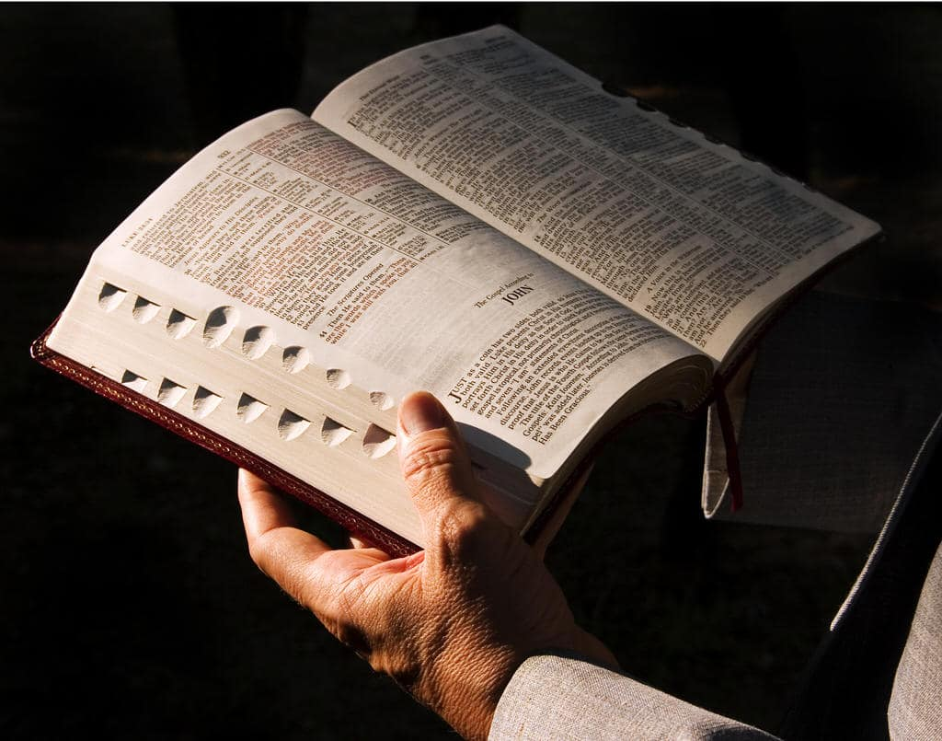
Euphemisms
Terms such as “Jesus,” “God,” and “Hell” are found in the Bible – but never irreverently
  Choose words carefully
We are known by the “fruit of our lips”
  2 Corinthians 10:4-5
Richie Thetford www.thetfordcountry.com

Slide 14
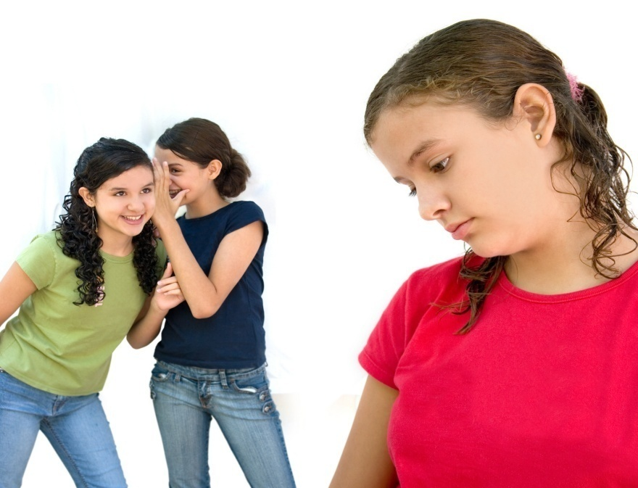
Conclusion
Strive to control our tongue
“But I say to you that for every idle word
men may speak, they will give account of it
in the day of judgment. For by your words
you will be justified, and by your words
you will be condemned.”
Matthew 12:36-37
Richie Thetford www.thetfordcountry.com

