Slide 1
Worldliness
Gambling
Gambling in America is bigger than it has ever been
Richie Thetford www.thetfordcountry.com

Slide 2
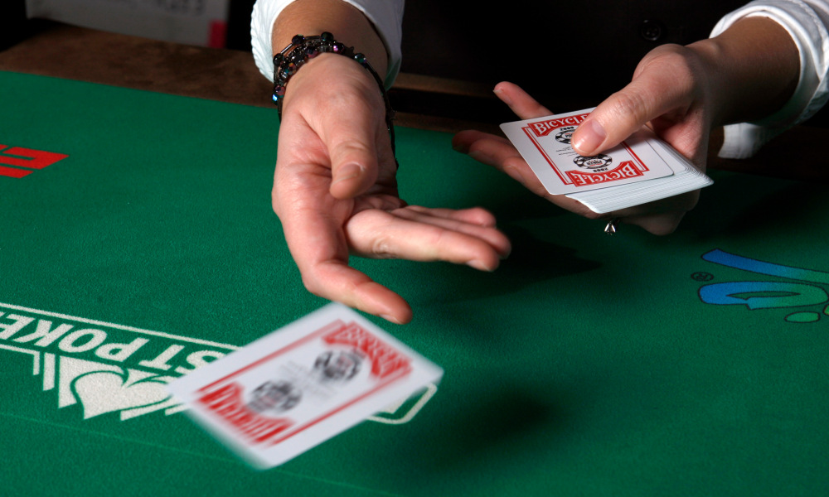
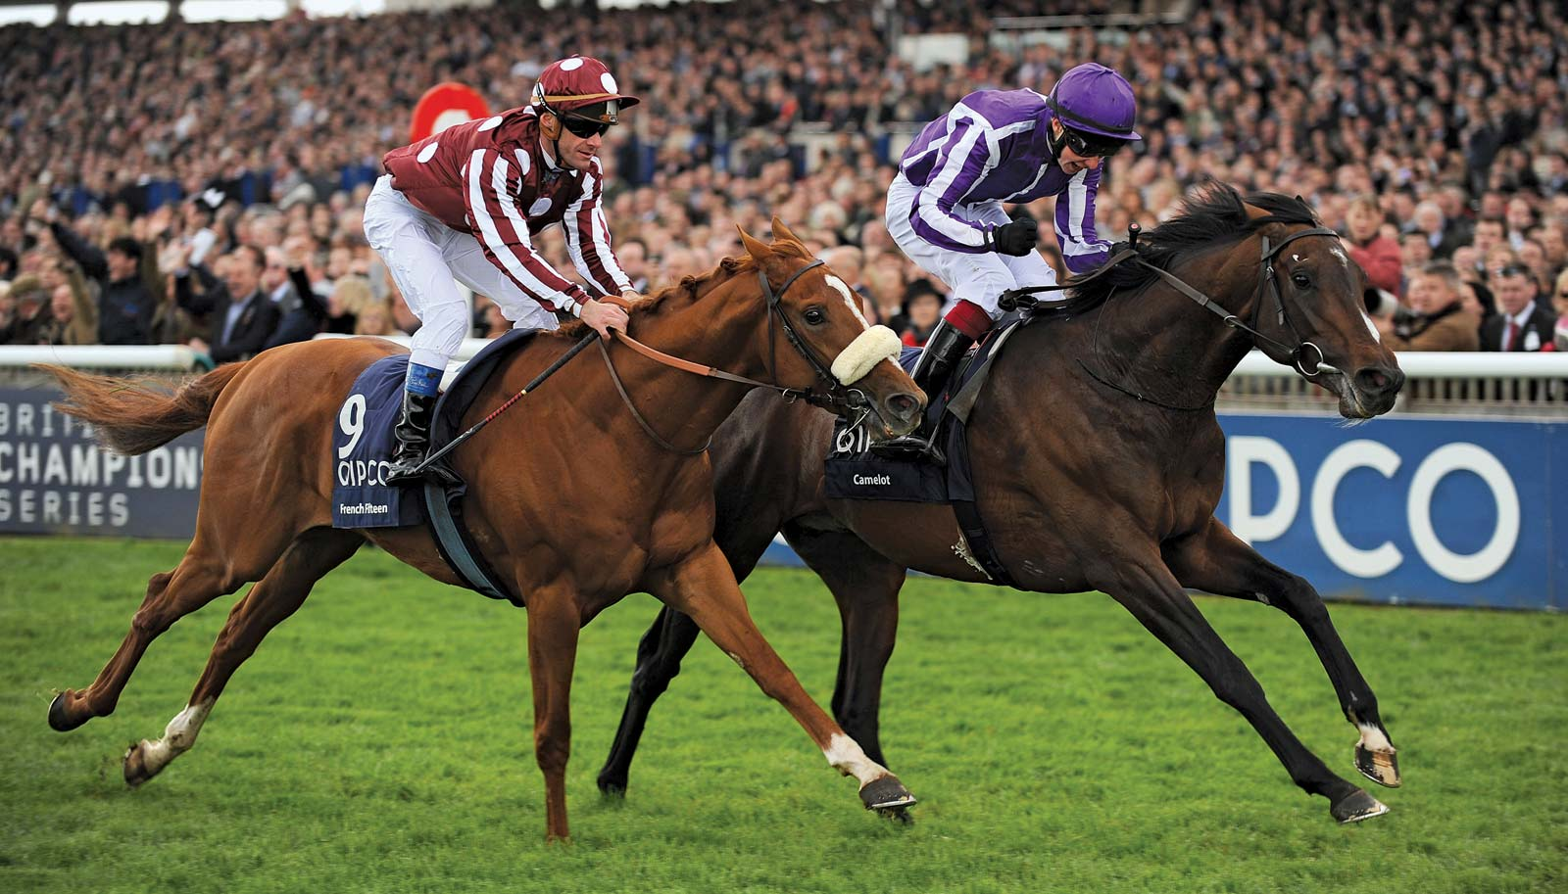
Takes on Different Forms
Cards (Poker)
Horse and Dog Racing
Lottery
Bingo
Raffle Tickets
Slot Machines
Roulette
Pitching Coins
Betting on Sports
Richie Thetford www.thetfordcountry.com

Slide 3
Defining Gambling
What gambling is:
“wagering money or other items of value on an uncertain event that is dependent either wholly on chance, as in roulette, or partly on chance and partly on skill, as in certain card games and in sporting contests.” (Microsoft Encarta)
“to play any game of chance for stakes…to stake or risk money, or anything of value, on the outcome of something involving chance…bet; wager” (Random House College Dictionary)
Richie Thetford www.thetfordcountry.com

Slide 4
Defining Gambling
Event
(uncertain)
Stake / Wager
Money or anything of value
Agreed upon before
Gambler # 1
Gambler # 2
Richie Thetford www.thetfordcountry.com

Slide 5
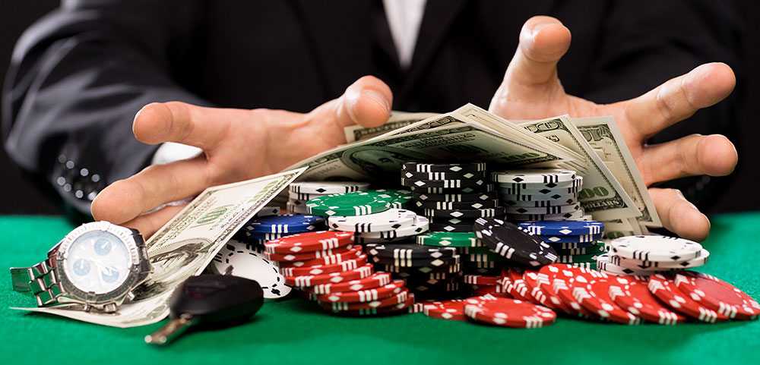
Defining Gambling
What gambling is not:
  Taking the normal risks of life
    Farming, driving, etc.
  In gambling:
    One stands to gain at the loss of others
  In Farming:
    Profit is not sought at the loss of others
Richie Thetford www.thetfordcountry.com

Slide 6
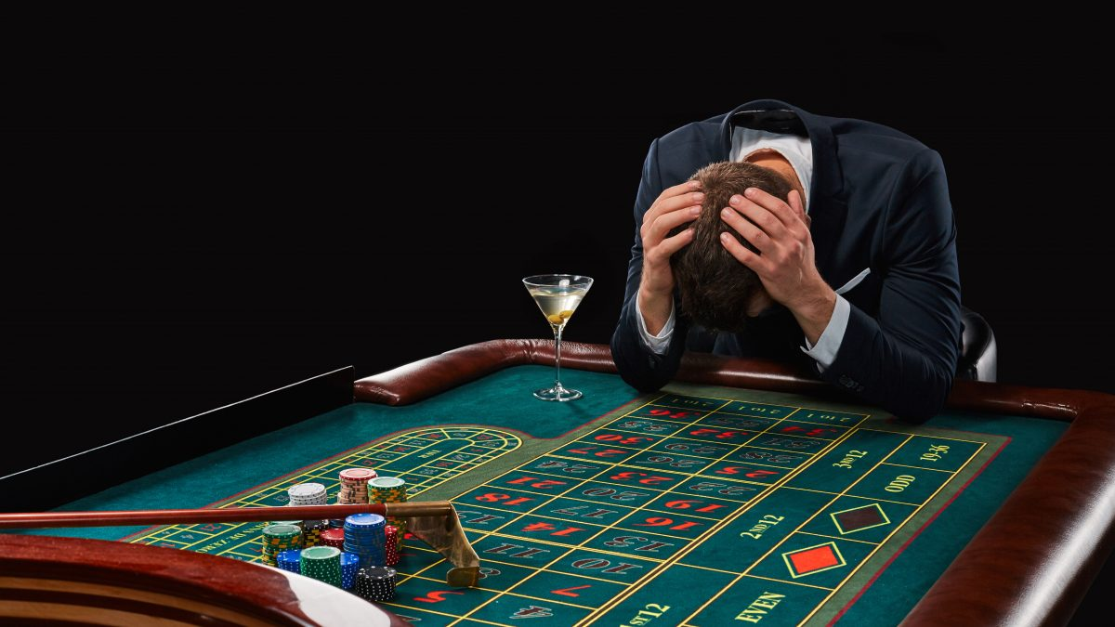
Sinful Problems of Gambling
Essential motive is covetousness
  Ephesians 5:5
  Colossians 3:5
  1 Timothy 6:10
The remedy:
  Colossians 3:1-4
Richie Thetford www.thetfordcountry.com

Slide 7

Sinful Problems of Gambling
Violates the principle of honest labor
  1 Thessalonians 4:11-12
  2 Thessalonians 3:10-12
  Matthew 7:12
Accompanied by other evils
  Matthew 7:16
  Proverbs 15:16
Richie Thetford www.thetfordcountry.com

Slide 8
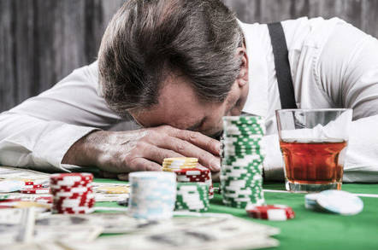
Sinful Problems of Gambling
Does not promote godliness
  Philippians 4:8
  1 Thessalonians 5:21-22
  Matthew 5:16
  James 4:4
  1 Timothy 6:17-19
Richie Thetford www.thetfordcountry.com

Slide 9
Sinful Problems of Gambling
It is deceptive
  1 Corinthians 15:33
  Proverbs 22:16
  2 Peter 2:19
Consumes innocent souls
Constant appeal to raw greed
Crafted fantasy of getting rich
Deception that winning is easy
Trap of devastating addiction
Victimization of the poor
Offers success and freedom
Richie Thetford www.thetfordcountry.com

Slide 10
Conclusion
Gambling is a product of worldliness
  Effort to lay up treasure on earth
It is a deceiver, mocker, destroyer
  Lives, families, souls
Put away covetousness
Learn to be content with our life
Hebrews 13:5
Philippians 3:12
Could any of us picture Jesus gambling?
Richie Thetford www.thetfordcountry.com

