Slide 1
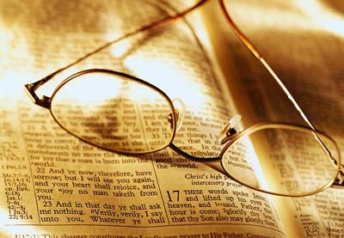
Worldliness
Drinking
1 Peter 4:3
Social Drinking?
Moderate Drinking?
Responsible Drinking?
Richie Thetford www.thetfordcountry.com

Slide 2
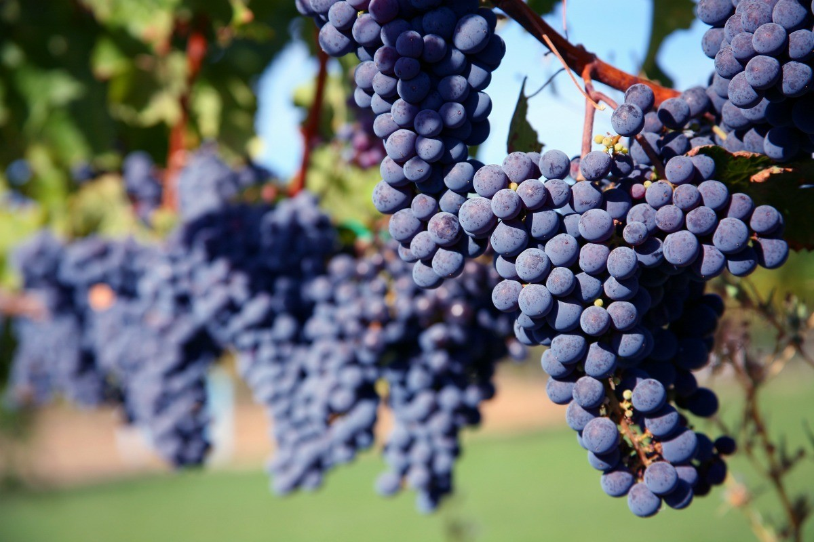
Arguments Made to Justify
Jesus turned water into wine
  “Wine” does not always refer to intoxicating drink
  “Wine” – the juice of the grape
    Isaiah 16:10
    Isaiah 65:8
Richie Thetford www.thetfordcountry.com

Slide 3
“Wine”
(Greek: Oinos)
Fermented
(Alcohol Content)
Ephesians 5:18
“drunk with wine”
Unfermented
(No Alcohol Content)
Matthew 9:17
Mark 2:22
“new wine
in new bottles”
Richie Thetford www.thetfordcountry.com

Slide 4
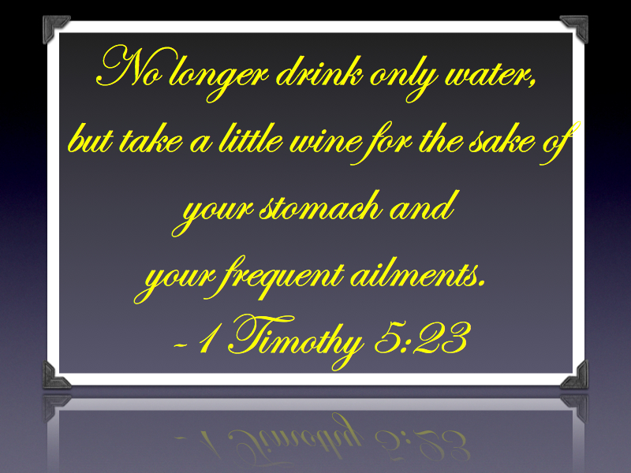
Arguments Made to Justify
Timothy told to drink wine
  1 Timothy 5:23
    No proof this was “fermented wine”
Deacons “not given to much wine”
  1 Timothy 3:8
  Ecclesiastes 7:17
  Romans 6:12
Richie Thetford www.thetfordcountry.com

Slide 5
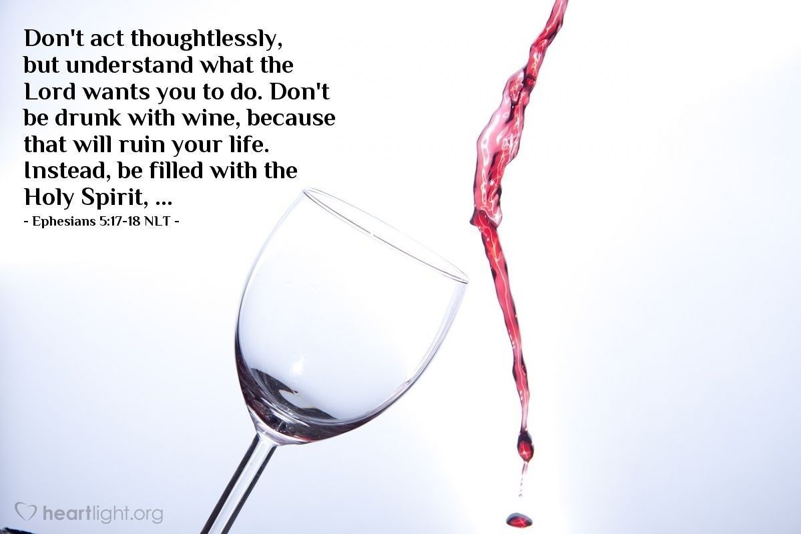
Drinking is Drunkenness
Drunkenness is sinful
  Galatians 5:19-21
  1 Corinthians 6:9-11
  Ephesians 5:18
    There are degrees
    of drunkenness
Richie Thetford www.thetfordcountry.com

Slide 6
Drinking is Drunkenness
Social drinking is also drunkenness
  Luke 12:45
  1 Thessalonians 5:6-8
Alcoholic beverages are a strong drink
  Proverbs 20:1
Greek word “methusko” – signifies “to make drunk, or to grow drunk, or to become intoxicated” (W. E. Vine)
Richie Thetford www.thetfordcountry.com

Slide 7
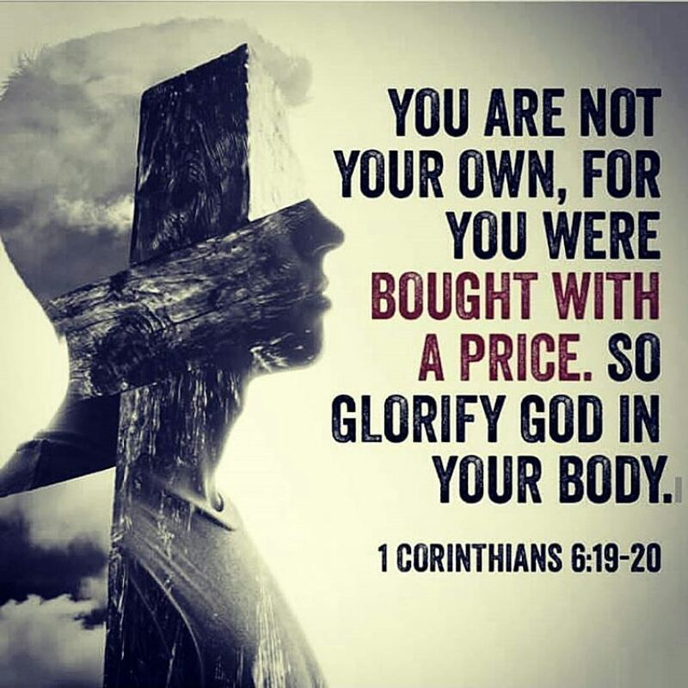
Drinking is Harmful
Sinful to purposefully harm our body
  1 Corinthians 6:19-20
    Must take care of our body because
    it belongs to God
Richie Thetford www.thetfordcountry.com

Slide 8
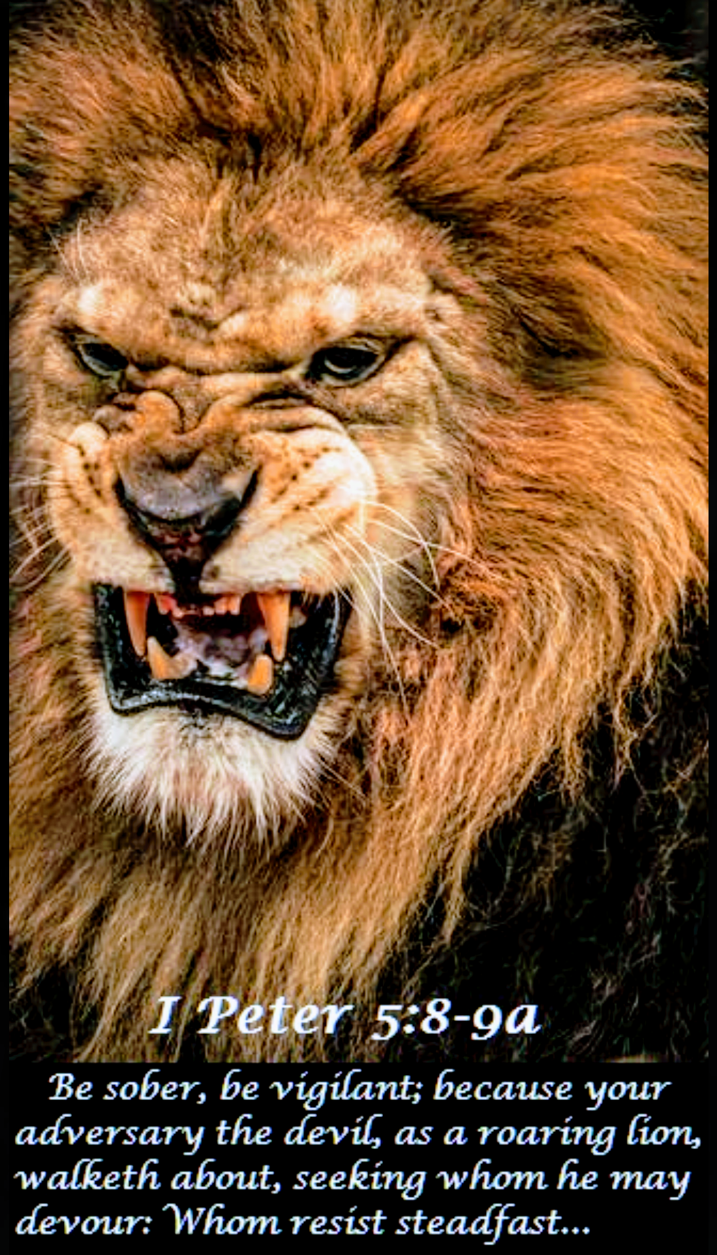
Drinking is Condemned
Peter’s teaching:
  1 Peter 4:1-4
    “Banqueting” – A drinking party
      Can’t have a drinking party
      without drinking
    Condemns all phases of drinking
Must be sober
  1 Peter 5:8
Richie Thetford www.thetfordcountry.com

Slide 9
Drinking influences Others
Moderate social drinking
  A major cause of recruiting new drinkers
  Matthew 18:6-7
These do not influence the drunk or alcoholic,
but rather those who have never drank before!
Richie Thetford www.thetfordcountry.com

Slide 10

Principles Violated
“Social drinker” can’t be an influence for good
  Matthew 5:13-16
  1 Thessalonians 5:21-22
Can’t convince the “drunkard”
to stop
  Romans 13:14
  Romans 14:21
Richie Thetford www.thetfordcountry.com

Slide 11
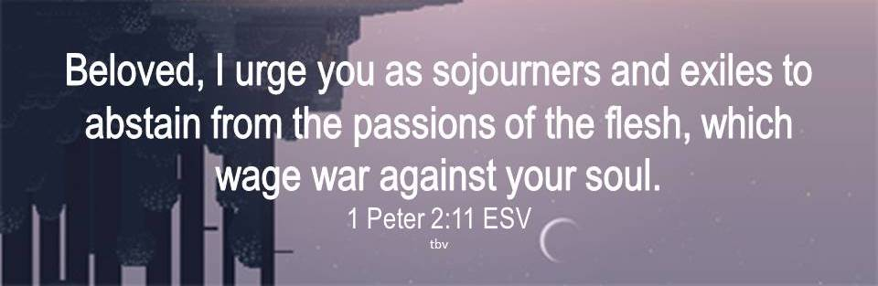
Principles Violated
Drinker is destroying mind and body
  1 Corinthians 6:19-20
Can’t abstain from fleshly lusts
  1 Peter 2:11
Richie Thetford www.thetfordcountry.com

Slide 12
Conclusion
Avoid the use of alcohol
Alcohol leads to unhappiness
  Millions of homes stand as living
  monuments to the effects of liquor
Alcohol kills everything that lives.
Alcohol preserves everything that is dead.
Richie Thetford www.thetfordcountry.com

Slide 13
Conclusion
One who never drinks at all WILL NEVER:
  Get drunk
  Become an alcoholic
  Be responsible for the damage drinking causes
  Become enslaved to that controlling habit
  Influence another person to drink
  Destroy their body by drinking
  Hurt Jesus and His church
1 Corinthians 10:31-32
Richie Thetford www.thetfordcountry.com

