Slide 1
Worldliness
Dancing
1 Peter 3:15
Christians live by a different standard
Romans 12:2
Richie Thetford www.thetfordcountry.com

Slide 2
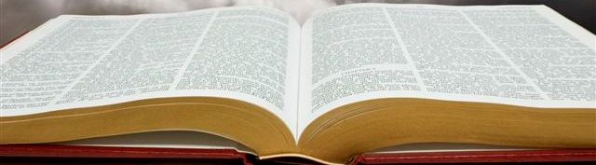
What is Worldliness?
Defined:
“Of or limited to this world; temporal or secular; devoted to or concerned with the affairs, pleasures, etc. of this world”
1 John 2:15-17
Richie Thetford www.thetfordcountry.com

Slide 3
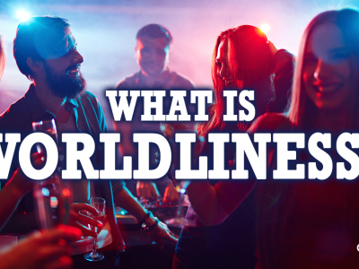
What is Worldliness?
A participation in sin
A life of following one’s passions
Living like the world
A life devoted to the temporal
Richie Thetford www.thetfordcountry.com

Slide 4
What is Dancing?
“Dancing is an expression in rhythmic movement of an intensified sense of life, arising from an inner perception
that stimulates both mind and body” (Grolier)
“To move rhythmically to music, using prescribed
or improvised steps and gestures” (American Heritage Dictionary)
Richie Thetford www.thetfordcountry.com

Slide 5

What is Dancing?
What is normally involved with dancing?
Close bodily contact
Moving in rhythm to the music
Romantic atmosphere: lights, music, etc.
Richie Thetford www.thetfordcountry.com

Slide 6
What is Appealing About Dancing?
Testimony of the world says that it is SEXUAL
“Most juvenile crime has its inception in the dance hall, either public or private.” (J. Edgar Hoover)
“It is a system of means, contrived with more than human ingenuity, to excite the instinct of sex action.” (Professor W. C. Wilkerson – Chicago Univ.)
“No woman can waltz well and waltz virtuously.” (T. A Vogner – Dance Inst)
Richie Thetford www.thetfordcountry.com

Slide 7
What is Appealing About Dancing?
Testimony of the world says that it is SEXUAL
“Among those who dance it is noteworthy that very few girls spend much time dancing with other girls. Neither do men dance very much with their own wives, nor brothers with their own sisters ... the secret of the popularity of dancing (or is it a secret) is the exciting, sexual stimulation resulting from the close embrace of male and female whether it be with music in dancing or without music in petting and necking.” (J. P. Gibson, MD)
Richie Thetford www.thetfordcountry.com

Slide 8
What is Appealing About Dancing?
Testimony of the world says that it is SEXUAL
“It is true that only a minority of church members dance, and possibly a small minority; but to whatever degree dancing is tolerated among members of the body, to just that degree the church tends toward the world, and allows the spirit of the world to infiltrate it.” (Homer Hailey)
Richie Thetford www.thetfordcountry.com

Slide 9
Biblical Principles
Lasciviousness
  Galatians 5:19-21
  Matthew 5:28
Lasciviousness is defined as: “Lewd; wanton; lustful; tending to produce lewd emotions.” (Webster)
Lewd is defined as: “Given to indulgence of lust; suiting or proceeding from unlawful sexual desire.” (Webster)
Richie Thetford www.thetfordcountry.com

Slide 10
Biblical Principles
Revelries or Carousals
  Revel Defined: “to rebel, carouse, a wild party or celebration.” (Webster)
  Dancing associated with sexual immorality and drunkenness in the New Testament
    1 Peter 4:3
    Romans 13:13
Richie Thetford www.thetfordcountry.com

Slide 11
Biblical Principles
Flee Lust
  1 Thessalonians 4:3-6
  2 Timothy 2:22
  Colossians 3:5
Flee Fornication
  1 Corinthians 6:18
Richie Thetford www.thetfordcountry.com

Slide 12
Other Considerations
Dancing is questionable
  Romans 14:23
  Psalms 1:1-2
Dancing harms good influence
  Matthew 5:14-16
  1 John 3:3
Richie Thetford www.thetfordcountry.com

Slide 13
Other Considerations
Dancing makes obedience to Christ impossible
  1 Thessalonians 5:21-22
  1 Corinthians 10:31
Richie Thetford www.thetfordcountry.com

Slide 14
Vital Questions
What is my reason for going?
What kind of people will be there?
What kind of activities will take place there?
Will I appear to be approving of evil practices?
Will I want to be seen there by other Christians?
Will I want to take other Christians there?
Would Christ be doing it and approve of it?
Richie Thetford www.thetfordcountry.com

Slide 15
Worldliness: Dancing
“Dancing is condemned with the word “lasciviousness.” Lasciviousness is that which tends to stir up the lewd and lustful desires. Dancing destroys spirituality. The condoning of dancing by the church, testifies to the weakness of that church. Will it hurt to just learn how to dance? Is there any harm in girls dancing with girls? Only in the sense that you are ‘pitching your tent toward Sodom.’ Why sow seed that will produce a sinful harvest? The old saying that, ‘a praying knee and a dancing foot don’t grow on the same leg is still a very true statement, even today. When your life is ruined, it is much like ‘water spilt,’ it can be started over, but not recalled.” (W. R. Jones)
Richie Thetford www.thetfordcountry.com

Slide 16

Worldliness: Dancing
Consider what God wants you to do
Seek wholesome, godly activities
  Will grow stronger – not weaker
  Will gain real friends – not lose them
  Will reap fruit of the spirit – not works of the flesh
Allow God to rule your life in EVERY WAY!
Richie Thetford www.thetfordcountry.com

