Slide 1
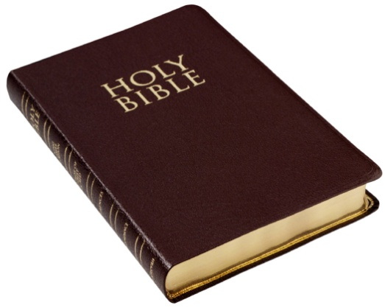
The Work of the Holy Spirit
Convicting Men of Sin
“And I will pray the Father, and He will give you another Helper, that He may abide with you forever – the Spirit of truth, whom the world cannot receive, because it neither sees Him nor knows Him; but you know Him, for He dwells with you and will be in you.”
John 14:16-17
Richie Thetford www.thetfordcountry.com

Slide 2
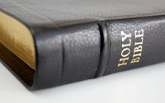
The Work of the Holy Spirit
Spirit had a work to perform
John 14:26
John 15:26
John 16:13
The work is described by John:
John 16:8-11
One cannot be convicted of sin until convinced that there is a standard of right and wrong
Richie Thetford www.thetfordcountry.com

Slide 3
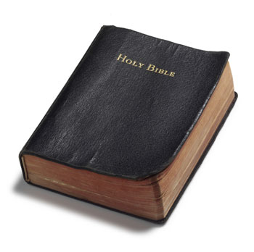
Convicting Men of Sin
Pentecost
Acts 2:23
Acts 2:37
Stephen’s sermon
Acts 6:10
Acts 7:51,54
Richie Thetford www.thetfordcountry.com

Slide 4
Convicting Men of Sin
Paul’s sermon to Felix
Acts 24:25
Paul’s example at Corinth
1 Corinthians 4:21
2 Corinthians 12:20-21
Richie Thetford www.thetfordcountry.com

Slide 5
Quench Not the Spirit
Holy Spirit convicts men of sin
1 Thessalonians 5:19
Preaching
Should not be obnoxious or abusive
Should exhibit a sincere love of truth
Should contrast truth vs error
QUENCH: “to extinguish; put out; to cool suddenly”
Richie Thetford www.thetfordcountry.com

Slide 6
The Work of the Holy Spirit
Not everyone who is convicted of sin will respond to the gospel
Some will realize their error and respond to the gospel and be saved
Never be ashamed of proclaiming the whole counsel of God!
“For whoever is ashamed of Me and My words in this adulterous and sinful generation, of him the Son of Man also will be ashamed when He comes in the glory of His Father with the holy angels.” Mark 8:38
Richie Thetford www.thetfordcountry.com

