Slide 1
Words That Describe a Christian
Richie Thetford www.thetfordcountry.com

Slide 2
Words that Describe the Christian
Alive
Romans 6:11
Loved
Revelation 1:5
Ephesians 2:4
Saved
1 Timothy 2:3-4
1 Peter 3:21
Richie Thetford www.thetfordcountry.com

Slide 3
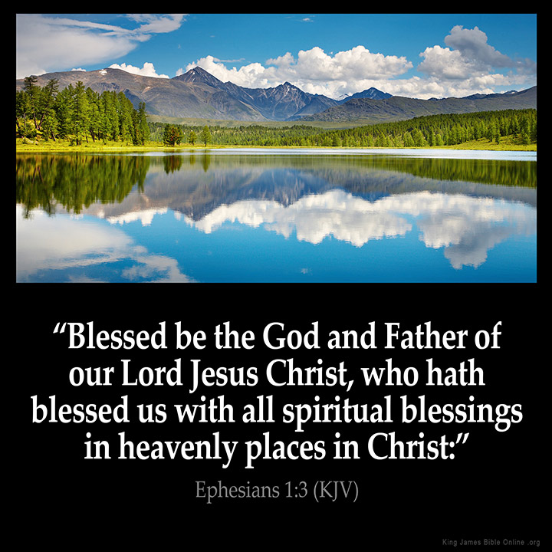
Words that Describe the Christian
In Christ
Ephesians 1:3
Galatians 3:26-27
Reconciled
Ephesians 2:16
Romans 5:10
Citizen
Colossians 1:13
Ephesians 2:19
Richie Thetford www.thetfordcountry.com

Slide 4
Words that Describe the Christian
Blessed
Romans 4:7-8
Galatians 3:8-9
Redeemed
1 Peter 1:18-19
New
2 Corinthians 5:17
Ephesians 4:24
Richie Thetford www.thetfordcountry.com

Slide 5
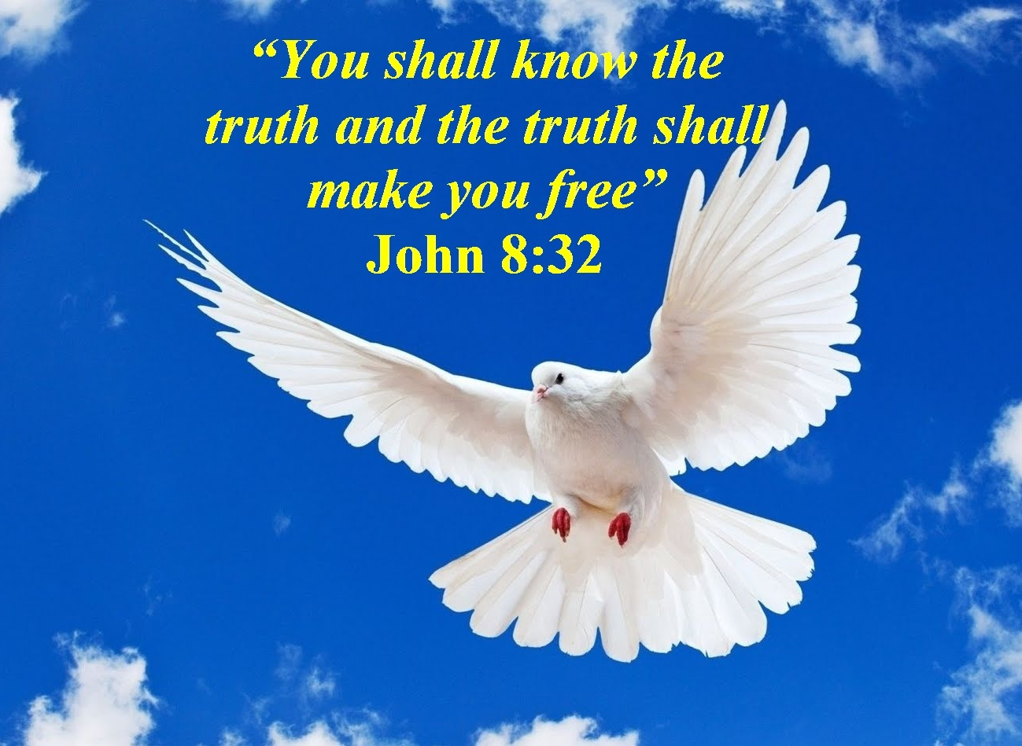
Words that Describe the Christian
Free
John 8:32
Romans 6:17-18
Forgiven
Colossians 2:13
Ephesians 1:7
Washed, Sanctified, Justified
1 Corinthians 6:9-11
Richie Thetford www.thetfordcountry.com

Slide 6
“For by grace you have been saved through faith, and that not of yourselves, it is the gift of God.” Ephesians 2:8
Richie Thetford www.thetfordcountry.com

