Slide 1
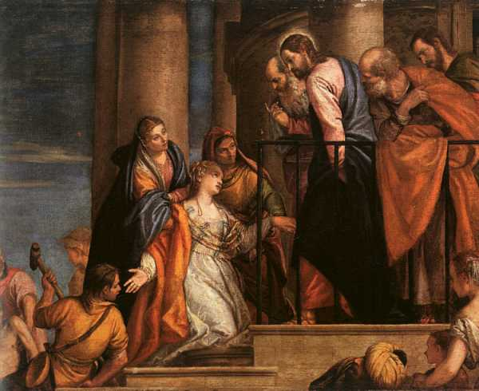
The Woman’s Need to Touch Jesus
Luke 8:43-48
Richard Thetford www.thetfordcountry.com

Slide 2
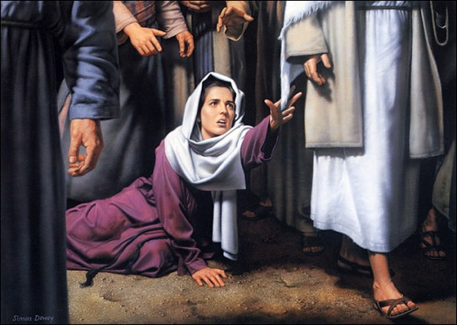
The Need to Touch Jesus
Verses 43-44:
  “A woman…came from behind,
  touched the border of His garment”
She came to Jesus and desired
to “touch” Him in a personal way
We have a need to “touch” Jesus
in a personal way
  Romans 3:10, 23
  Romans 6:23
Richard Thetford www.thetfordcountry.com

Slide 3

The Need to Touch Jesus
Our effort that is needed:
  Ignore “just going along with the crowd”
  Ignore “the peer pressure”
  Ignore “the worldly cures”
  Ignore “our fears”
  Ignore “our own
  weaknesses”
Richard Thetford www.thetfordcountry.com

Slide 4
The Need for God to Know
Verses 45-46:
  “Who touched Me…Somebody touched Me, for I perceive….”
    Who is desiring of His healing power
    Salvation healing for those who desire Him
    The woman had to make a choice
Our desperate need to answer Jesus
She made her choice
  We have a choice to make in our life!
Deuteronomy
30:15-20
Richard Thetford www.thetfordcountry.com

Slide 5
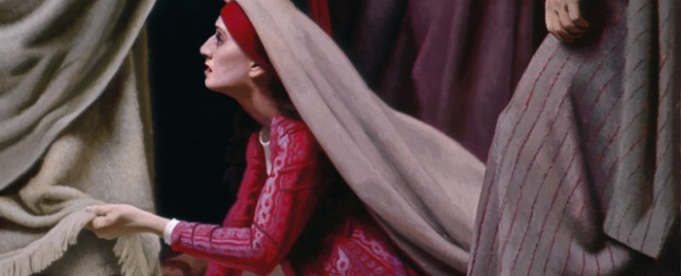
The Need for Mankind to Acknowledge Publicly
Verse 47:
  “She declared to Him in the presence of all…”
    She overcame her fears & man’s intimidation
    She came “trembling”
    Received God’s blessing because
    of her efforts to “touch Jesus”
Richard Thetford www.thetfordcountry.com

Slide 6

The Need for Mankind to Acknowledge Publicly
We must likewise make a diligent
effort to reach out for (confess) Jesus
  Matthew 10:32-33
  Romans 10:9-10
  Hebrews 10:23
Richard Thetford www.thetfordcountry.com

Slide 7
Won’t you come to Jesus and “touch Him” today?
Only Jesus could save her, Only Jesus can save you!
Richard Thetford www.thetfordcountry.com

