Slide 1
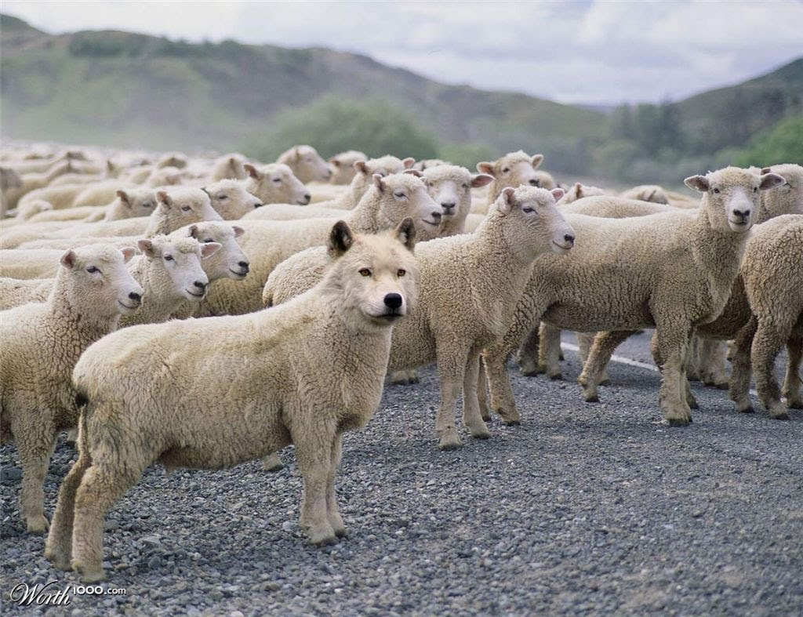
The
Wolf
in
Sheep’s Clothing
Matthew 7:15-20
Richie Thetford www.thetfordcountry.com

Slide 2
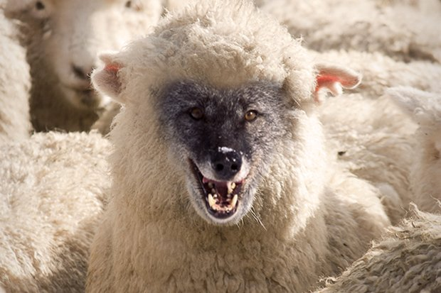

The Wolf in Sheep’s Clothing
We Must Judge
“beware of false prophets”
  Matthew 7:1-5
Not to judge without evidence
  John 7:24
  Leviticus 19:15
  Deuteronomy 1:17
Word of God is the basis of judgment
  John 12:48
Richie Thetford www.thetfordcountry.com

Slide 3

The Wolf in Sheep’s Clothing
How Can We Know a False Teacher?
Try them or test them
  Jeremiah 29:8-9; 5:30-31; 23:21-22
  Deuteronomy 18:20-21
  Colossians 2:8
  1 Timothy 1:3; 4:1-2
  Titus 1:10-11
  2 John 9-11
Richie Thetford www.thetfordcountry.com

Slide 4
Jeremiah 29:8-9 For thus says the LORD of hosts, the God of Israel: Do not let your prophets and your diviners who are in your midst deceive you, nor listen to your dreams which you cause to be dreamed. For they prophesy falsely to you in My name; I have not sent them, says the LORD.
Jeremiah 5:30-31 An astonishing and horrible thing Has been committed in the land: The prophets prophesy falsely, And the priests rule by their own power; And My people love to have it so. But what will you do in the end?
Jeremiah 23:21-22 I have not sent these prophets, yet they ran. I have not spoken to them, yet they prophesied. But if they had stood in My counsel, And had caused My people to hear My words, Then they would have turned them from their evil way And from the evil of their doings.
Richie Thetford www.thetfordcountry.com

Slide 5
Deuteronomy 18:20 But the prophet who presumes to speak a word in My name, which I have not commanded him to speak, or who speaks in the name of other gods, that prophet shall die.
Colossians 2:8 Beware lest anyone cheat you through philosophy and empty deceit, according to the tradition of men, according to the basic principles of the world, and not according to Christ.
1 Timothy 1:3 As I urged you when I went into Macedonia — remain in Ephesus that you may charge some that they teach no other doctrine,
1 Timothy 4:1-2 Now the Spirit expressly says that in latter times some will depart from the faith, giving heed to deceiving spirits and doctrines of demons, speaking lies in hypocrisy, having their own conscience seared with a hot iron,
Richie Thetford www.thetfordcountry.com

Slide 6
Titus 1:10-11 For there are many insubordinate, both idle talkers and deceivers, especially those of the circumcision, whose mouths must be stopped, who subvert whole households, teaching things which they ought not, for the sake of dishonest gain.
2 John 9-11 Whoever transgresses and does not abide in the doctrine of Christ does not have God. He who abides in the doctrine of Christ has both the Father and the Son. If anyone comes to you and does not bring this doctrine, do not receive him into your house nor greet him; for he who greets him shares in his evil deeds.
Richie Thetford www.thetfordcountry.com

Slide 7

The Wolf in Sheep’s Clothing
How Can We Know a False Teacher?
Try and test the teacher
to see if he is true or false
  1 John 4:1
  Revelation 2:2
  1 Thessalonians 5:21
Richie Thetford www.thetfordcountry.com

Slide 8
1 John 4:1 Beloved, do not believe every spirit, but test the spirits, whether they are of God; because many false prophets have gone out into the world.
Revelation 2:2 I know your works, your labor, your patience, and that you cannot bear those who are evil. And you have tested those who say they are apostles and are not, and have found them liars
1 Thessalonians 5:21 Test all things; hold fast what is good.
Richie Thetford www.thetfordcountry.com

Slide 9

The Wolf in Sheep’s Clothing
How Can We Know a False Teacher?
False teachers will come!
  2 Peter 2:1
  Acts 20:29-30
  Romans 16:17-18
Richie Thetford www.thetfordcountry.com

Slide 10
2 Peter 2:1 But there were also false prophets among the people, even as there will be false teachers among you, who will secretly bring in destructive heresies, even denying the Lord who bought them, and bring on themselves swift destruction.
Acts 20:29-30 For I know this, that after my departure savage wolves will come in among you, not sparing the flock. Also from among yourselves men will rise up, speaking perverse things, to draw away the disciples after themselves.
Romans 16:17-18 Now I urge you, brethren, note those who cause divisions and offenses, contrary to the doctrine which you learned, and avoid them. For those who are such do not serve our Lord Jesus Christ, but their own belly, and by smooth words and flattering speech deceive the hearts of the simple.
Richie Thetford www.thetfordcountry.com

Slide 11

The Wolf in Sheep’s Clothing
How Can We Know a False Teacher?
False teachers:
  Enter among the saints
  Can be recognized
  Can be tested or proven by the word of God
  Can be exposed for what they are
Richie Thetford www.thetfordcountry.com

Slide 12
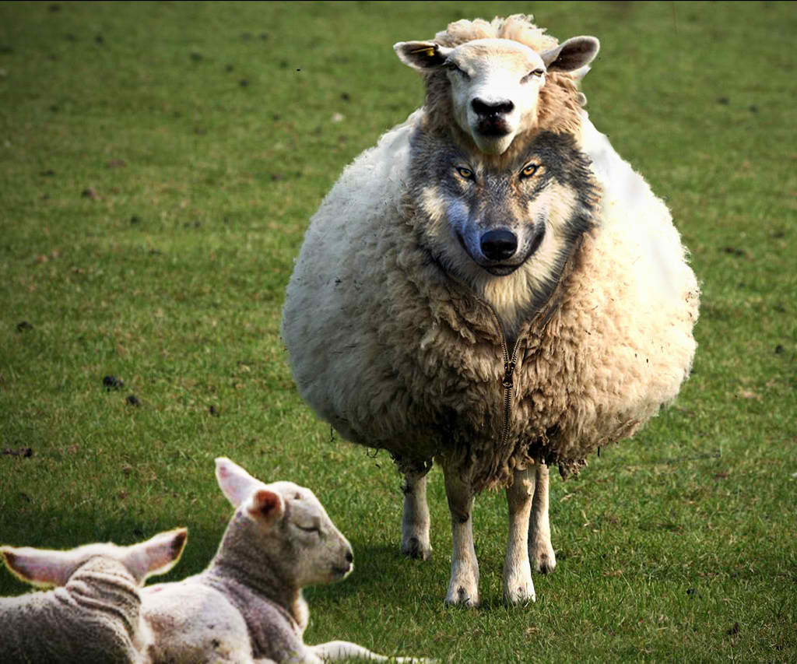
The Wolf in Sheep’s Clothing
How Do False Teachers Come?
They come camouflaged
  Don’t announce they’re Satan’s servants!
They come deceitfully
  2 Corinthians 11:13-15
  Ephesians 4:14
  Jude 4, 8, 16
    Will continue to come into the church
    Will continue to arise from among us
Richie Thetford www.thetfordcountry.com

Slide 13
2 Corinthians 11:13-15 For such are false apostles, deceitful workers, transforming themselves into apostles of Christ. And no wonder! For Satan himself transforms himself into an angel of light. Therefore it is no great thing if his ministers also transform themselves into ministers of righteousness, whose end will be according to their works.
Ephesians 4:14 that we should no longer be children, tossed to and fro and carried about with every wind of doctrine, by the trickery of men, in the cunning craftiness of deceitful plotting,
Richie Thetford www.thetfordcountry.com

Slide 14
Jude 4 For certain men have crept in unnoticed, who long ago were marked out for this condemnation, ungodly men, who turn the grace of our God into lewdness and deny the only Lord God and our Lord Jesus Christ.
Jude 8 Likewise also these dreamers defile the flesh, reject authority, and speak evil of dignitaries.
Jude 16 These are grumblers, complainers, walking according to their own lusts; and they mouth great swelling words, flattering people to gain advantage.
Richie Thetford www.thetfordcountry.com

Slide 15
The Wolf in Sheep’s Clothing
How Do False Teachers Come?
Congregations have been led away
  Can be: Elders, Preachers, Deacons, Bible class teachers
    Pretending to be spiritual or very godly
    They have appealing speeches
“For when they speak great swelling words of emptiness, they allure through the lusts of the flesh, through lewdness, the ones who have actually escaped from those who live in error. While they promise them liberty, they themselves are slaves of corruption; for by whom a person is overcome, by him also he is brought into bondage.”
2 Peter 2:18-19
Richie Thetford www.thetfordcountry.com

Slide 16

The Wolf in Sheep’s Clothing
Examine Their Fruit
One can tell a person by their fruit
  Matthew 7:16-20
Examine one’s fruit
Try the spirits
  Examine everyone by the Word of God
  Must not allow the “wolf” to lead innocent
  sheep astray – we are warned about this!
Richie Thetford www.thetfordcountry.com

Slide 17
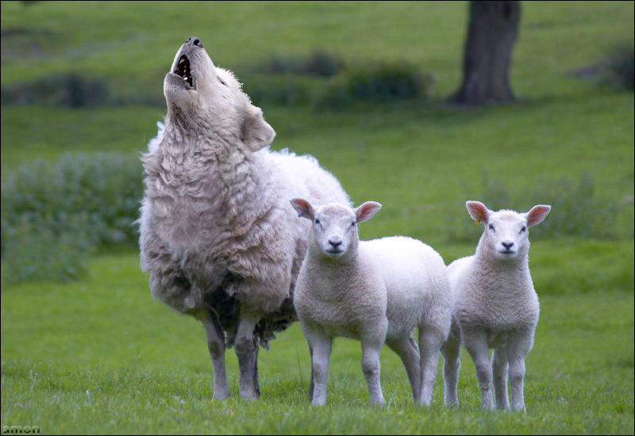
The Wolf in Sheep’s Clothing
Saints MUST be cautious
Satan works with the ferociousness of a lion
  1 Peter 5:8
    Tries to destroy the Christian and his faith
Satan uses men who are false teachers, wolves in sheep’s clothing
    Disguise themselves as honest, faithful servants of God
    Are really ravenous wolves – devouring the innocent
Use God’s Word to test the false teacher
2 Timothy 3:16-17
Richie Thetford www.thetfordcountry.com

