Slide 1
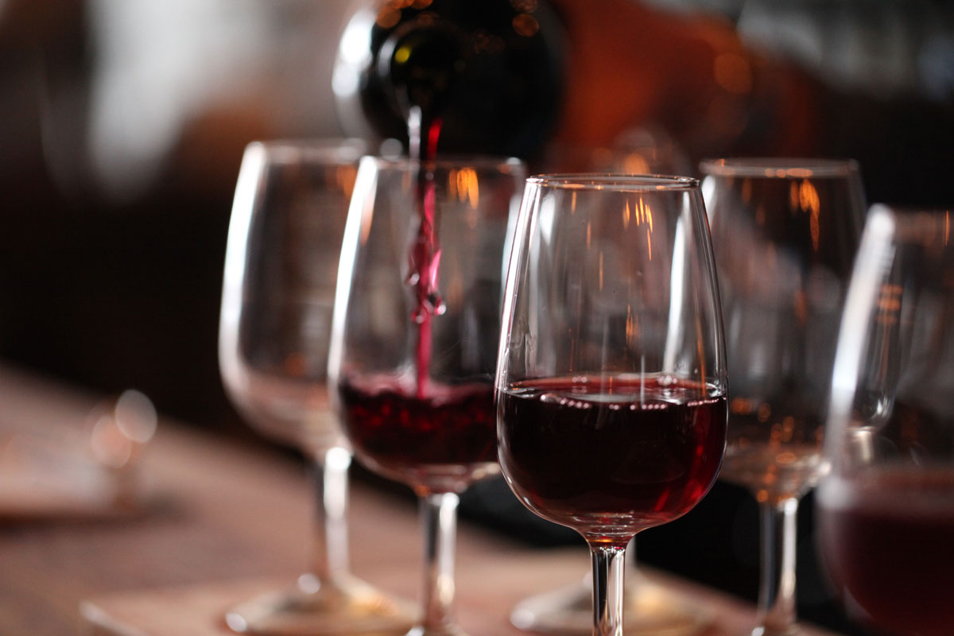
Wine
Richie Thetford www.thetfordcountry.com

Slide 2
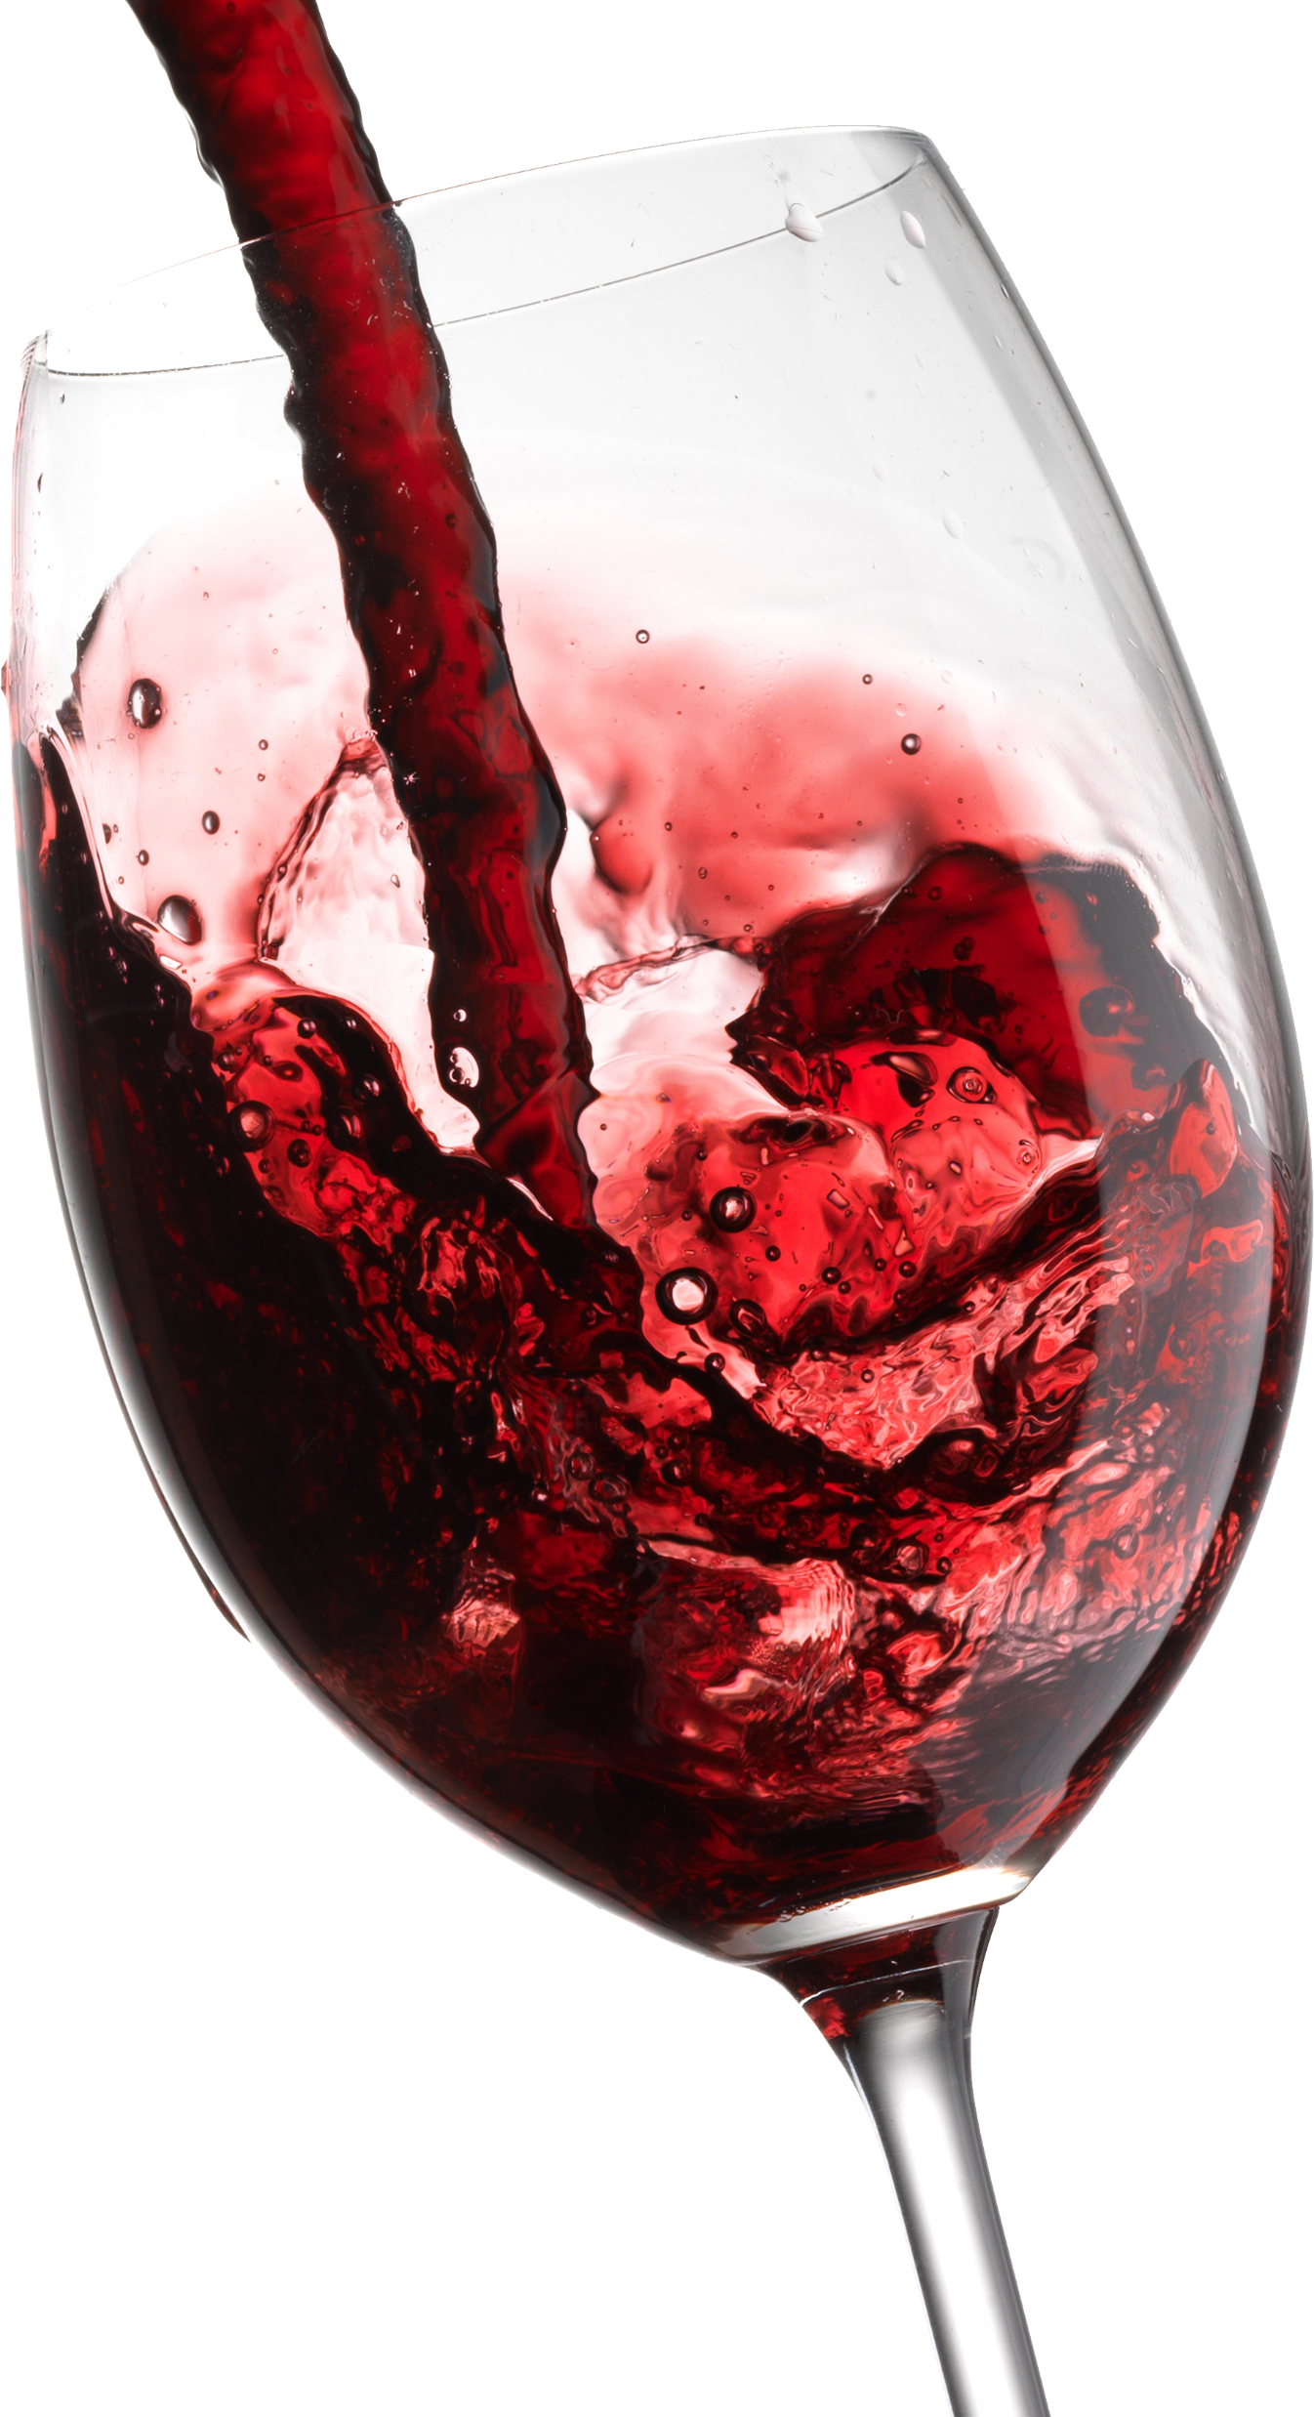
Questions Concerning Wine
Doesn’t Proverbs 31:6-7 allow people to drink alcohol?
Proverbs 31:6-7
To be contrasted with verses 4-5
Drink given to those ready to perish
Likened to our morphine, narcotics, or painkillers
Does NOT justify social or recreational drinking
Richie Thetford www.thetfordcountry.com

Slide 3
Questions Concerning Wine
Didn’t Noah and Lot get drunk?
Genesis 9:24-25
Genesis 19:30-38
Not passages helpful to the postiton that justifies “social drinking”
Examples to avoid the use of alcohol
Richie Thetford www.thetfordcountry.com

Slide 4
Questions Concerning Wine
Doesn’t a Christian have the liberty to drink alcohol because of what Paul said in Romans 14:21?
Romans 14:21
Liberties Christians have
Matters that are lawful to do
Christians NEVER have liberty to engage in anything sinful
1 Thessalonians 5:21-22
1 Peter 2:11
Richie Thetford www.thetfordcountry.com

Slide 5
Conclusion of our Series on Wine
Would you defend this statement?
“A wise and good thing to do is to start drinking alcohol”
Can this be encouraged?
Proverbs 20:1
1 Peter 5:8
1 Thessalonians 5:6-8
1 Peter 4:2
Romans 8:6
1 Corinthians 6:20
It is NOT wise to drink alcohol --- because God says NO!
Richie Thetford www.thetfordcountry.com

Slide 6
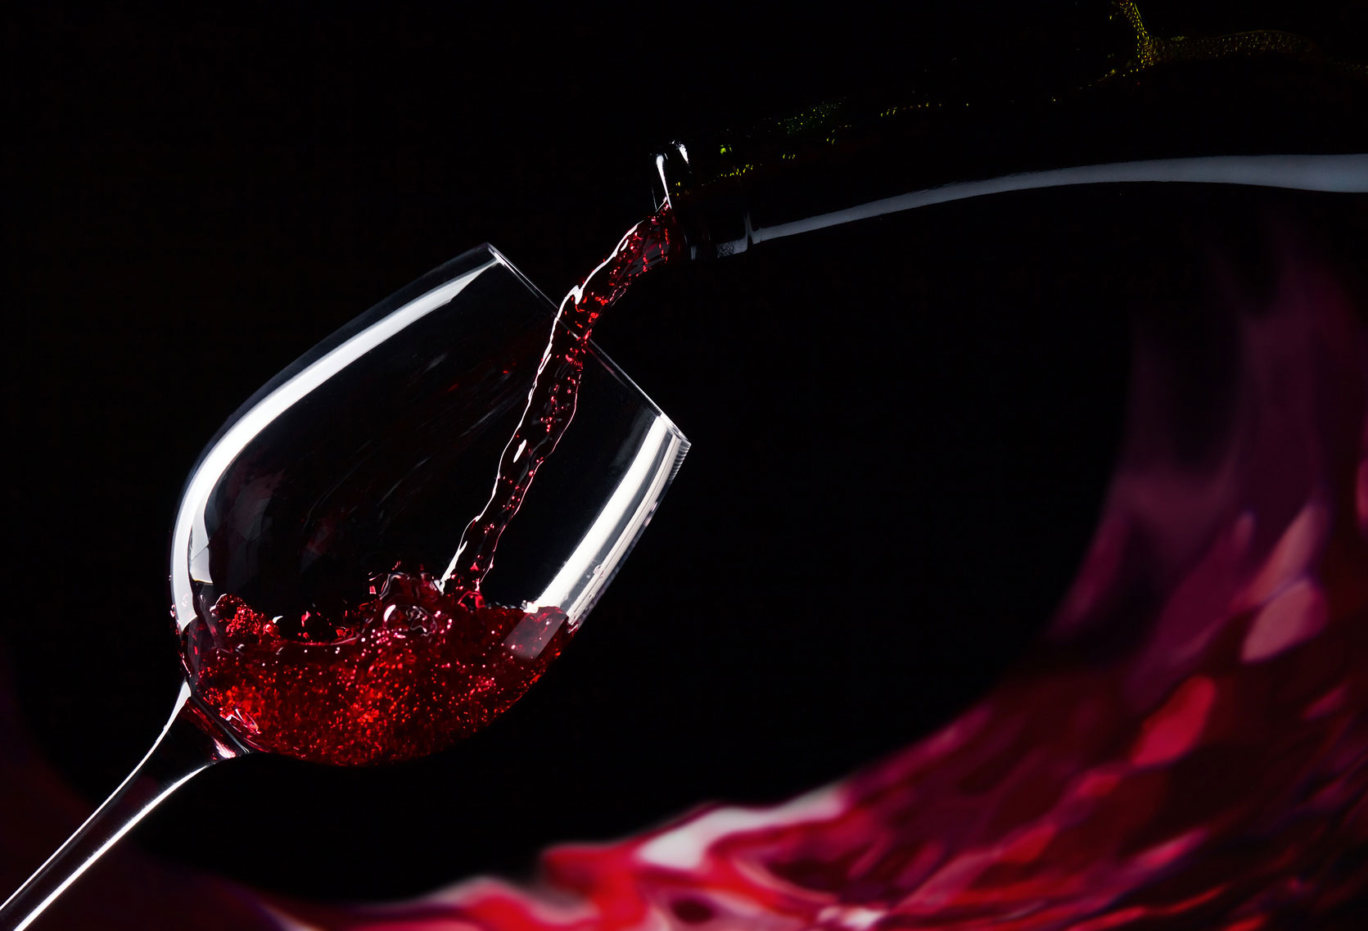
“Woe to those who call evil good, and good evil; Who put darkness for light, and light for darkness; Who put bitter for sweet, and sweet for bitter!”
Isaiah 5:20
Richie Thetford www.thetfordcountry.com

