Slide 1
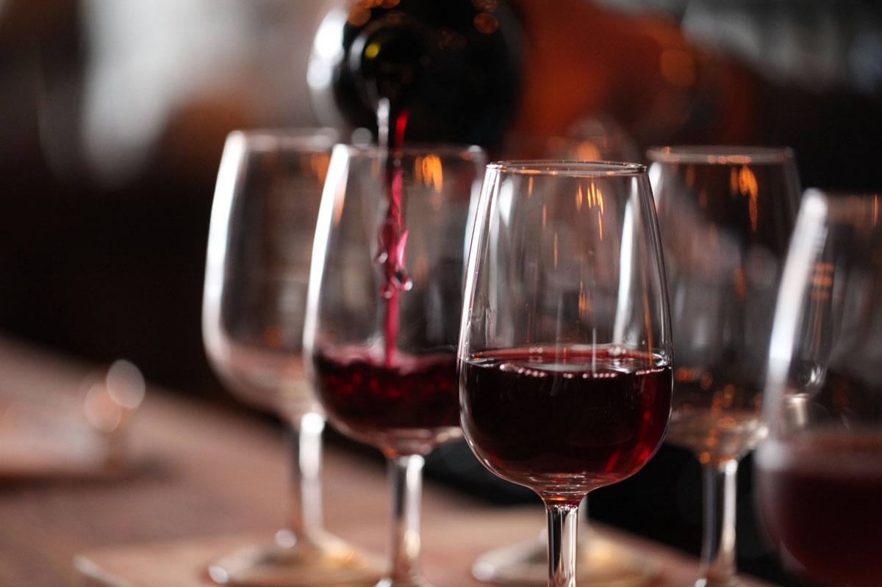
Wine
Richie Thetford www.thetfordcountry.com

Slide 2
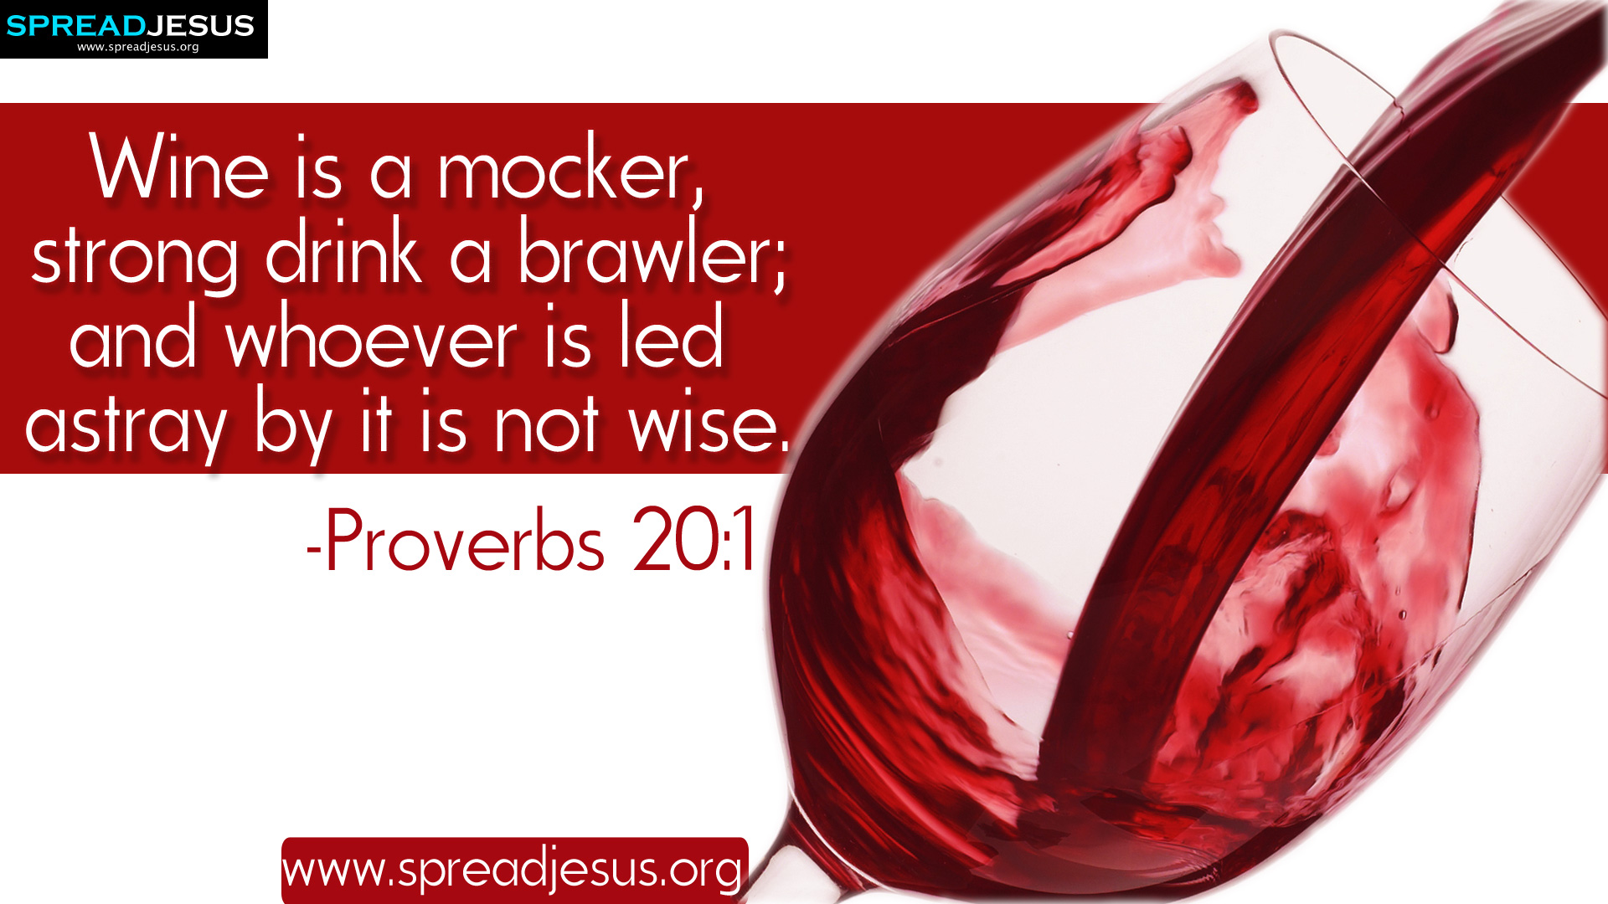
Seven Key Passages of Scripture
What God has said about
“social” or “recreational”
drinking of alcohol:
Richie Thetford www.thetfordcountry.com

Slide 3
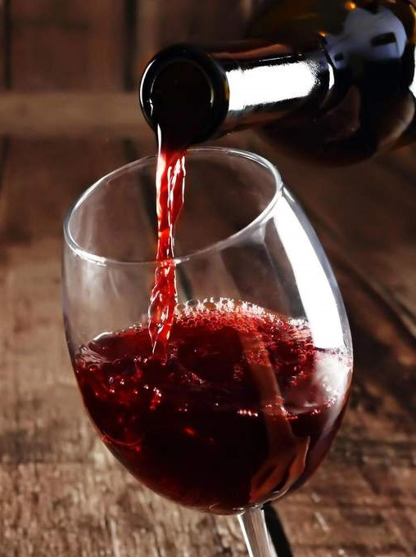
Seven Key Passages of Scripture
Who has woe? Who has sorrow? Who has contentions? Who has complaints? Who has wounds without cause? Who has redness of eyes? Those who linger long at the wine, Those who go in search of mixed wine. Do not look on the wine when it is red, When it sparkles in the cup, When it swirls around smoothly; At the last it bites like a serpent, And stings like a viper. Your eyes will see strange things, And your heart will utter perverse things. Yes, you will be like one who lies down in the midst of the sea, Or like one who lies at the top of the mast, saying: "They have struck me, but I was not hurt; They have beaten me, but I did not feel it. When shall I awake, that I may seek another drink?"
Proverbs 23:29-35
Richie Thetford www.thetfordcountry.com

Slide 4
Seven Key Passages of Scripture
It is not for kings, O Lemuel, It is not for kings to drink wine, Nor for princes intoxicating drink; Lest they drink and forget the law, And pervert the justice of all the afflicted.
Proverbs 31:4-5
Richie Thetford www.thetfordcountry.com

Slide 5
Seven Key Passages of Scripture
Do you not know that the unrighteous will not inherit the kingdom of God? Do not be deceived. Neither fornicators, nor idolaters, nor adulterers, nor homosexuals, nor sodomites, nor thieves, nor covetous, nor drunkards, nor revilers, nor extortioners will inherit the kingdom of God. And such were some of you. But you were washed, but you were sanctified, but you were justified in the name of the Lord Jesus and by the Spirit of our God.
1 Corinthians 6:9-11
Richie Thetford www.thetfordcountry.com

Slide 6
Seven Key Passages of Scripture
Now the works of the flesh are evident, which are: adultery, fornication, uncleanness, lewdness, idolatry, sorcery, hatred, contentions, jealousies, outbursts of wrath, selfish ambitions, dissensions, heresies, envy, murders, drunkenness, revelries, and the like; of which I tell you beforehand, just as I also told you in time past, that those who practice such things will not inherit the kingdom of God.
Galatians 5:19-21
Richie Thetford www.thetfordcountry.com

Slide 7
Seven Key Passages of Scripture
And do not be drunk with wine, in which is dissipation; but be filled with the Spirit,
Ephesians 5:18
Richie Thetford www.thetfordcountry.com

Slide 8
Seven Key Passages of Scripture
For we have spent enough of our past lifetime in doing the will of the Gentiles—when we walked in lewdness, lusts, drunkenness, revelries, drinking parties, and abominable idolatries. In regard to these, they think it strange that you do not run with them in the same flood of dissipation, speaking evil of you.
1 Peter 4:3-4
Richie Thetford www.thetfordcountry.com

Slide 9

Seven Key Passages of Scripture
God has condemned drinking alcohol
in every degree or aspect
  Ephesians 5:18
    “methusko” – the process of getting drunk
    Not to begin the process of becoming drunk
    Can’t begin the process of getting drunk
    without a drink!
But put on the Lord Jesus Christ,
and make no provision for the flesh, to fulfill its lusts.
Romans 13:14
Richie Thetford www.thetfordcountry.com

Slide 10

Seven Key Passages of Scripture
God has condemned drinking alcohol
in every degree or aspect
  1 Peter 4:3-4
    “Excess of wine” – an “overflow or surplus of wine….drunkenness” (Strong’s)
    “Revelings” – a “letting loose” or “carousal” (Strong’s)
    “Banquetings” – a drinking, drinking bout, or an assembling together for the purpose of drinking (Strong’s)
We are not to be engaged in the recreational use of alcohol
Richie Thetford www.thetfordcountry.com

Slide 11
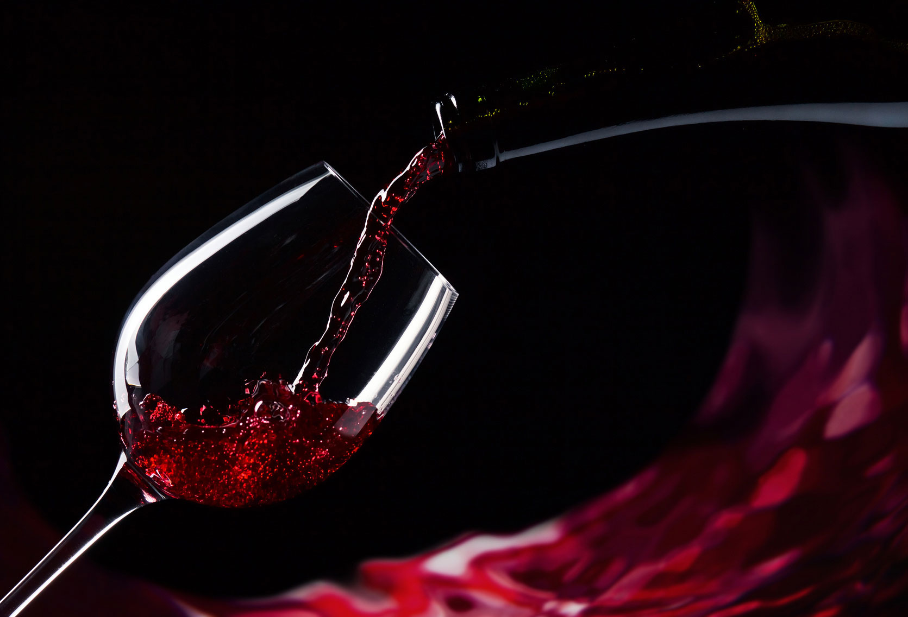
“Woe to those who call evil good, and good evil; Who put darkness for light, and light for darkness; Who put bitter for sweet, and sweet for bitter!”
Isaiah 5:20
Richie Thetford www.thetfordcountry.com

