Slide 1
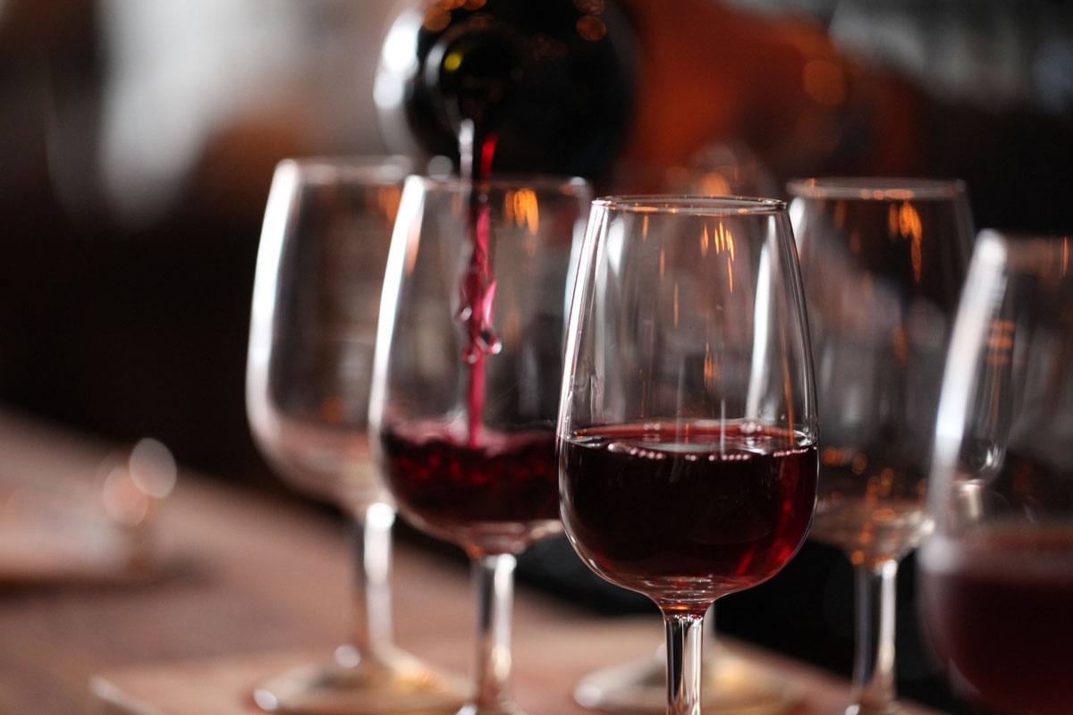
Wine
Richie Thetford www.thetfordcountry.com

Slide 2
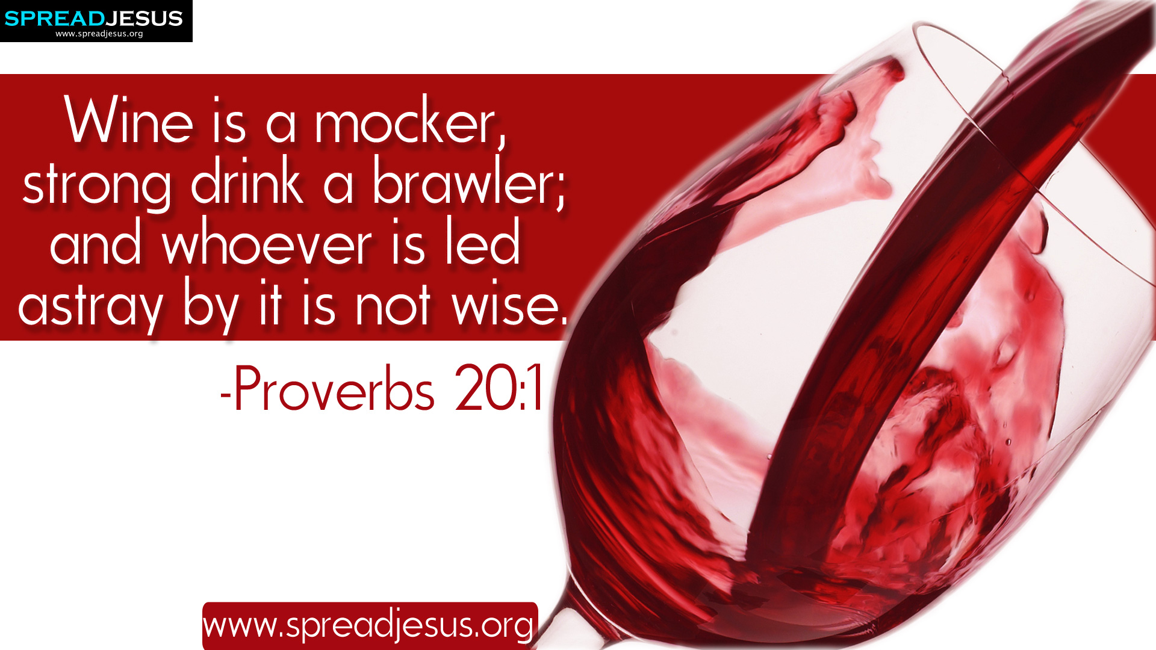
Introduction
What God says:
  Proverbs 20:1
  Proverbs 23:29-35
  1 Peter 4:3
Traditions or Doctrine?
  Matthew 15:8-9
  Acts 4:18-20
  1 Peter 2:21-22
  Colossians 3:17
Richie Thetford www.thetfordcountry.com

Slide 3
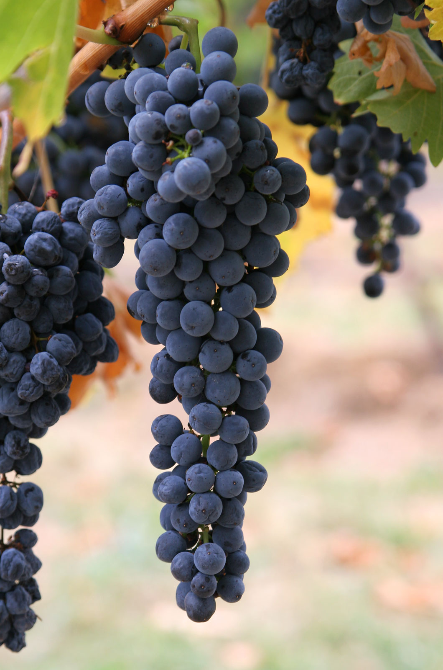
Does Bible “wine” mean “alcoholic wine?”
“Wine” is a generic term
  “the fruit of the grape”
  Could be fermented or unfermented
Context of the Bible passage shows us
how God intends for it to be used
Richie Thetford www.thetfordcountry.com

Slide 4
Does Bible “wine” mean “alcoholic wine?”
Generic Term | Items
Groceries | Bread, eggs, milk, sugar, flour, salt Soap, batteries, pens, paper
Automobile | Manufacturer Model, kind, size, color, interior
Furniture | Chair, couch Television, bookshelf, piano
Music | Vocal, instrumental, or both Rock, country, religious
Wine | Fermented, unfermented
Richie Thetford www.thetfordcountry.com

Slide 5
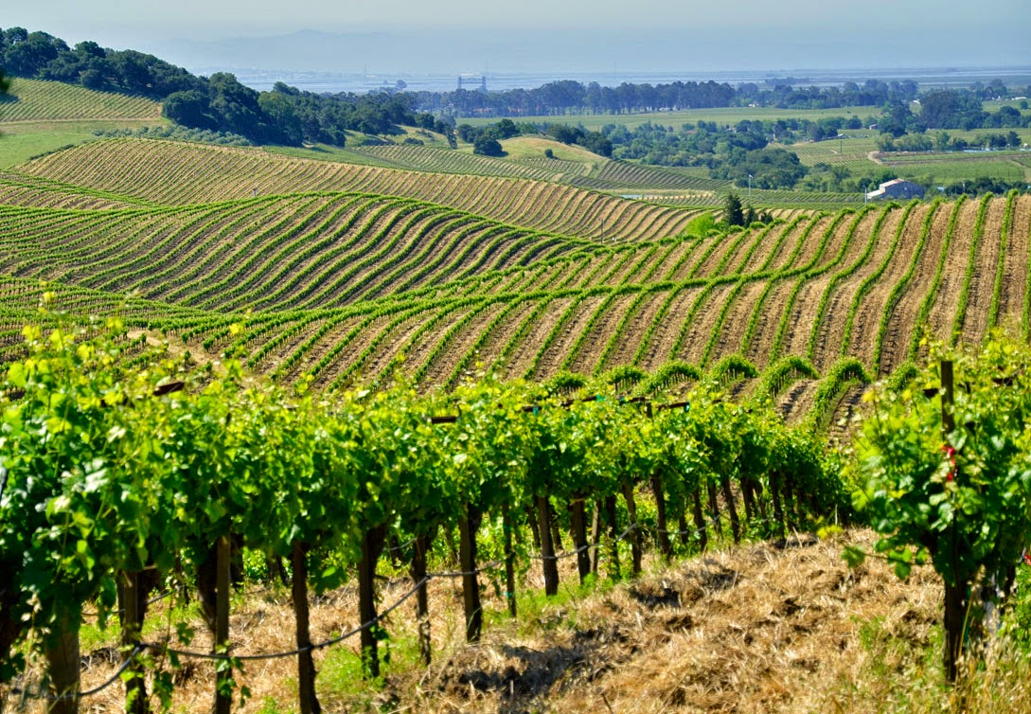
Does Bible “wine” mean “alcoholic wine?”
Other examples of “wine”
  John 19:29-30
  Isaiah 27:2
  Nehemiah 5:18
A mistake to assume that
the word “wine” refers to
an alcoholic drink unless
context shows that it does
Richie Thetford www.thetfordcountry.com

Slide 6
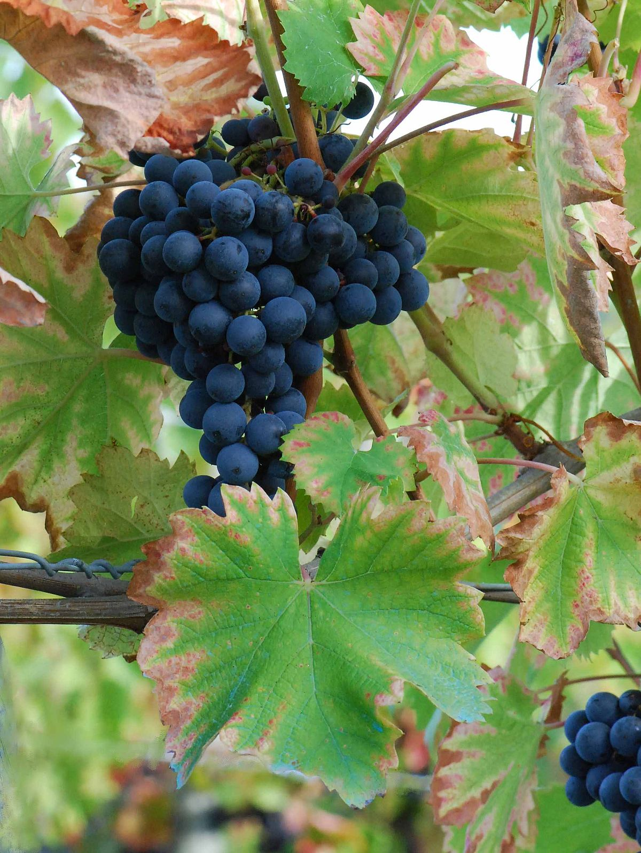
Apples to Apples
Are those who justify social drinking
actually drinking “wine” or “strong drink?”
  Fermented wine in ancient Palestine
  contained not over 5 to 8 percent alcohol
  In our society brandy, rum, whisky and gin
  contain 50% or more alcohol
Modern-day alcoholic drinks cannot
be compared to the fermented wine
in Bible times
Richie Thetford www.thetfordcountry.com

Slide 7
Apples to Apples
Alcoholic Content in Most Modern-Day Wines
Wine | Content
Wine Coolers | 4-7%
Table Wine (general) | 8-14%
White, dry | 11%
White, sparkling | 12%
White, sweet | 12.4%
Cabernet | 11-14%
Dessert Wine | 14-20%
Zinfandels | 17-22%
Vermouth | 17-22%
Port Wine | 20%
Richie Thetford www.thetfordcountry.com

Slide 8

Strong Drink
Don’t confuse “wine” with “strong drink”
  God considers wine and strong drink
  distinct from one another
“Strong drink” – intoxicating beverage
  Leviticus 10:9
  1 Samuel 1:15
  Proverbs 20:1
  Luke 1:15
Would a true Christian be in favor of partaking in something God condemns?
Richie Thetford www.thetfordcountry.com

Slide 9
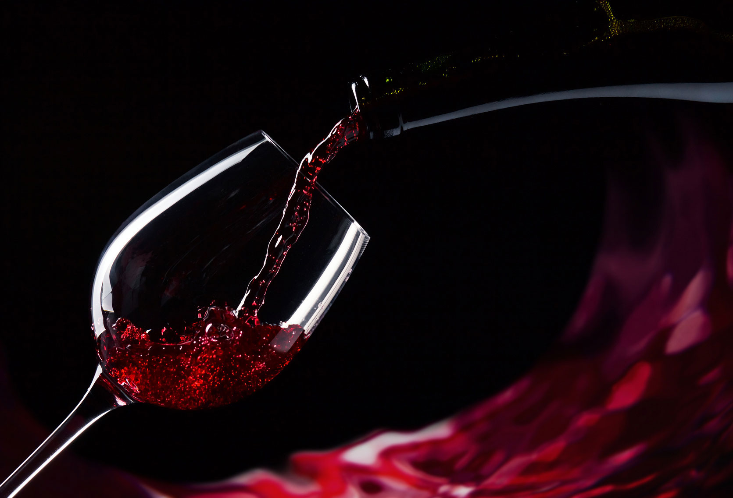
“Woe to those who call evil good, and good evil; Who put darkness for light, and light for darkness; Who put bitter for sweet, and sweet for bitter!”
Isaiah 5:20
Richie Thetford www.thetfordcountry.com

