Slide 1
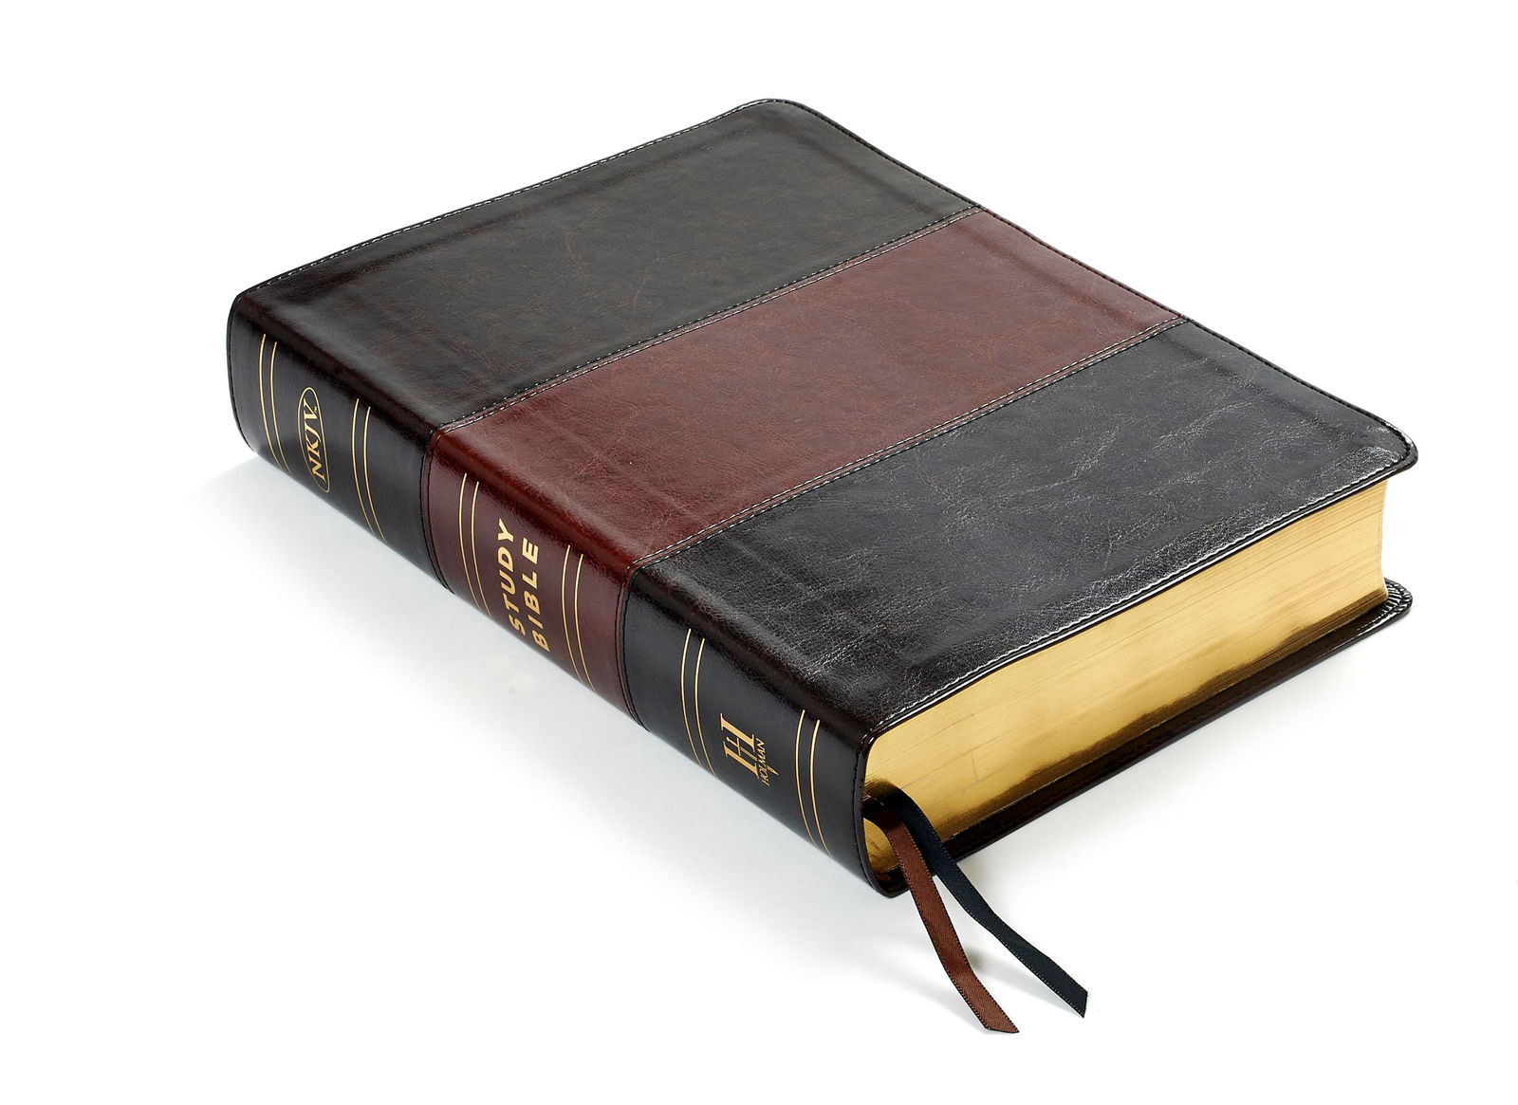
Why Obey the Gospel of Christ?
Acts 2:40-41
Richard Thetford www.thetfordcountry.com

Slide 2
Those Who Do Not Will Miss the Joy of Being a Christian
Godliness profits us now and later
1 Timothy 4:8
Mark 10:29-31
Joy of our relationship
Acts 20:36-38
1 Thessalonians 2:19-20
Richard Thetford www.thetfordcountry.com

Slide 3
Those Who Do Not Will Miss the Joy of Being a Christian
Joy of being a Christian
Acts 16:25
Acts 16:34
The Christian can…..
“rejoice in the Lord always” (Philippians 4:4)
Richard Thetford www.thetfordcountry.com

Slide 4
Those Who Do Not Cannot Say They Love God
To love God is to keep His commandments
John 14:15
John 14:23
To love God is to show our gratitude
1 John 4:9-10
Richard Thetford www.thetfordcountry.com

Slide 5
Those Who Do Not Are Lost
What Jesus came to do….
Luke 19:10
Jesus calls on us to obey
Matthew 23:37-39
Obedience is necessary
2 Thessalonians 1:7-9
Richard Thetford www.thetfordcountry.com

Slide 6
Those Who Do Not Will Miss Heaven
Heaven – a place of rest
Revelation 14:13
No sorrow, no death
Revelation 21:1-8
Heaven – in God’s presence
Revelation 22:5
Richard Thetford www.thetfordcountry.com

Slide 7
Conclusion
Alternatives
Romans 2:6-11
Jesus’ invitation to all
Matthew 11:28-30
Richard Thetford www.thetfordcountry.com

Slide 8
How to obey – in order to be saved
Hear – Romans 10:17
Believe – Hebrews 11:6
Repent – Luke 13:3
Confess – Matthew 10:32
Be baptized – Acts 2:38; Mark 16:16
Live faithfully – Revelation 2:10
Richard Thetford www.thetfordcountry.com

