Slide 1

Why I Left
The Institutional church of Christ
“And you shall know the truth, and the truth shall make you free.”
John 8:32

Slide 2
Why I Left
The Institutional church of Christ
3
Things are Necessary
to Obedience to God
Study
Learn the truth
Put it into practice

Slide 3
Why I Left
The Institutional church of Christ
What we have been taught may NOT be right
  Must change when we know the truth
  Acts 17:11
Lessons Learned

Slide 4
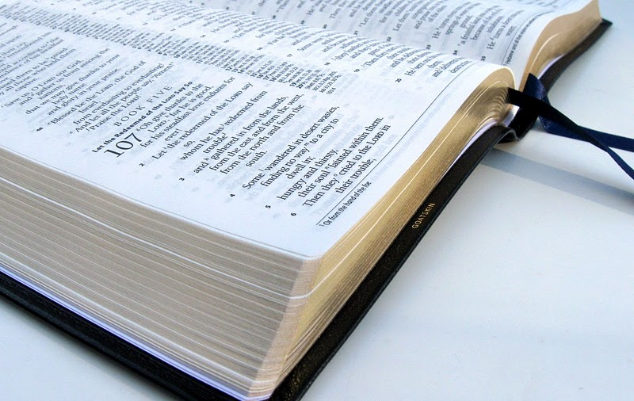
Why I Left
The Institutional church of Christ
There’s
Only
Book, Chapter, Verse
1
In Context
Difference

Slide 5
UNDERSTANDING
Why I Left
The Institutional church of Christ
Respect for Bible Authority
  2 Peter 1:20-21
Knowing what “Expediency” is
  “suitability for a given purpose; appropriateness to the conditions” (webster)
    For a thing to be “expedient”
    it must first be lawful

Slide 6
UNDERSTANDING
Why I Left
The Institutional church of Christ
Fellowship Halls, Recreation, Entertainment
  Not a work of the church
    Churches try to accommodate
    man’s social needs
    Where is Bible Authority for
    churches to build and maintain
    so called “fellowship halls” and
    activity centers?

Slide 7
UNDERSTANDING
Why I Left
The Institutional church of Christ
The Benevolent work of the church is restricted to “saints”
  What does the Bible teach?
    Church operates in the area of
    limited benevolence (saints)
    Church operates in the field of
    unlimited benevolence (anyone)

Slide 8
The Benevolent Work of the Church
Scripture | Relieved |  |  | Administered Relief
 | Saint | Alien | Orphan | Local Church | Spons Church | Benev Society
Acts 2:44-45 | X |  |  | X
Acts 4:32-35 | X |  |  | X
Acts 6:1-6 | X |  |  | X
Acts 11:27-30 | X |  |  | X
Rom 15:25-32 | X |  |  | X
1 Cor 16:1-3 | X |  |  | X
2 Cor 8:1-4, 13-14 | X |  |  | X
2 Cor 9:1, 12-13 | X |  |  | X
1 Tim 5:16 | X |  |  | x

Slide 9
New Testament Benevolence
Individual | Church To Its Own | Church To Church(es) | Church to Benevolent Org/Sponsoring Church
Matt 5:43-48 | Acts 2:44-45 | Acts 11:27-30 | ?
Matt 25:35-40 | Acts 4:32-35 | Rom 15:25-32 | ?
Luke 10:30-37 | Acts 6:1-6 | 1 Cor 16:1-3 | ?
Acts 9;36-39 | 1 Tim 5:16 | 2 Cor 8 | ?
Acts 20:34-35 |  | 2 Cor 9 | ?
1 Cor 16:15 |  |  | ?
Eph 4:28 |  |  | ?
1 Tim 5:4, 16 |  |  | ?
1 Tim 6:17-18 |  |  | ?
James 1:26-27 |  |  | ?
James 2:15-18 |  |  | ?
1 John 3:17-18 |  |  | ?
God’s Word PROVES That This IS Unquestionably Right!

Slide 10
UNDERSTANDING
Why I Left
The Institutional church of Christ
Knowing there is a scriptural plan for church cooperation
  A look at both plans:

Slide 11
The UNscriptural Plan
Local
Church
Sponsoring
Church
Evangelism
Benevolence
Edification
Local
Church
over
Local
Church

Slide 12

The scriptural Plan
Members
Evangelism
Worship
Benevolence
Discipline
Every
Local
Church
Over its own
1 Timothy 3:5; Acts 20:28; 1 Peter 5:2;
Hebrews 13:17; 1 Timothy 5:17

Slide 13
Why I Left
The Institutional church of Christ
Consider the cost of discipleship
Luke 9:23; Matthew 10:34-39
Study
  2 Timothy 2:15
Learn the Truth
  John 8:32
Practice the Truth
  Matthew 7:21
“And you shall know the truth, and the truth shall make you free.”
John 8:32

