Slide 1
Why Do People Blame God?
Job 10:1-13
Richie Thetford www.thetfordcountry.com

Slide 2

They Don’t Know There Is
Someone Else to Blame
Satan is man’s adversary
  John 8:44
We must resist him
  1 Peter 5:8-9
Richie Thetford www.thetfordcountry.com

Slide 3

People Don’t Take Responsibility
We are each responsible
for our own life
  Galatians 6:7-8
Richie Thetford www.thetfordcountry.com

Slide 4
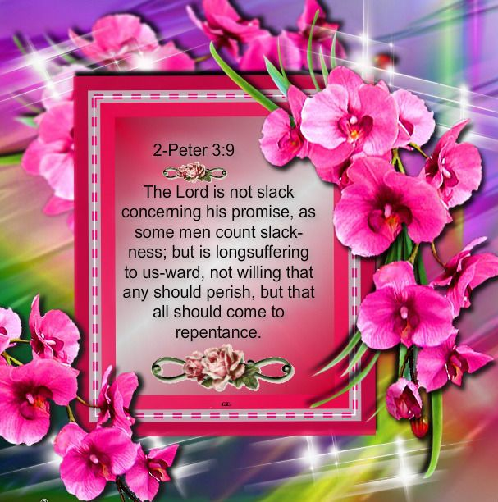
God is an Easy Target
They forget about God’s
longsuffering
  2 Peter 3:9-12
We will have to give an
account of our actions
  Acts 17:30-31
Richie Thetford www.thetfordcountry.com

Slide 5

Some Don’t Believe in Free-will,
So God is to Blame
Bible is truth – choose
between right and wrong
  Deuteronomy 30:19
  Joshua 24:15
  Matthew 7:13-14
Richie Thetford www.thetfordcountry.com

Slide 6
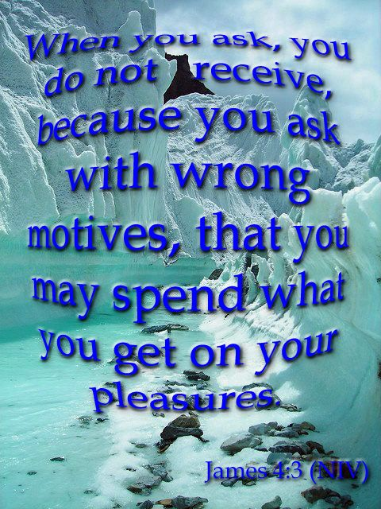
Many Believe That God
Must Fix Their Problems
Based on a false understanding
  John 16:23
Fail to realize – no blank check
  James 4:3
  1 John 5:14
  2 Corinthians 12:7-9
Richie Thetford www.thetfordcountry.com

Slide 7

God is Responsible for Everything
God’s responsible for the good
  James 1:17
God not responsible for the evil
  Romans 2:6-11
Richie Thetford www.thetfordcountry.com

Slide 8
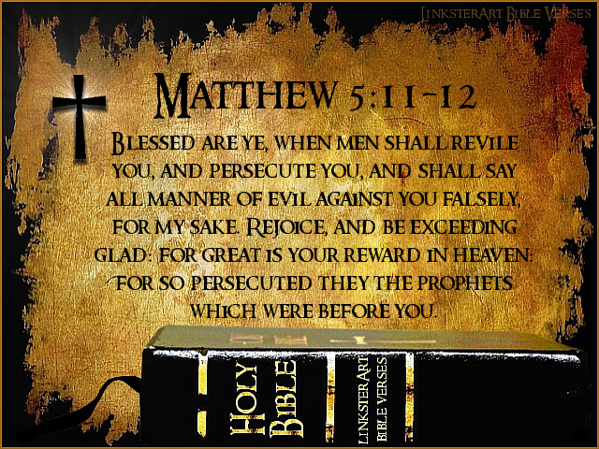
People Make Wrong Assumptions
Jesus told His disciples
to rejoice
  Matthew 5:11-12
The Apostle Paul’s
pleasure
  2 Corinthians 12:9-10
Richie Thetford www.thetfordcountry.com

Slide 9

People Forget to Praise God
God is only worthy of praise
  Psalms 18:3
  Revelation 4:11
Richie Thetford www.thetfordcountry.com

Slide 10
Why Do People Blame God?
Job 10:1-13
Richie Thetford www.thetfordcountry.com

