Slide 1
Why Am I Here?
Richie Thetford www.thetfordcountry.com

Slide 2
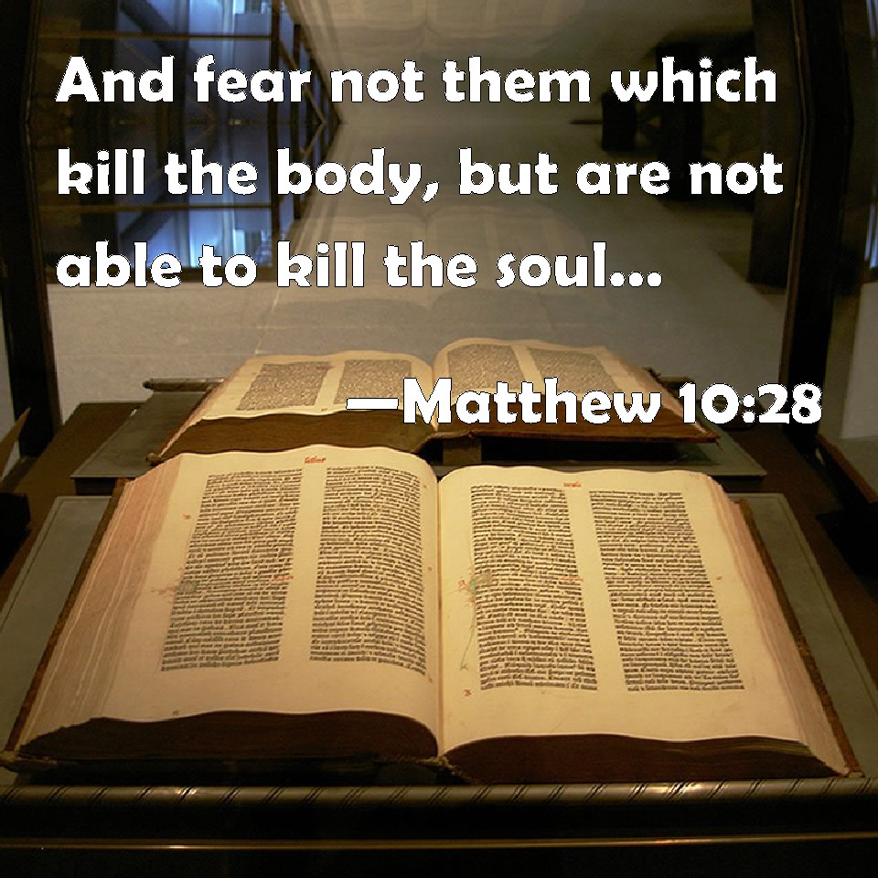
Life is More Than Physical Existence
Made in the Image of God
Genesis 1:26-27
Man possesses a soul
Matthew 10:28
Hebrews 12:9
Ecclesiastes 12:7
Richie Thetford www.thetfordcountry.com

Slide 3
Material Possessions
Success is often gauged by what one has
Luke 12:15
Matthew 16:26
Matthew 6:25
The Bible teaches that we are here for a purpose and God has told us what our purpose in life really is
Richie Thetford www.thetfordcountry.com

Slide 4
My Purpose in Life
To Glorify God
John 3:16
1 Corinthians 6:20
To Magnify Christ
Philippians 1:20
John 5:23
Richie Thetford www.thetfordcountry.com

Slide 5
My Purpose in Life
To Help Others
Galatians 6:10
Romans 15:1
To Prepare for Heaven
1 Peter 1:3
Glorify God
Magnify Christ
Help Others
Prepare for Heaven
Richie Thetford www.thetfordcountry.com

