Slide 1

Who is Able to Stand?
Revelation 6:17
Richie Thetford www.thetfordcountry.com

Slide 2
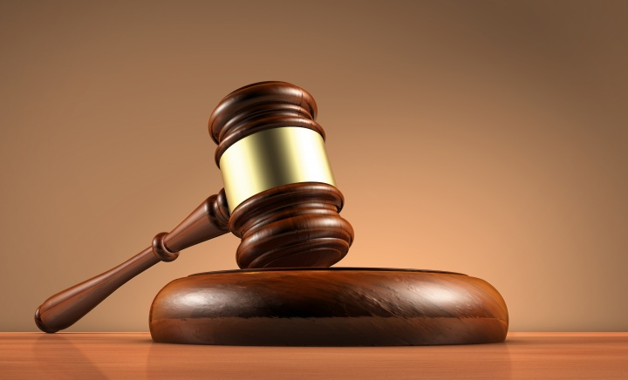
Judgment coming for all men
Hebrews 9:27
Hebrews 10:27
Acts 17:31
Richie Thetford www.thetfordcountry.com

Slide 3

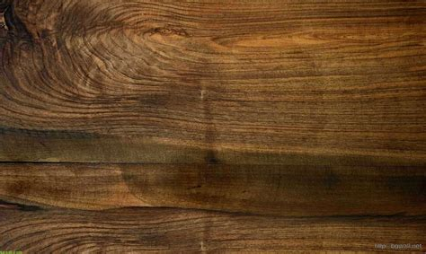
Necessity of a Standard
Various standards
Bible standard at the judgment
  John 12:48
  Matthew 24:35
Richie Thetford www.thetfordcountry.com

Slide 4
All Are Tested
Division
  Luke 12:51-53
The test for sinners
  Matthew 19:16-22
  Ruth 1:16-17
  Luke 14:26-27
Test for children of God
  Genesis 22:1-12
  1 Kings 19:1-18
  Matthew 4:1-11
  Hebrews 12:9-11
Richie Thetford www.thetfordcountry.com

Slide 5
Why the Day is Great
The end of time
  2 Peter 3:10-13
The great resurrection
  John 5:28-29
A great change will take place
Richie Thetford www.thetfordcountry.com

Slide 6
Who Will Stand?
Not unbelievers
  Hebrews 11:6; Luke 12:46
Not the impenitent
  Luke 13:3; Acts 17:30-31
Not the unbaptized
  Mark 16:16; Acts 2:38
Not the backsliders
  Hebrews 6:4-6; 2 Peter 2:20-21
Richie Thetford www.thetfordcountry.com

Slide 7

Who Will Stand?
Not the disobedient
  Matthew 7:21; Hebrews 5:8-9;
  2 Thessalonians 1:8-9
Only the faithful will be
able to stand before Jesus
  Revelation 2:10
  Matthew 24:12-13
  Revelation 14:13
Richie Thetford www.thetfordcountry.com

Slide 8
Results of the Test
Condemnation to those who fail
  Matthew 25:46
  Revelation 14:9-11; 20:10
Eternal bliss to those who pass
  Matthew 5:12
  2 Corinthians 4:17
  Romans 8:16-17
Richie Thetford www.thetfordcountry.com

Slide 9
Who is Able to Stand?
2 Timothy 4:6-8
Richie Thetford www.thetfordcountry.com

