Slide 1

Who We Are
Psalms 139:14
Richard Thetford www.thetfordcountry.com

Slide 2

Who We Are
Think consciously
and carefully
  Proverbs 23:7
  Matthew 12:33-37
  Mark 7:20-23
  Proverbs 4:23
Richard Thetford www.thetfordcountry.com

Slide 3
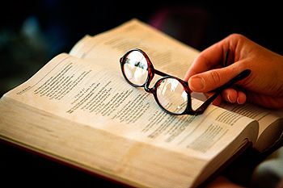
Who We Are
Elements are a part of who we are
  Family
  Physical characteristics – 1 Corinthians 6:19-20
  Conduct – Colossians 3:17
  Thoughts – Philippians 4:8
  Values – John 7:24; 1 Corinthians 3:1-4
  Character – 2 Peter 1:2-7
Richard Thetford www.thetfordcountry.com

Slide 4
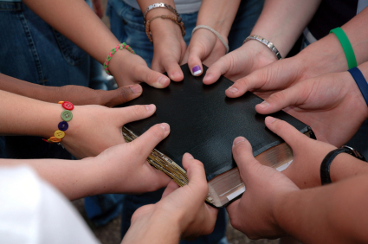
Who We Are
Inward person that is most significant
  1 Samuel 16:7
  1 Peter 3:4-5
  Romans 2:28-29
Combination of qualities
  No two people possess these
Richard Thetford www.thetfordcountry.com

Slide 5
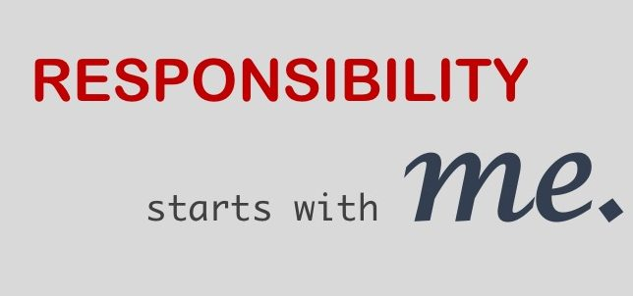
Taking Responsibility for Who We Are
Society’s view
Bible’s teaching
  Luke 10:42
  Joshua 24:15
  1 Kings 18:21
  Romans 12:2
  Colossians 3:1-2
Richard Thetford www.thetfordcountry.com

Slide 6
Taking Responsibility for Who We Are
Responsible for who we are
We are able to choose:
  Thoughts, decisions, emotions
  Knowledge, aptitudes, skills
  Beliefs, attitudes, values, ideals
  Personality, reputation, character
  Eternal destiny and happiness
Ecclesiastes 11:9-10
Richard Thetford www.thetfordcountry.com

Slide 7

Being Who We Are
Happiness and joy come from integrity
  John 13:17
  James 1:25
  James 4:17
“To thine own self be true”
We need to be the very best “WE” can be
Richard Thetford www.thetfordcountry.com

Slide 8
Conclusion
“If a man hasn’t discovered something that
he will die for, he isn’t fit to live”
--- Martin Luther King Jr.
“Would the little boy you were
be proud of the man you are?
--- Walt Disney
Ecclesiastes 12:1
Richard Thetford www.thetfordcountry.com

