Slide 1
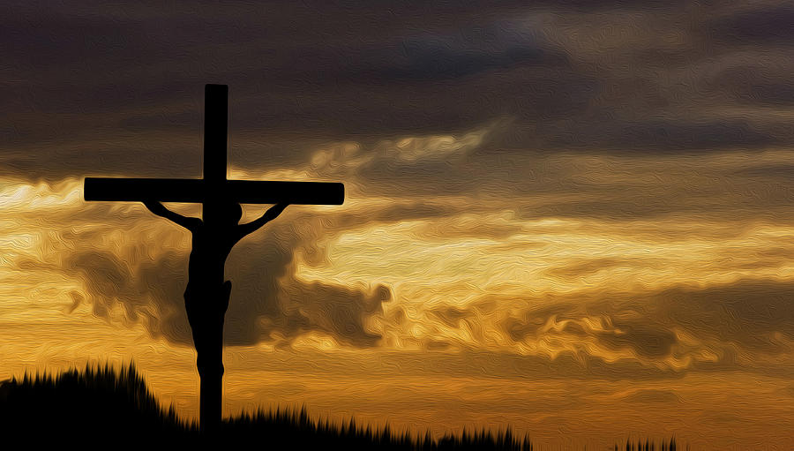
Who Was Responsible for Killing Jesus?
Richard Thetford www.thetfordcountry.com

Slide 2
The Jews had no authority to put one to death
  John 18:28-31
Pilate gave orders for Christ to be crucified
  John 19:16-18
Roman soldiers carried out the actual crucifixion
  Matthew 27:26-31
The Death of Jesus
The Romans Were Responsible For Killing Jesus
Richard Thetford www.thetfordcountry.com

Slide 3
The Jews carried the greater guilt
  John 19:10-15
The Jews accepted responsibility for their actions
  Matthew 27:22-25
Paul laid blame for Jesus’ death on the Jews
  1 Thessalonians 2:14-15
The Death of Jesus
The Jews Were Responsible For Killing Jesus
“...On you may come all the righteous blood shed on the earth.” (Matt 23:32-36)
Richard Thetford www.thetfordcountry.com

Slide 4
It was according to the Father’s purpose
Note Peter’s sermon on Pentecost
  Acts 2:22-23
  Acts 4:27-28
Jesus was delivered by the determined purpose and foreknowledge of God
The Death of Jesus
God Was Responsible For Allowing
Jesus’ Death
Richard Thetford www.thetfordcountry.com

Slide 5
Jesus had the power to deliver Himself – yet it was His own will that He die for the sins of the world
  John 10:11-18
He came to minister and to
give His life
  Matthew 20:28
He became obedient to death
  Philippians 2:8
The Death of Jesus
Jesus Himself Was Responsible For His Own Death
Richard Thetford www.thetfordcountry.com

Slide 6
He was bruised because of our iniquities
  Isaiah 53:5, 8, 10-12
  1 Peter 2:24
  Hebrews 9:25-28
  Hebrews 10:10-14
Those who refuse to obey, consider the death of Jesus as unholy
  Hebrews 10:26-29
The unfaithful crucify Him again
  Hebrews 6:4-6
The Death of Jesus
You and I Are Responsible For
Killing Jesus
Richard Thetford www.thetfordcountry.com

Slide 7
Who Was Responsible for Killing Jesus?
The Romans crucified Him
The Jews demanded that He die
God sent His Son to die for us
Jesus willingly died to redeem us from sin
All of us – because we are sinners, must bear responsibility for Jesus’ death
Richard Thetford www.thetfordcountry.com

