Slide 1
Who Can Be Saved?
Richard Thetford www.thetfordcountry.com

Slide 2
Who Cannot Be Saved?
One who makes money their god
1 Timothy 6:9-10
The immoral person
Galatians 5:19-21
The self-righteous
Matthew 5:20; 18:3
Luke 18:9-14
Romans 10:1-2
Richard Thetford www.thetfordcountry.com

Slide 3
Who Cannot Be Saved?
The uncharitable
James 1:27
He who turns away from Jesus
John 6:66-67
Acts 4:11-12
Richard Thetford www.thetfordcountry.com

Slide 4
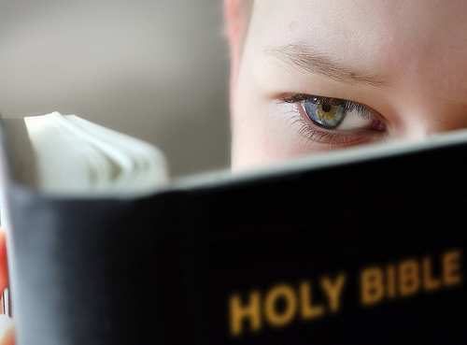
Who Can Be Saved?
The obedient
James 2:14, 17
Acts 9:6; 16:30-33
The one who will act now
2 Corinthians 6:2
John 9:4
Luke 12:16-20
Richard Thetford www.thetfordcountry.com

Slide 5
Who Can Be Saved?
The merciful
Matthew 5:7
The one who seeks God now
Isaiah 55:6
God’s plan of salvation
Hear, believe, repent, confess be baptized and live faithful
Richard Thetford www.thetfordcountry.com

