Slide 1
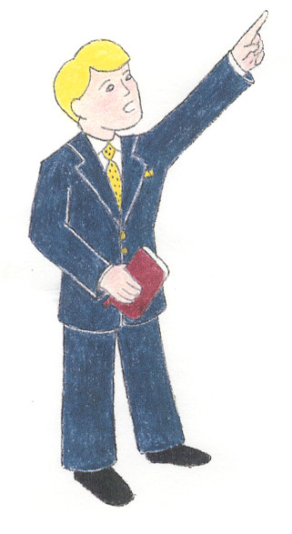
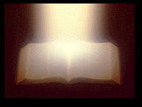
Where Millions Miss
“the way”
“…but he who does the will
of My Father in heaven.”
Matthew 7:13-14
John 14:6
Matt 7:21

Slide 2
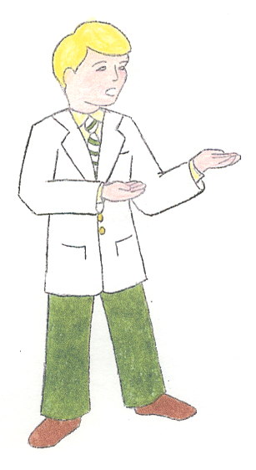
Where Millions Miss
“the way”
God as Creator
The Flood
Virgin Birth
Genesis 1:1
Genesis 6
Matthew 1:22-23

Slide 3
Where Millions Miss
“the way”
God’s Son
Faith
Godly Sorrow
Matthew 3:16-17
John 1:12
2 Corinthians 7:10

Slide 4


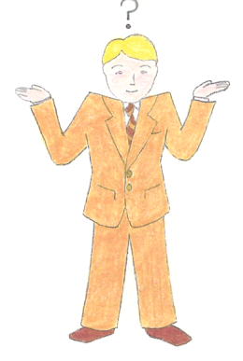
Where Millions Miss
“the way”
LIFE
Sp Growth
Rev 2:10
2 Pet 1:5-11
Baptism
Mark 16:16
Acts 2:41, 47;
1 Cor 12:13
Confession
Rom 10:9-10
Repentance
Acts 2:38
Preacher
said so
Unfaithful
Matt 13:41-42
Faith Only
Thoughts
Feelings
Join Ch of Choice
D
EATH
ESTRUCTION
AMNATION
EVIL’S HELL
Jam 2:24
Isa 55:8-9
Prov 28:26; Heb 2:1;
Matt 16:18
“a way that seems right” Prov 14:12

