Slide 1
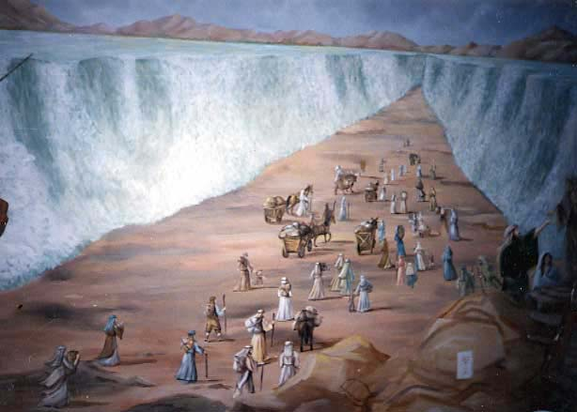
“When That Which Is Perfect Has Come”
1 Corinthians 13:8-13
The
Purpose
of
Miracles
To show man that GOD is the one behind the events
  Exodus 6:6-7; 7:5, 17
    Parting of the Red Sea
    The Flood, Babel, Plagues of Egypt, Fall of Jericho

Slide 2
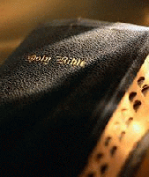
“When That Which Is Perfect Has Come”
1 Corinthians 13:8-13
Gifts of the Holy Spirit
How were they given?
  Direct laying on of the apostles hands
    Acts 8:14-18; 19:6; Romans 1:11; 2 Timothy 1:5-6
What was their purpose?
  To bring people to faith in Christ
    1 Corinthians 2:4-5
  To edify the Church
    1 Corinthians 14:12, 26

Slide 3
“When That Which Is Perfect Has Come”
1 Corinthians 13:8-13
Miraculous Gifts will Cease
(Verse 8)
There will be a time when they will:
  FAIL
  CEASE
  VANISH
When will they
“be done away?”

Slide 4
“When That Which Is Perfect Has Come”
1 Corinthians 13:8-13
“When that which is perfect
has come…” (Verses 9-10)
“For we know in part and we prophesy in part. But when that which is perfect has come, then that which is in part will be done away.”
“perfect” (teleios)
that which grows to completeness or wholeness

Slide 5
“When That Which Is Perfect Has Come”
1 Corinthians 13:8-13
“in part” (Verse 10)
Prophecy
Tongues
“when that which is perfect has come…”
John 16:13
2 Peter 1:2-3
Knowledge

Slide 6
“When That Which Is Perfect Has Come”
1 Corinthians 13:8-13
Paul’s Analogy of
Child to man (Verse 11)
“When I was a child, I spoke as a child, I understood as a child, I thought as a child; but when I became a man, I put away childish things.”
Children need help as they grow
God has given us help so we can grow
(Ephesians 4:11-16)

Slide 7
“When That Which Is Perfect Has Come”
1 Corinthians 13:8-13
The Mirror (Verse 12)
Dim outline of God’s will
  James 1:25
Perfect law tells us all we need to know
  2 Peter 1:2-3; 2 Tim 3:16-17
Ultimate purpose summed up by John
  John 20:30-31
“For now we see in a mirror, dimly, but then face to face. Now I know in part, but then I shall know just as I also am known.”

Slide 8
“When That Which Is Perfect Has Come”
1 Corinthians 13:8-13
What will abide?
(Verse 13)
“And now abide faith, hope, love, these three;
but the greatest of these is love.”
FAITH – will one day be realized
HOPE – will one day be realized
LOVE – will abide forever!

Slide 9
“When That Which Is Perfect Has Come”
1 Corinthians 13:8-13
“When that which is
perfect has come…”

