Slide 1
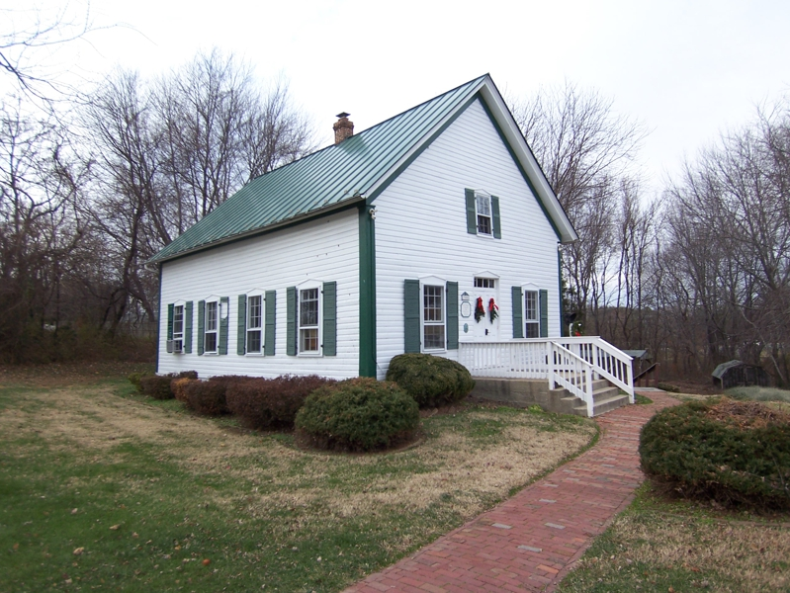
What Is the Church?
Richie Thetford www.thetfordcountry.com

Slide 2
The Word “church” in Scripture
It has significance
How it is applied to us today
Church means “ekklesia” – “the called out”
Applied in a spiritual sense
“I will build my church” – Matthew 16:18
A “called out” group
The “church” is His body
Colossians 1:18, 24
Ephesians 1:22-23
Richie Thetford www.thetfordcountry.com

Slide 3
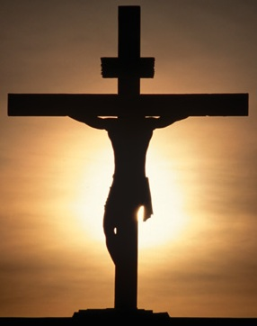
The Word “church” in Scripture
Christ’s blood was shed for ALL people
Matthew 26:28
Hebrews 2:9
Hebrews 5:9
Only ONE church in scripture
Matthew 16:18
Colossians 1:18
Ephesians 4:4
Richie Thetford www.thetfordcountry.com

Slide 4
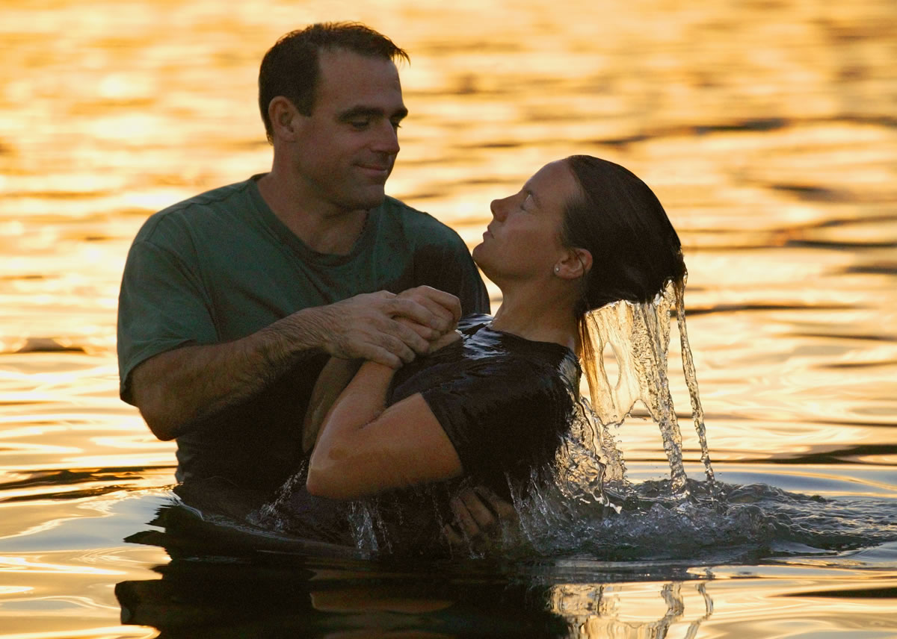
The “church” is the Body of Christ
The Lord must add you to His body
Acts 2:47
Baptized for the remission of sins
Acts 2:36-38, 41
Richie Thetford www.thetfordcountry.com

Slide 5
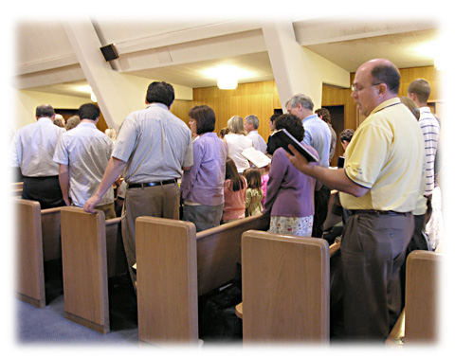
What Work Does the “church” Have on Earth?
The “church” in a congregational sense
Romans 16:16
Christians engage in worship to God
John 4:24
Acts 2:42
Acts 20:7
1 Corinthians 16:1-2
Ephesians 5:19
Richie Thetford www.thetfordcountry.com

Slide 6
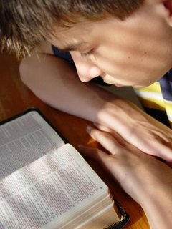
What Work Does the “church” Have on Earth?
Serving God through:
Evangelism
1 Thessalonians 1:8
Edification of the saints
Ephesians 4:11-12
Benevolence to the saints
Acts 11:28-30
We do this today!
2 Timothy 2:2
Richie Thetford www.thetfordcountry.com

Slide 7
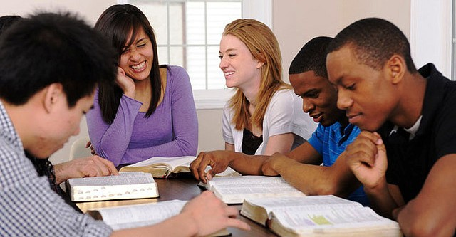
Conclusion
The “church” is far different than the world’s view
Must respect what Christ has founded
Has a specific work and must be doing it
The “church” is a spiritual relationship with a spiritual work
Romans 14:17
Those of us “in Christ” are an active part of the church that Jesus died for and purchased with His own blood.
Richie Thetford www.thetfordcountry.com

