Slide 1
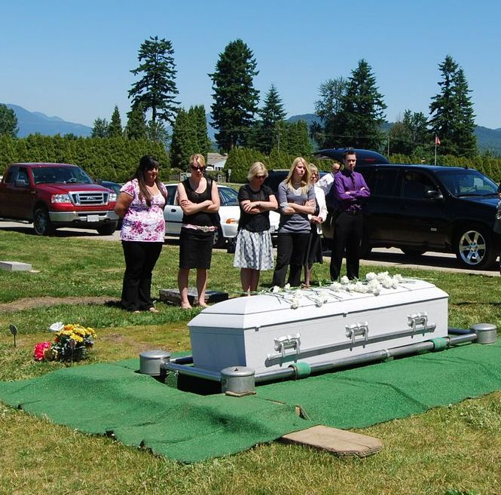
What Will Others Say About Us Over Our Grave?
Hebrews 9:27; Ecclesiastes 7:1-2

Slide 2
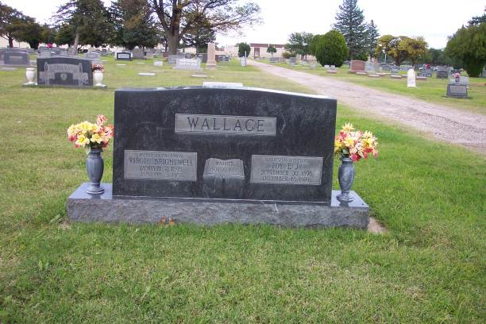
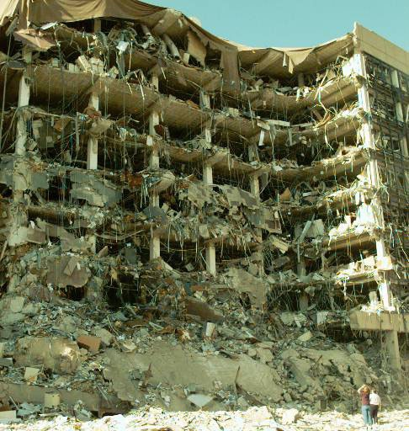
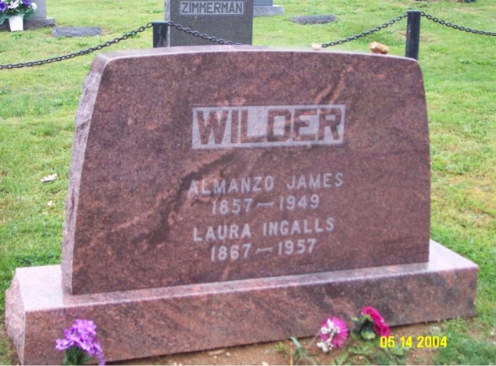
Foy E. Wallace Jr.
Alfred P. Murrah Federal Building
Laura Ingalls Wilder

Slide 3
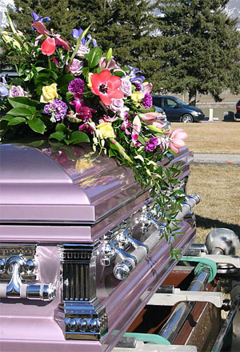
What Will Be Said of Us?
Did we have a positive impact on others?
Were we full of faith, courage, hope and perseverance?
Will others struggle to find good in us?
Were We A Devoted
CHRISTIAN?

Slide 4
Life Is A Book
Each day a page is written
The deeds of the day are the sentences forming the paragraphs
Our attitudes that we display are the punctuation marks
Each year marks a new chapter in our book
When death comes – the last chapter is finished and the book is complete

Slide 5
Life Is A Book
God keeps track of our deeds – we will be judged accordingly
2 Corinthians 5:10
We must strive to live in a way that our name will be added to God’s book of life
Revelation 3:5; 20:12, 15; 21:27
Matthew 7:21; Revelation 22:18-19

Slide 6
It’s Not Too Late to Be Added to the Book of Life
While we have life we can change
The apostle Paul did
Acts 8:1-3; 22:6-10, 16
We must recognize the wrong and turn our life to Christ
Believe (Hebrews 11:6)
Repent (Luke 13:3; Acts 17:30)
Confess (Romans 10:10)
Baptized (Acts 2:38; Mark 16:16)

Slide 7
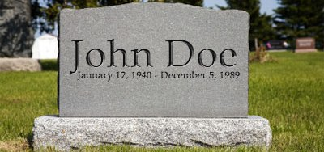
Without obedience to God’s will, there will be sadness in the hearts of those who stand over our grave
If we were to die today, would we be in the Lamb’s Book of Life?
And he said “Naked I came from my mother’s womb, and naked shall I return there. The LORD gave, and the LORD has taken away; blessed be the name of the LORD.” (Job 1:21)
Live a life of godliness being faithful to the Lord

