Slide 1
What Is truth?
John 18:33-38
Richie Thetford www.thetfordcountry.com

Slide 2

Not Mental Adjustment
Truth must abide through knowledge
  1 John 2:4
  Proverbs 14:12
  Jeremiah 10:23
  Mark 7:6-8
  2 Timothy 4:3-4
Richie Thetford www.thetfordcountry.com

Slide 3
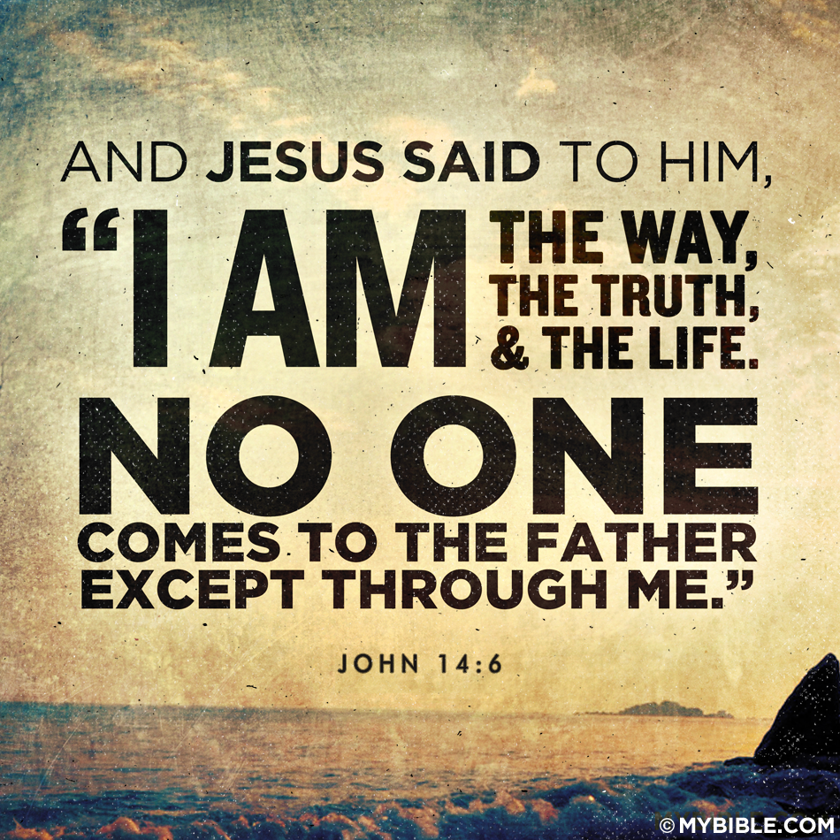
I Am the Truth
Jesus is the only way to salvation
  John 14:6
  John 1:14
  John 1:17
  Hebrews 6:18
  1 John 5:7
  John 16:13
  John 8:45-47
  John 18:36-37
Richie Thetford www.thetfordcountry.com

Slide 4
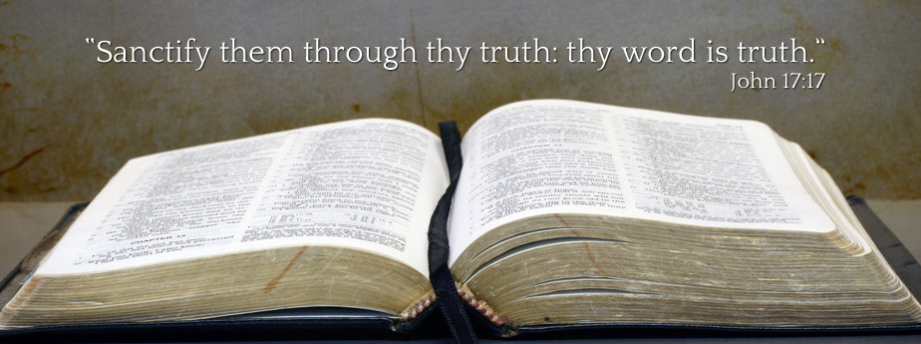
Your Word is Truth
Must listen to God’s Word
  John 17:17
  Psalms 119:142, 151
  Isaiah 25:1
  Daniel 4:27
  Romans 1:24-25
Richie Thetford www.thetfordcountry.com

Slide 5
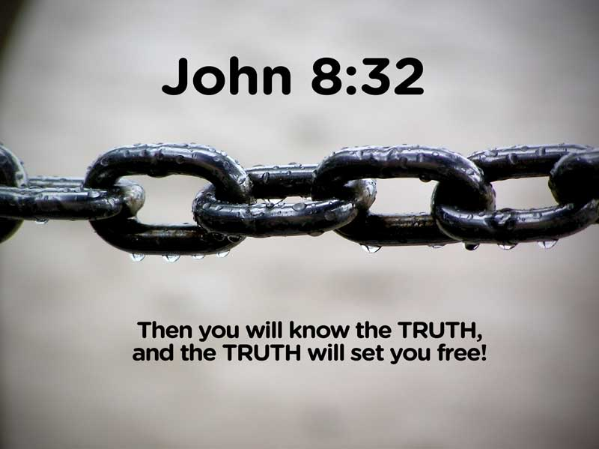
Church is the Pillar of Truth
Must present the truth
  1 Timothy 3:15
Truth Shall Make You Free
Can only be made free with the truth
  John 8:32
  Joshua 24:14
  2 Thessalonians 2:10
  2 Timothy 2:25-26
Richie Thetford www.thetfordcountry.com

Slide 6

Conclusion
Do you KNOW the truth?
Have you obeyed
the truth?
  Romans 1:18
  2 Thessalonians 2:12
“Have I therefore become your enemy because I tell you the truth?
Galatians 4:16
Richie Thetford www.thetfordcountry.com

