Slide 1

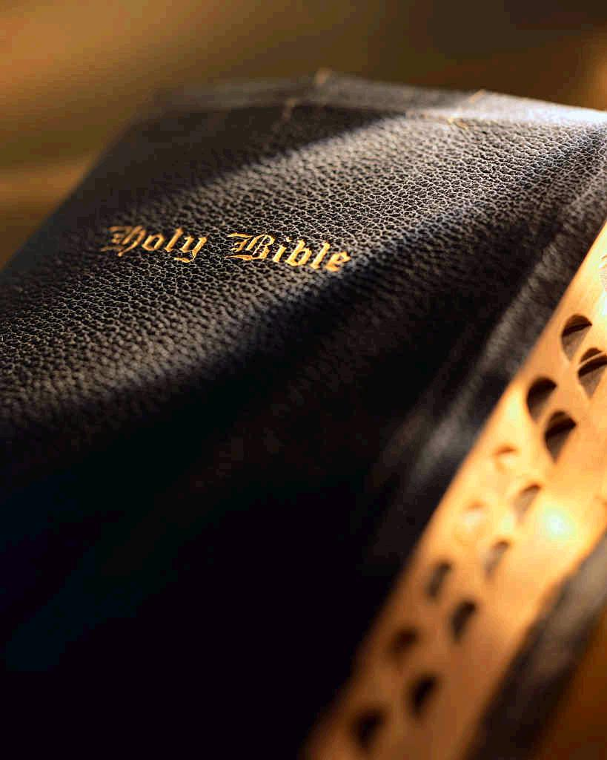
WHAT IF?
Richie Thetford www.thetfordcountry.com

Slide 2
WHAT IF?
God does exist?
The Bible really is His inspired Word?
My soul will survive the death of the body?
God really intends to punish the disobedient?
God does reward the obedient?
Hell is just as real as heaven?
Jesus really is the Son of God?
Jesus did die for my sins?
Jesus actually arose from the dead?
Jesus does come again?
Richie Thetford www.thetfordcountry.com

Slide 3
WHAT IF all these things are true and
I AM LOST?
I cannot blame God
  He made every provision for my salvation
    John 3:16; Titus 2:11-14
“For when we were still without strength, in due time Christ died for the ungodly. For scarcely for a righteous man will one die; yet perhaps for a good man someone would even dare to die. But God demonstrates His own love toward us, in that while we were still sinners, Christ died for us.”
Romans 5:6-8
Richie Thetford www.thetfordcountry.com

Slide 4
WHAT IF all these things are true and
I AM LOST?
I cannot blame Jesus Christ
  Jesus came into this world to save sinners
    1 Timothy 1:15
  Prophesied He would die a cruel death
    Isaiah 53:1-12
Richie Thetford www.thetfordcountry.com

Slide 5
WHAT IF all these things are true and
I AM LOST?
I cannot blame Jesus Christ
  He did it willingly!
    Philippians 2:5-11
  He left us with facts that must be believed and commandments that must be obeyed
    1 Corinthians 15:1-8
Richie Thetford www.thetfordcountry.com

Slide 6
I MUST REALIZE
God wants everyone to be saved
  When and how am I saved by the gospel?
  In keeping with the great commission
    Given by Jesus (Matthew 28:18-20)
“Then Crispus, the ruler of the synagogue, believed on the Lord with all his household. And many of the Corinthians, hearing, believed and were baptized.”
Acts 18:8
Richie Thetford www.thetfordcountry.com

Slide 7
I MUST REALIZE
That I am saved ONLY by obeying
the Words of Jesus
  John 14:15: “if you love me, keep my commandments”
    Hebrews 5:9
Richie Thetford www.thetfordcountry.com

Slide 8
I MUST REALIZE
  WHAT MUST I DO?
Hear Him
Believe Him
Repent of Sins
Confess Him
Be Baptized
Romans 10:17
Hebrews 11:6; Acts 17:30;
Romans 10:10; Acts 2:38; 22:16; Mark 16:16; 1 Peter 3:21
Richie Thetford www.thetfordcountry.com

Slide 9
I MUST REALIZE
That all spiritual blessings that I receive are found only in Christ
“Blessed be the God and Father of our Lord Jesus Christ, who has blessed us with every spiritual blessing in the heavenly places in Christ” Ephesians 1:3
Richie Thetford www.thetfordcountry.com

Slide 10
I MUST REALIZE
That all spiritual blessings that I receive are found only in Christ
  How do I come into the spiritual condition referred to as being “in Christ?”
    Romans 6:2-6
  No blessings for those who haven’t:
    Died to sin, been baptized, walk anew
Richie Thetford www.thetfordcountry.com

Slide 11
WHAT IF –
I Change and Obey?
“But God be thanked that though you were slaves of sin, yet you obeyed from the heart that form of doctrine to which you were delivered. And having been set free from sin, you became slaves of righteousness.” Romans 6:17-18
At the point I come into the saved relationship “in Christ”
  I am numbered among the saved in the church, the kingdom of Christ
    Colossians 1:13-14; Acts 2:40-41, 47
Richie Thetford www.thetfordcountry.com

Slide 12
WHAT IF –
I Change and Obey?
“But God be thanked that though you were slaves of sin, yet you obeyed from the heart that form of doctrine to which you were delivered. And having been set free from sin, you became slaves of righteousness.” Romans 6:17-18
When I am added to His body, the church, through baptism, then:
  I AM SAVED!
    1 Corinthians 12:13; Ephesians 5:23; Revelation 2:10
Richie Thetford www.thetfordcountry.com

Slide 13
WHAT IF –
I Change and Obey?
When Jesus comes again, I can have comfort that I will forever be with Him!
“For the Lord Himself will descend from heaven with a shout, with the voice of an archangel, and with the trumpet of God. And the dead in Christ will rise first.
Then we who are alive and remain shall be caught up together with them in the clouds to meet the Lord
in the air. And thus we shall always be with the Lord. Therefore comfort one another with these words.”
1 Thessalonians 4:16-18
Richie Thetford www.thetfordcountry.com

Slide 14
CONCLUSION
God, Christ, Holy Spirit
  Has made my salvation possible!
    Possible by Christ in ONE body
    Possible by His shed blood
Richie Thetford www.thetfordcountry.com

Slide 15
CONCLUSION
What if I am Lost?
  I can only blame MYSELF!
What if I am saved?
  I can and will be by
  obeying Jesus!
    2 Timothy 4:7-8
Richie Thetford www.thetfordcountry.com

