Slide 1

What Happens
When We Die?
Richie Thetford www.thetfordcountry.com

Slide 2
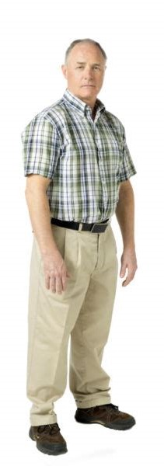
Life in the Flesh
Two parts of man
  Matthew 10:28; 16:26
  1 Thessalonians 5:23
Death separates the two parts
  Hebrews 9:27
  Ecclesiastes 12:7
  Acts 7:59
  James 2:26
  2 Peter 1:13-14
  2 Timothy 4:6
Spirit
Body
DUST
Ecclesiastes 12:7
GRAVE
John 12:17
SLEEP
1 Thessalonians 4:13f
Body
Richie Thetford www.thetfordcountry.com

Slide 3
The World (place of life)
The Spirit’s destination
  Saved – Paradise
    Acts 2:38, 42; 1 Peter 3:21
  Lost – Torment
    2 Thessalonians 1:7-8
    Matthew 7:21-23
Spirit
Richie Thetford www.thetfordcountry.com

Slide 4

The World (place of life)
The Spirit’s destination
  Saved – Paradise
    Acts 2:38, 42; 1 Peter 3:21
  Lost – Torment
    2 Thessalonians 1:7-8
    Matthew 7:21-23
Spirit
Matthew
7:13
D
E
A
T
H
The Saved
Narrow Gate
The Lost
Wide Gate
Matthew
7:14
Richie Thetford www.thetfordcountry.com

Slide 5

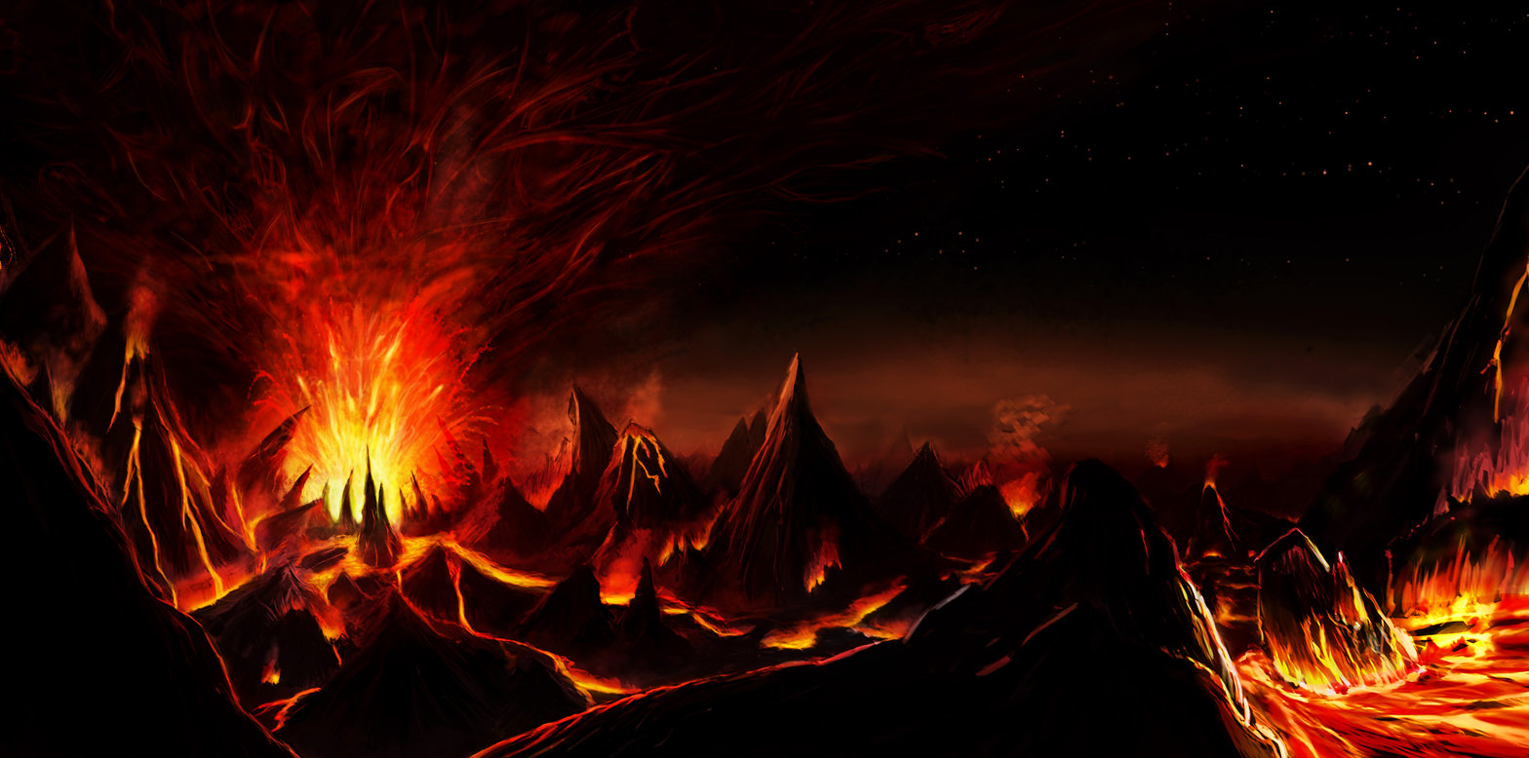
Luke 23:43
Acts 2:31
Philippians 1:21-23
Revelation 14:13
R
E
S
U
R
R
E
C
T
I
O
N
HADES
Body
PARADISE
Narrow
Gate
D
E
A
T
H
Luke 16:19-31
“Great Gulf Fixed” (Luke 16:26)
Luke 16:23
2 Peter 2:4
2 Peter 2:9
Jude 6
Wide
Gate
TORMENT
Richie Thetford www.thetfordcountry.com

Slide 6
The Resurrection
R
E
S
U
R
R
E
C
T
I
O
N
Warnings to prepare
  Romans 2:4-11
  Hebrews 10:28-31; 2:1-3
  2 Peter 3:9-14
Resurrection
  Luke 20:37-38
  John 5:28-29
  1 Corinthians 15:51-52
  1 Thessalonians 4:16
1 Corinthians
15:42-44
Richie Thetford www.thetfordcountry.com

Slide 7
R
E
S
U
R
R
E
C
T
I
O
N
REWARDED
Come
2 Corinthians 5:10
JUDGMENT DAY
Hebrews 9:27
John 12:48
Revelation 20:12-15
CONDEMNED
Depart
Richie Thetford www.thetfordcountry.com

Slide 8
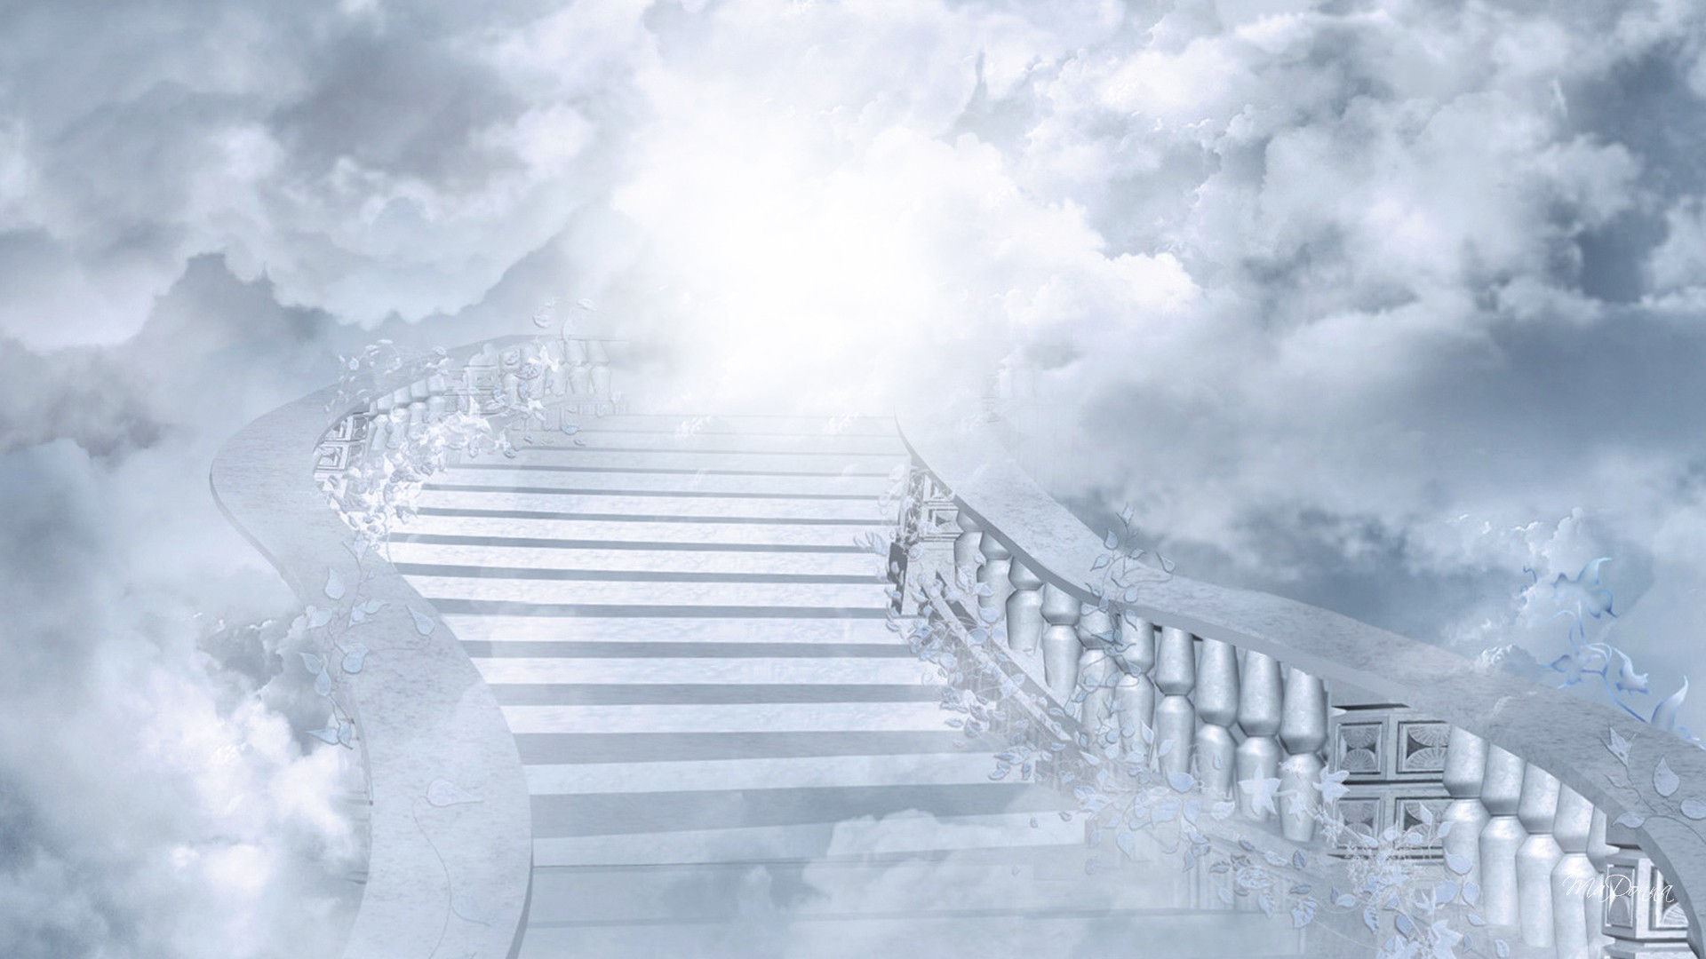
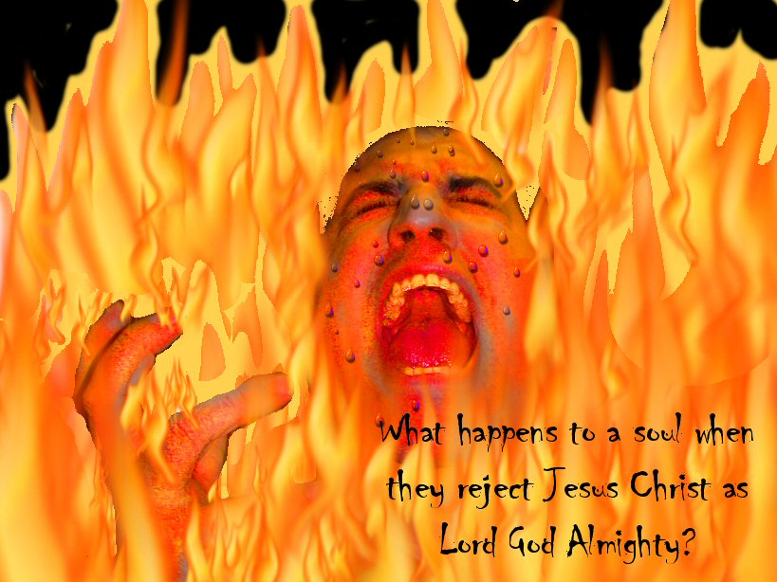
Revelation 21:1-7
Revelation 22:1-5
Matthew
REWARDED
Come
HEAVEN
25:34
JUDGMENT DAY
Matthew
CONDEMNED
Depart
HELL
25:41
Matthew 10:28
Mark 9:47-48
Matthew 25:30-46
Richie Thetford www.thetfordcountry.com

