Slide 1
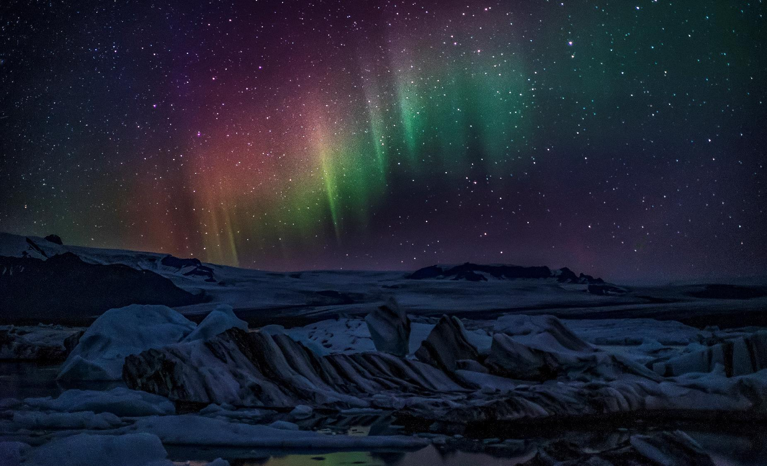
What Everyone Needs to Know About Jesus
Richie Thetford www.thetfordcountry.com

Slide 2

Jesus Does Not Want to Condemn You
Many see Christianity as the “religion of no”
Jesus said:
  John 12:47; John 3:17
Jesus loves every person
  Matthew 11:28-30; John 10:10;
  1 Timothy 2:4; 2 Peter 3:9;
  Jeremiah 31:3; John 13:1
Richie Thetford www.thetfordcountry.com

Slide 3
Jesus is God’s Answer to Man’s Sin
Sin is the greatest problem man has
  James 2:10; Romans 6:23
Someone had to die
  Isaiah 53:5-6
Animal sacrifice was only temporary
  Hebrews 10:4; Acts 13:23;
  John 3:16; 1 John 4:14; Hebrews 4:15
Richie Thetford www.thetfordcountry.com

Slide 4
Jesus is the Son of God
Must come to one of three conclusions
Jesus was the Son of God
  Acts 10:38
Richie Thetford www.thetfordcountry.com

Slide 5
Jesus is “One of Us” (Son of Man)
“And the Word became flesh and dwelt among us, and we beheld His glory, the glory as of the only begotten of the Father, full of grace and truth.” (John 1:14)
Jesus was miraculously conceived
  Matthew 1:23; Luke 1:35;
  Isaiah 7:14
Jesus lived a common life
for 30 years
Richie Thetford www.thetfordcountry.com

Slide 6
Jesus Was Crucified for Being Too Holy
Religious people killed Jesus
  Socialized with sinners (Mark 2:13-17)
  Healed on the Sabbath Day (Matthew 12:9-14)
  Drove money changers from the temple ( John 2:13-16)
  Accepted Worship (Matthew 9:18; 20:20)
Jesus made claims Jewish leaders
considered as blasphemy
  Would only be blasphemy if it were NOT true!
Richie Thetford www.thetfordcountry.com

Slide 7
Jesus Came Back to Life
Jesus lived again
  Died and was buried
  What happened to His body?
    Enemies stole the body
    Disciples stole the body
    He was resurrected
Richie Thetford www.thetfordcountry.com

Slide 8
Jesus Built the Church – Wants All to Belong
Only lasting institution from Jesus’ life is His church
  Matthew 16:18
Promise fulfilled on Pentecost
The church grew rapidly
The same church exists today
  Acts 2:47; 1 Corinthians 15:1-4
Richie Thetford www.thetfordcountry.com

Slide 9
Jesus Reigns Over the Whole World
Ascended to His throne
  Acts 1:9-11; Psalms 24:7-10;
  1 Timothy 6:15
There are places where His rule
is not recognized
  Revelation 3:20
Richie Thetford www.thetfordcountry.com

Slide 10
Jesus Will Judge Everyone
He will come in His glory!
  Matthew 25:31-33
We will all be there – be prepared
  John 12:48
Richie Thetford www.thetfordcountry.com

Slide 11
Jesus Wants Each Person to Follow Him
He really does want to save you
  Matthew 11:28-30
Only Jesus can save your soul
  Matthew 16:26
Richie Thetford www.thetfordcountry.com

