Slide 1
What Counsel Do We Seek?
“Blessed is the man Who walks not in the counsel of the ungodly, Nor stands in the path of sinners, Nor sits in the seat of the scornful”
Psalms 1:1
Proverbs 12:5
Proverbs 1:5
Richie Thetford www.thetfordcountry.com

Slide 2
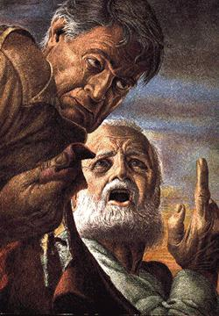
Examples of Those Seeking Counsel
Those seeking bad counsel
  King Saul
    Deuteronomy 18:9-12
    1 Samuel 28:7-20
      He did not do what God told him to do
Richie Thetford www.thetfordcountry.com

Slide 3
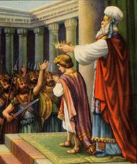
Examples of Those Seeking Counsel
Those seeking bad counsel
  Ahaziah
    2 Chronicles 22:2-5
      He constantly sought wicked counsel
Richie Thetford www.thetfordcountry.com

Slide 4
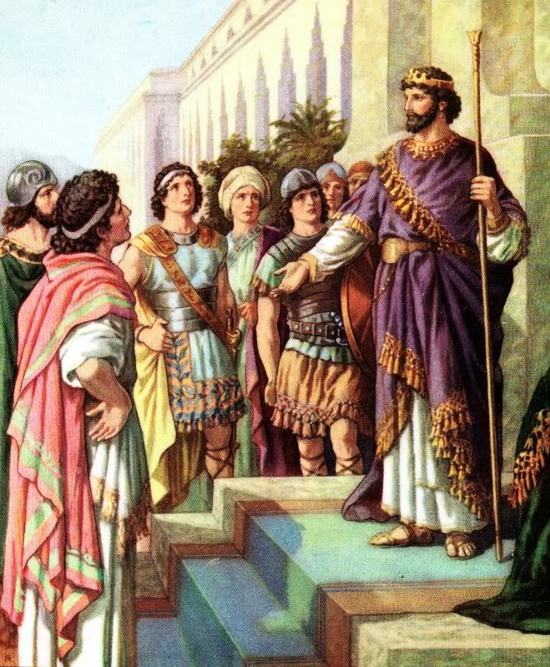
Examples of Those Seeking Counsel
Those who received good counsel
and did not do it
  Rehoboam
    1 Kings 12:3-8
      Looked for someone that would tell him
      “music to his ears”
Richie Thetford www.thetfordcountry.com

Slide 5
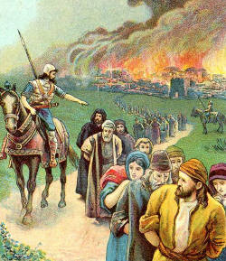
Examples of Those Seeking Counsel
Those who received good counsel
and did not do it
  Zedekiah
    Jeremiah 38:14-23
      He never surrendered and Jeremiah’s
      counsel came true
Richie Thetford www.thetfordcountry.com

Slide 6
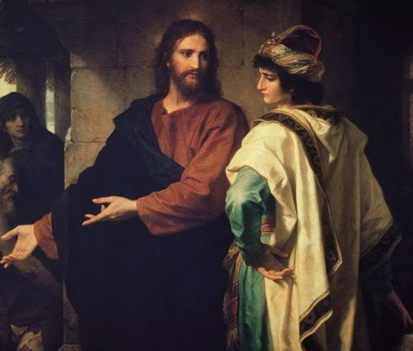
Examples of Those Seeking Counsel
Those who received good counsel
and did not do it
  The Young Man
    Matthew 19:16-22
      Many do not listen to Jesus and
      turn to counsel that will lead them
      further from “eternal life”
Richie Thetford www.thetfordcountry.com

Slide 7
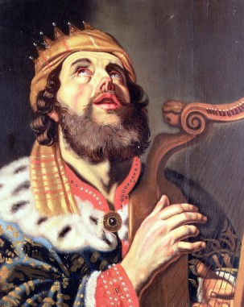
Examples of Those Seeking Counsel
Those who received good counsel
and did it!
  David
    1 Chronicles 14:8-17
      God was with David because he kept
      His counsel
Richie Thetford www.thetfordcountry.com

Slide 8
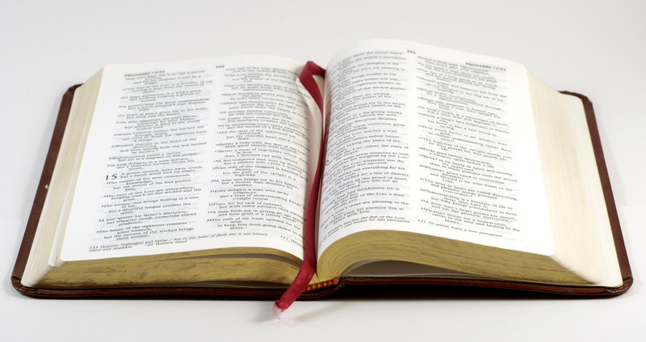
Examples of Those Seeking Counsel
Those who received good
counsel and did it!
  The Apostles
    Acts 1:21-26
      Their counsel was in the
      Lord and He directed them
Richie Thetford www.thetfordcountry.com

Slide 9
What Counsel Are We Seeking?
Bad Counsel
Not considering what is good?
Wrong Counsel
Only interested in hearing what you want to hear?
Right Counsel
Preparing to carry it out?
Richie Thetford www.thetfordcountry.com

Slide 10
What Counsel Do We Seek?
Situation | Right | Wrong
Instructions on how you are to perform on the job | Supervisor | Co-Worker Previous Worker
What is expected of you in math class | Teacher | Peers Previous Students
Church member seeking guidance on day to day situations | Bible Elders Preacher | World New Convert Weak Member
“A wise man will hear and increase learning, and a man of understanding will attain wise counsel”
Proverbs 1:5
Richie Thetford www.thetfordcountry.com

Slide 11

Christians Need to Seek Counsel from Above
Giving God the credit
  Psalms 16:7
  Psalms 33:11
  Psalms 73:24
  Proverbs 12:15; 9:9
We must be careful what counsel we seek!
Richie Thetford www.thetfordcountry.com

