Slide 1


Matthew 23:23
Matthew 5:20
Richie Thetford www.thetfordcountry.com

Slide 2
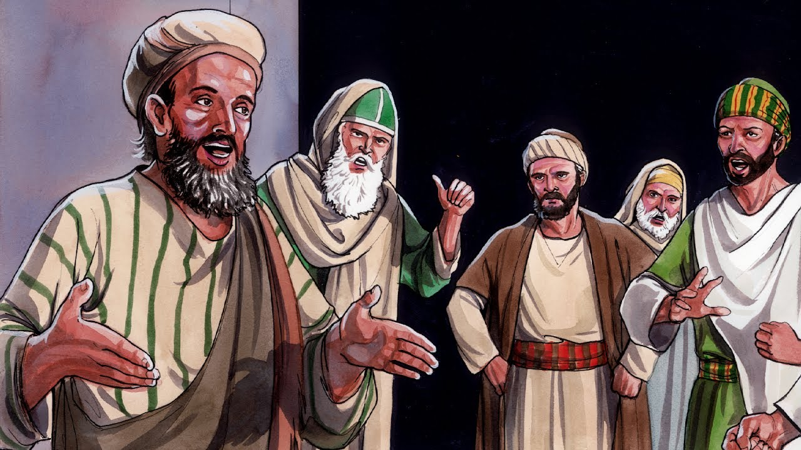
Who Are These Pharisees?
Associated themselves with the “Law” – to observe strictly
Had the greatest influence upon the congregations
Their teachings:
  Every soul is imperishable
  The existence of Angels and spirits
    Acts 23:8
  All depends on fate and God
  Looked at politics from a religious view
Richie Thetford www.thetfordcountry.com

Slide 3
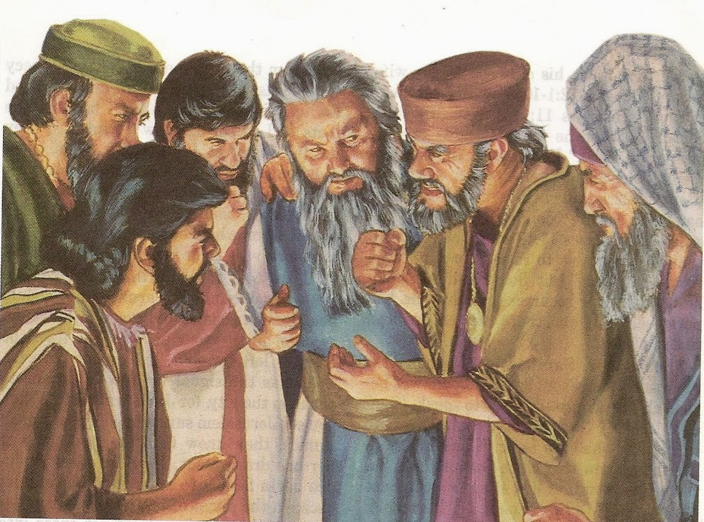
Who Are These Pharisees?
Their practices:
  Avoided non-Pharisees because they were considered “unclean”
    Mark 2:14-17
Richie Thetford www.thetfordcountry.com

Slide 4
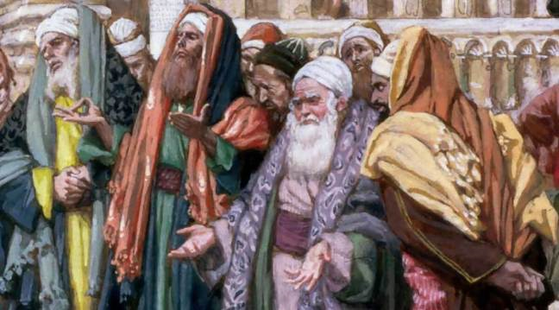
Who Are These Pharisees?
According to history – Seven different kinds of Pharisees:
  Shechemite Pharisee
  Tumbling Pharisee
  Bleeding Pharisee
  Mortar Pharisee
  What-am-I-yet-to-do Pharisee
  Pharisee from fear
  Pharisee from love
Richie Thetford www.thetfordcountry.com

Slide 5
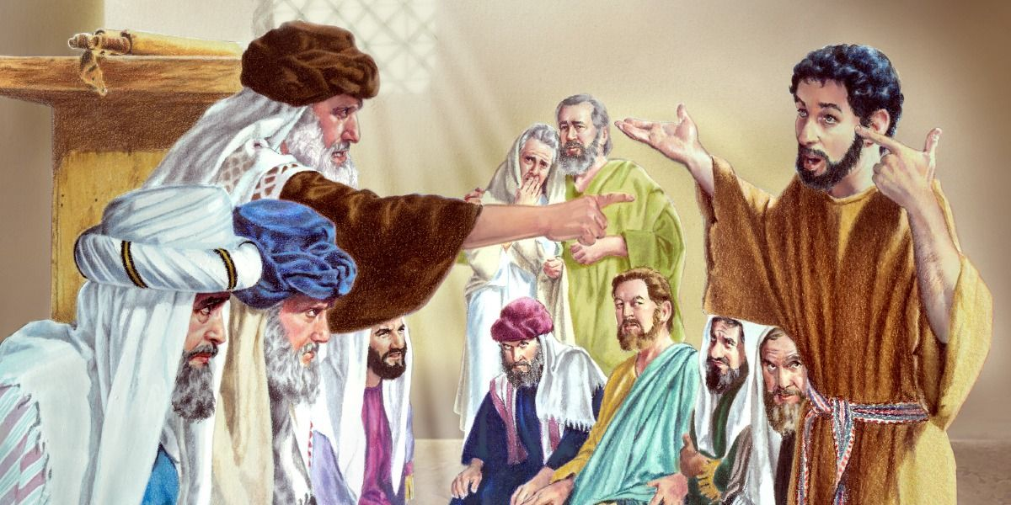
Comparing Pharisaism and Christianity
Pharisee was focused on keeping every letter of the law – something greater was overlooked
  Matthew 5:17, 21-22
Jesus’ aim was to call
men to the law of God
  Matthew 12:1-13
  Mark 7:2-4
Richie Thetford www.thetfordcountry.com

Slide 6
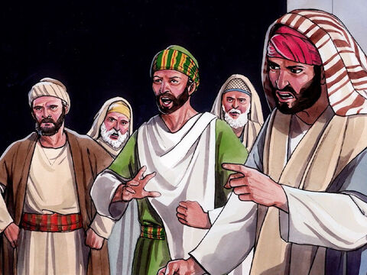
Comparing Pharisaism and Christianity
Jesus’ aim was to teach men that true piety consisted not in forms, but in substance
  Luke 11:42
Religion should be in man’s
heart
  Luke 11:37-41
  Matthew 19:3
  Matthew 19:7-8
Richie Thetford www.thetfordcountry.com

Slide 7
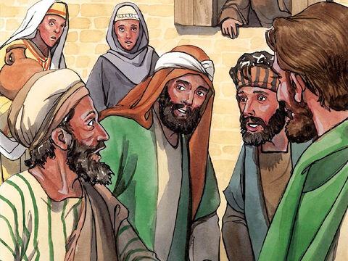
Comparing Pharisaism and Christianity
Pharisees sought mainly to attract attention
and admiration of men
  Matthew 6:2; 6:16; 23:5-6
Pharisees regarded degraded
classes to be shunned
  Luke 7:39; 15:2
Pharisees devoted energies to making
converts to their narrow views
  Matthew 23:15
Richie Thetford www.thetfordcountry.com

Slide 8
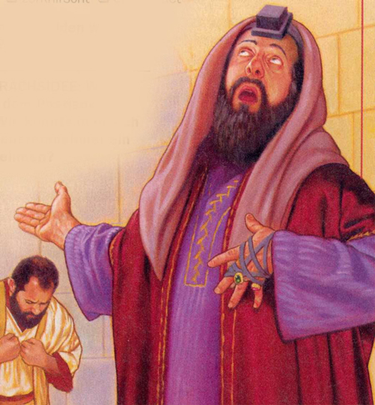
Conclusion
Jesus did not think much of these kind of Pharisees
Our righteousness must exceed that of the Pharisees
  Matthew 5:20
  Romans 6:17; 10:9-10
  Matthew 5:6
Are we all keeping these “weightier matters”
of the Word of God today?
Richie Thetford www.thetfordcountry.com

