Slide 1
We May Certainly Know the Certainties!
Luke 1:1-4
Richie Thetford www.thetfordcountry.com

Slide 2
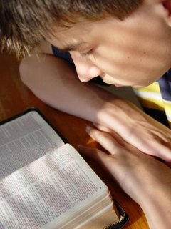
Certainty of God’s Promises
Three humble servants:
Zacharias and Elizabeth
“the birth of John the Baptist”
Mary
“the birth of Jesus the Messiah”
Richie Thetford www.thetfordcountry.com

Slide 3
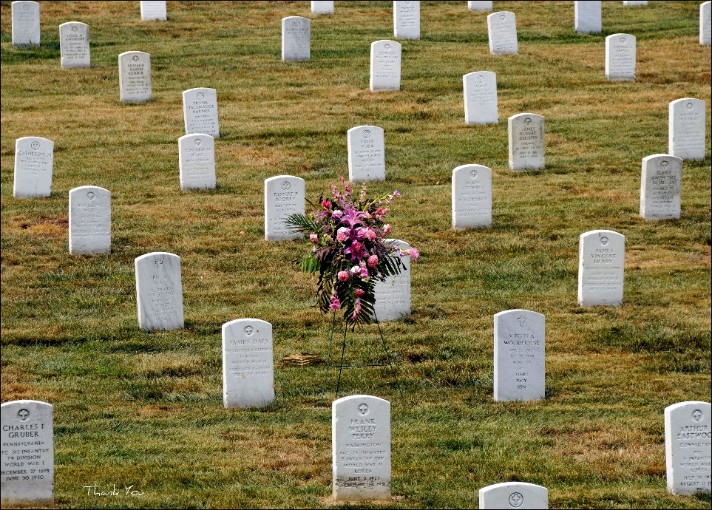
Certainty of Death
An absolute truth
Psalms 89:48
Ecclesiastes 3:19-21
Ecclesiastes 2:14-16
Hebrews 9:27
Brevity of Life
Job 14:1-2
James 4:14
Richie Thetford www.thetfordcountry.com

Slide 4
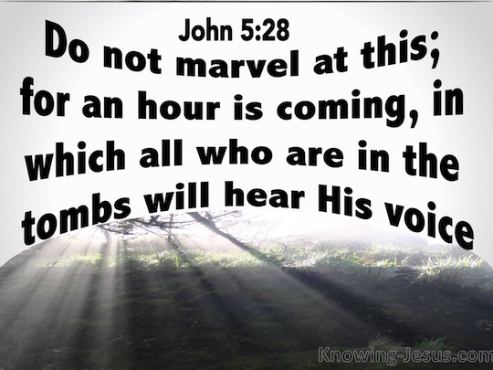
Certainty of the Resurrection
Will be a resurrection one day
John 5:28-29
John 11:23-24
1 Thessalonians 4:13-18
Richie Thetford www.thetfordcountry.com

Slide 5
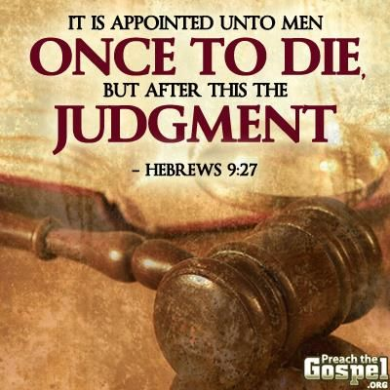
Certainty of the Judgment
For ALL of mankind
Hebrews 9:27
Romans 14:10-12
2 Corinthians 5:10
Richie Thetford www.thetfordcountry.com

Slide 6
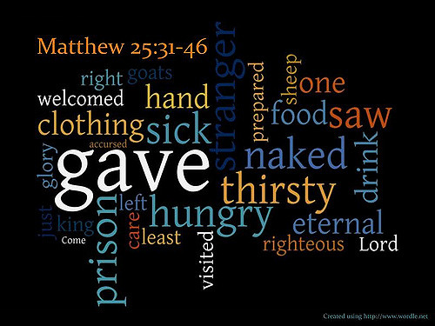
Certainty of Eternal Separation
Separation from the good and evil
Luke 16:19-31
Matthew 25:31-46
2 Thessalonians 1:6-9
Revelation 21:8
Revelation 20:10
Richie Thetford www.thetfordcountry.com

Slide 7
We May Certainly Know the Certainties!
John 3:16
God’s certainties are given so that we might establish our lives with proper foundations and proper perspectives
Richie Thetford www.thetfordcountry.com

