Slide 1
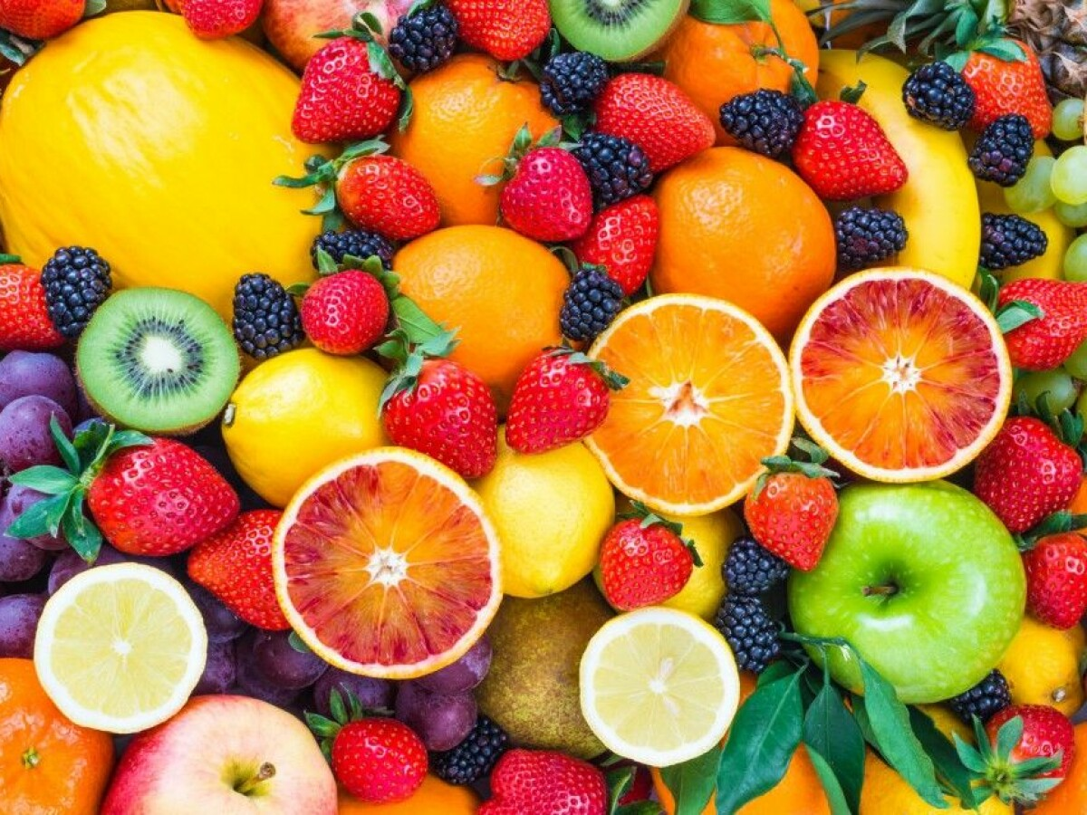
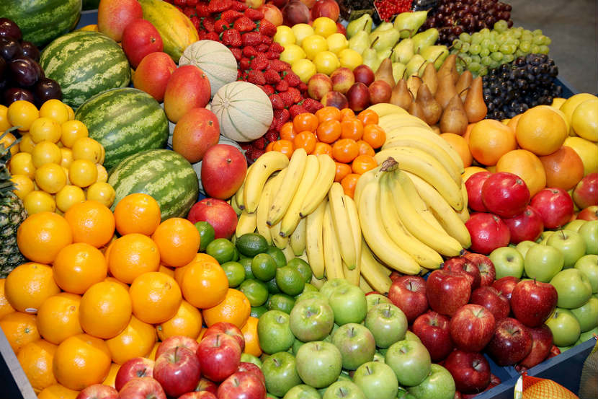
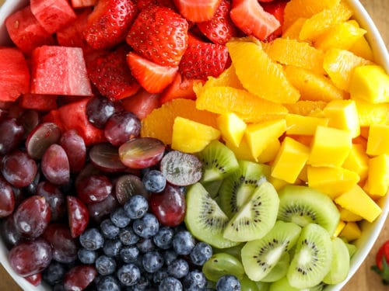
We Are Known By Our FRUIT
Matthew 12:33-37
Richie Thetford www.thetfordcountry.com

Slide 2
Fruit of the Spirit
“But the fruit of the Spirit is love, joy, peace, longsuffering, kindness, goodness, faithfulness, gentleness, self-control. Against such there is no law.”
Galatians 5:22-23
Are we producing this kind of fruit?
Richie Thetford www.thetfordcountry.com

Slide 3
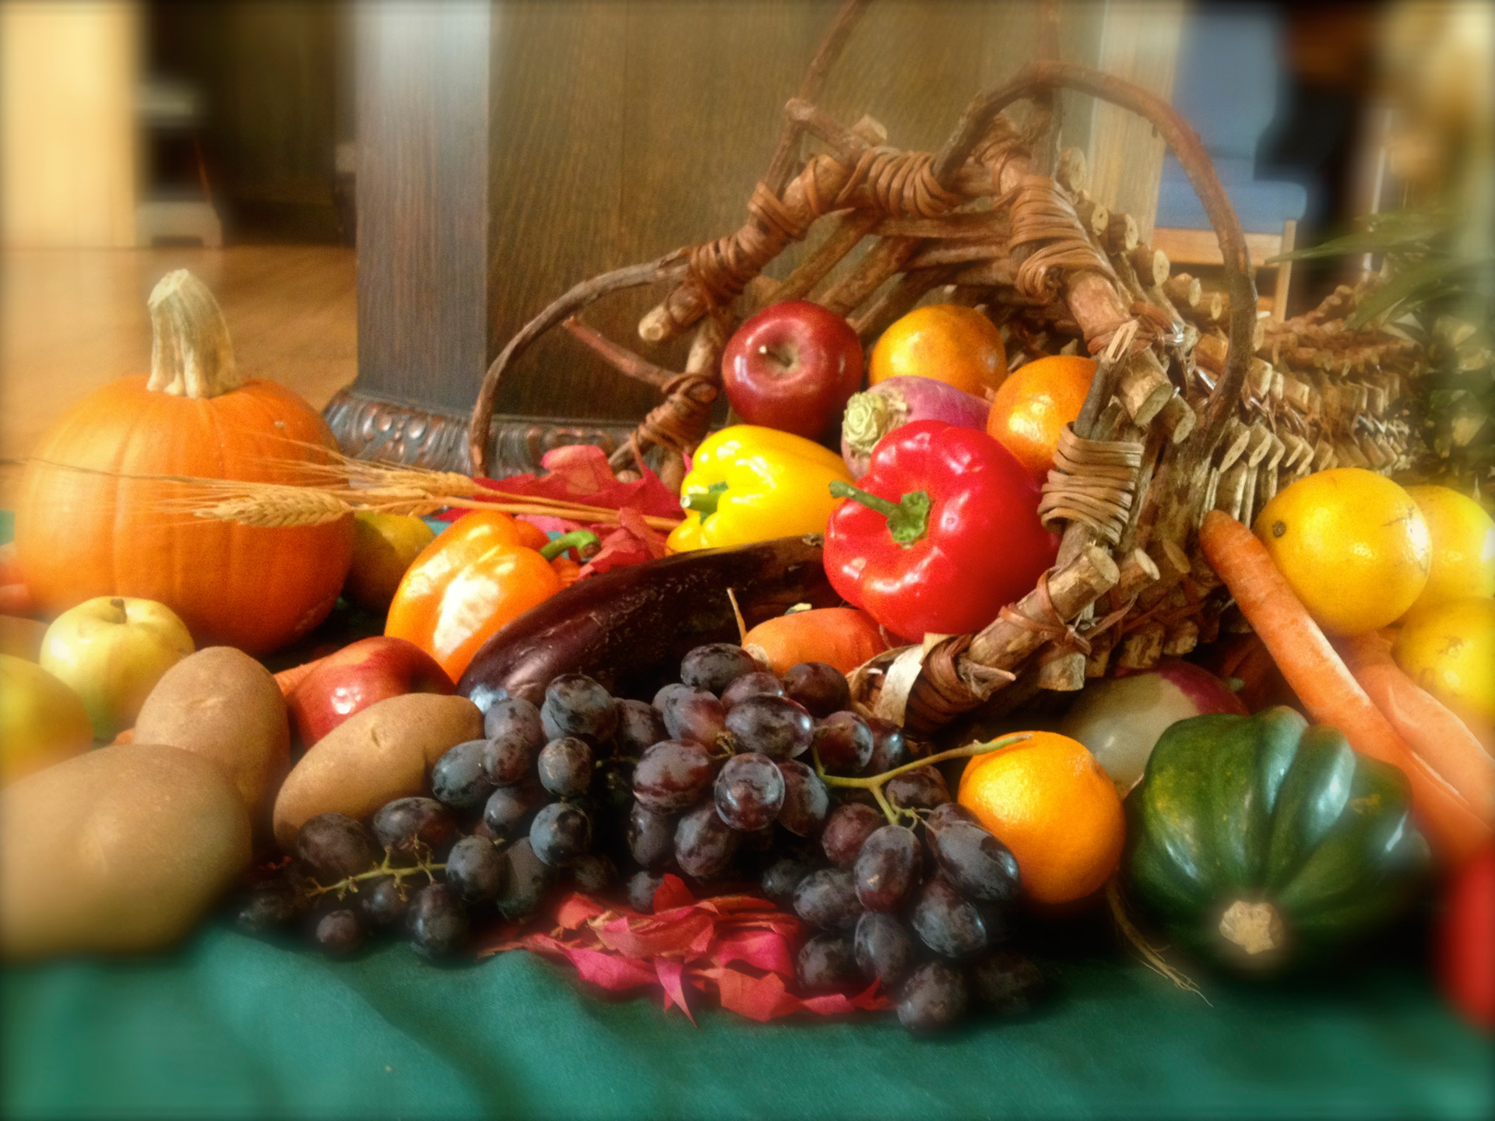
“Produce”
Product of nature and nurturing
“fruit of the spirit” is produced as one is “led by the Spirit”
Galatians 5:16, 18, 25
Live by the direction of the Spirit-inspired gospel
“the faith” revealed unto us
Galatians 3:2; 1:11
Richie Thetford www.thetfordcountry.com

Slide 4
“Produce”
Spiritual fruit by abiding in Christ
John 15:1-8
Abide in His word
John 8:31-32
Good fruit produced by obedience of the gospel
Can others see the good fruit of Jesus in us?
Richie Thetford www.thetfordcountry.com

Slide 5
“Identification”
Fruit of our life identifies to whom we belong
Proves our discipleship
Marks us as belonging to Christ (Matthew 7:20)
Fruit of the Spirit leads us to victory over the flesh
Galatians 5:24
1 Peter 4:1-2
Should identify us with Christ
Richie Thetford www.thetfordcountry.com

Slide 6
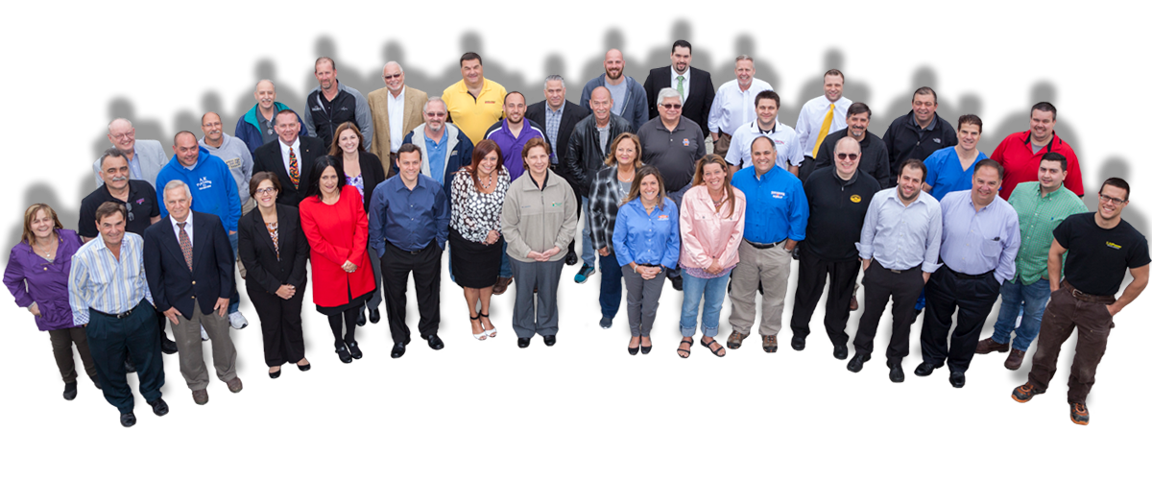
What Kind of FRUIT Should This Tree Produce?
CHRIST
Ephesians
5:23
Colossians 1:18,24
Galatians 5:22-23
BODY
1 Corinthians 12:12-27
2 Peter 1:5-11
Richie Thetford www.thetfordcountry.com

Slide 7
“Maturity”
Fruit must grow to maturity
Spiritual fruit takes time to mature
Encouraged to grow to maturity
Acts 20:32
Philippians 3:13-14
Hebrews 6:1
1 Peter 2:2
Richie Thetford www.thetfordcountry.com

Slide 8
“Maturity”
Occurs when we obey the word of God
Hebrews 5:12-14
We need diligence and patience as we grow
Personal Bible study and Bible classes
God will not accept us if we do not bear fruit for Him
Luke 13:6-9
2 Peter 1:5-11
Richie Thetford www.thetfordcountry.com

Slide 9
Conclusion
CHRIST
BODY
By bearing the fruit of the Spirit – we show Christ to the world!
Matthew 5:16
Philippians 2:14-15
Richie Thetford www.thetfordcountry.com

Slide 10
Conclusion
CHRIST
BODY
The family and the church will inherit a reputation in the community based on the fruit that others can see hanging on our branches
Richie Thetford www.thetfordcountry.com

