Slide 1

Richard Thetford www.thetfordcountry.com

Slide 2
“This is the message which we have heard from Him and declare to you, that God is light and in Him is no darkness at all. If we say that we have fellowship with Him, and walk in darkness, we lie and do not practice the truth. But if we walk in the light as He is in the light, we have fellowship with one another, and the blood of Jesus Christ His Son cleanses us from all sin.”
1 John 1:5-7
Richard Thetford www.thetfordcountry.com

Slide 3

Are You in the Light?
The light is God
  James 1:17
  1 Peter 2:9
  1 Timothy 6:16
  1 John 4:8
  1 John 3:20
  Psalms 139:1-6
  Luke 12:6-7
Richard Thetford www.thetfordcountry.com

Slide 4
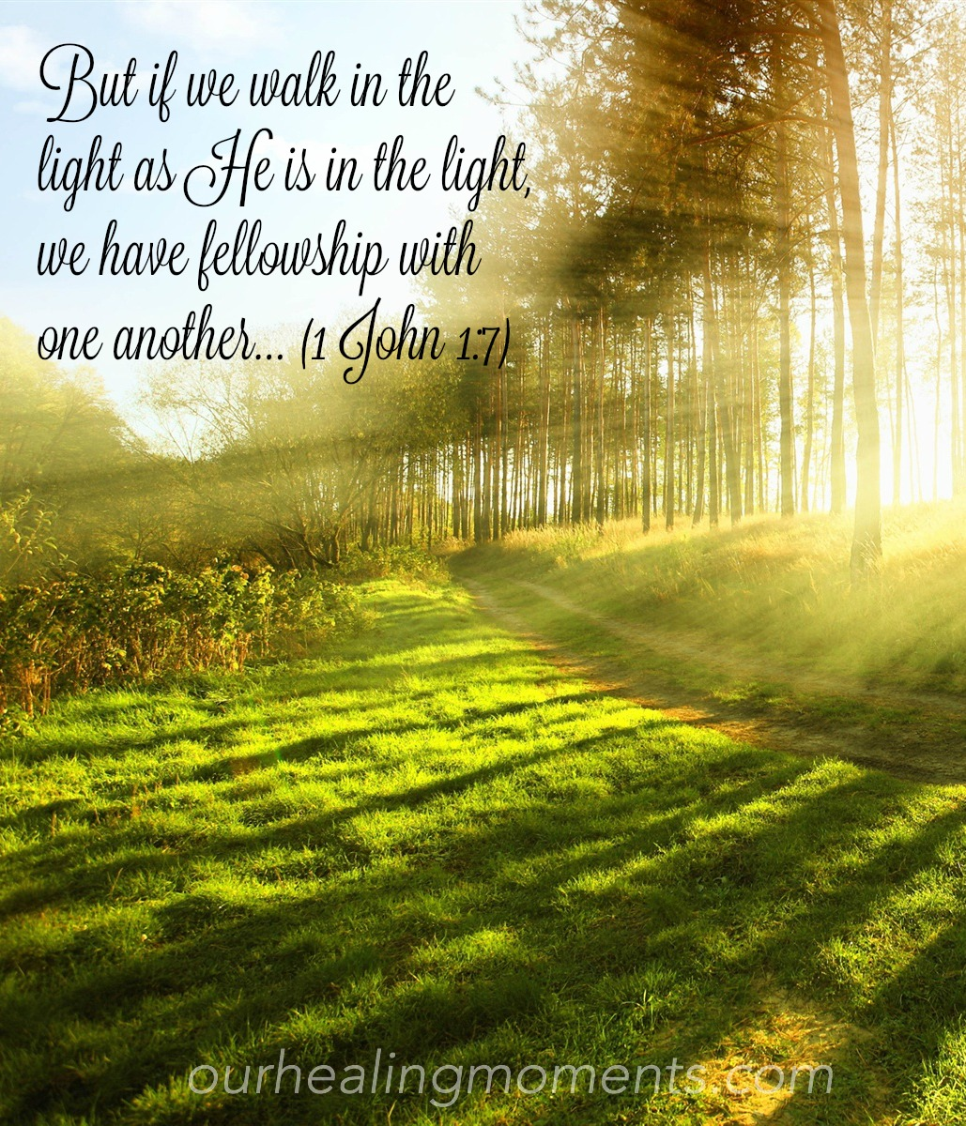
Are You in the Light?
We have fellowship when
walking in the light
  1 John 1:7
Blood of Jesus cleanses us
  Isaiah 1:18
  Hebrews 9:13-14
Richard Thetford www.thetfordcountry.com

Slide 5

Straddling Between Light and Darkness?
No in-between state
  Luke 11:23
Some live close to darkness
  Romans 13:13-14
  Ephesians 5:8-12
Some have difficulty knowing
  Titus 1:15
  1 Timothy 4:1-2
Richard Thetford www.thetfordcountry.com

Slide 6
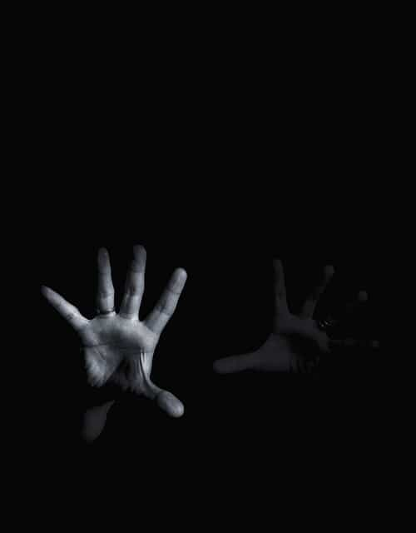
Are We Lost in the Darkness?
A bad and scary thing
Blindness is the result
Some think they are in the light
  1 John 1:6, 8
If we hate – we are in darkness
  1 John 2:9-11
Let someone show us the way
  Matthew 18:12-14
Richard Thetford www.thetfordcountry.com

Slide 7
Where are we?
Richard Thetford www.thetfordcountry.com

