Slide 1
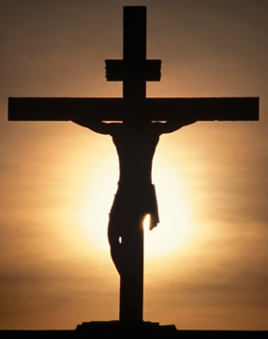
Victory defined: Final and complete supremacy; superiority in battle or war; success in any contest or struggle involving the defeat of an opponent or the overcoming of obstacles”
VICTORY
through
CHRIST!
1 Corinthians 15:57-58

Slide 2
Victory through Christ!
VICTORY
through
CHRIST!
Everyone delights in victory!
1 Corinthians 9:24
Promised victory through Christ
1 Corinthians 15:57
Romans 8:31-39
Philippians 4:13

Slide 3
Victory over Sin
VICTORY
through
CHRIST!
Over the guilt of sin
Romans 3:23
Hebrews 10:16-22
1 Peter 1:18-20
Over the power of sin
Romans 6:12-14
2 Peter 2:9
1 Corinthians 10:13

Slide 4
Victory over Trials of Life
VICTORY
through
CHRIST!
Over sorrow
Job 14:1
2 Corinthians 1:3-5
Over difficulties
Matthew 20:20
Hebrews 13:5

Slide 5
Victory over Trials of Life
VICTORY
through
CHRIST!
Over fear
1 John 4:18
Daniel 2:44
Matthew 16:18
Hebrews 12:28

Slide 6
Victory over Trials of Life
VICTORY
through
CHRIST!
Over the world
1 John 5:4
John 15:18-19
John 17:14-16
2 Timothy 1:8-13
John 16:33
Hebrews 4:15

Slide 7
Victory over Death
VICTORY
through
CHRIST!
Question of Job
Job 14:14
Through Christ – we are assured victory!
1 Corinthians 15:20-22, 55-57
As Jesus overcame death – so will we
1 Corinthians 15:44

Slide 8
Paul’s Challenge
VICTORY
through
CHRIST!
“Therefore, my beloved brethren, be steadfast, immovable, always abounding in the work of the Lord, knowing that your labor is not in vain in the Lord.”
1 Corinthians 15:58
We will be rewarded accordingly
Romans 2:6-11

Slide 9
Conclusion
VICTORY
through
CHRIST!
“Now thanks be to God who always leads us in triumph in Christ, and through us diffuses the fragrance of His knowledge in every place. For we are to God the fragrance of Christ among those who are being saved and among those who are perishing. To the one we are the aroma of death leading to death, and to the other the aroma of life leading to life. And who is sufficient for these things?”
2 Corinthians 2:14-16
Life is one VICTORY after another in Christ!

Slide 10
Conclusion
VICTORY
through
CHRIST!
Must be “IN” Christ to receive the VICTORY!
Galatians 3:26-27
Must allow Christ to live in us
Galatians 2:20

