Slide 1
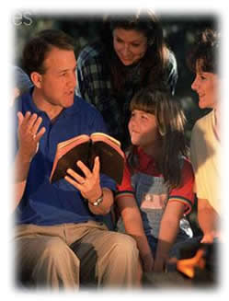
The Value of
Righteous Living

Slide 2
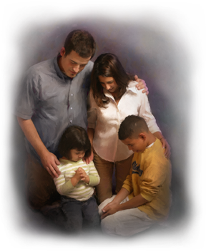
The Value of Righteous Living
“Righteousness exalts a nation, but sin is a reproach to any people.”
Proverbs 14:34
“…fear God and keep His commandments, for this is man’s all.”
Ecclesiastes 12:13

Slide 3
What Is Righteousness?
“Character or quality of being right or just”
We can know what is right
  Romans 1:16-17
  Acts 10:35
  Psalms 119:10-18
  Philippians 4:8
  Psalms 119:172
“Righteousness embraces the idea of the right knowledge in the mind, leading to the right action in life” (W. E. Vine)

Slide 4
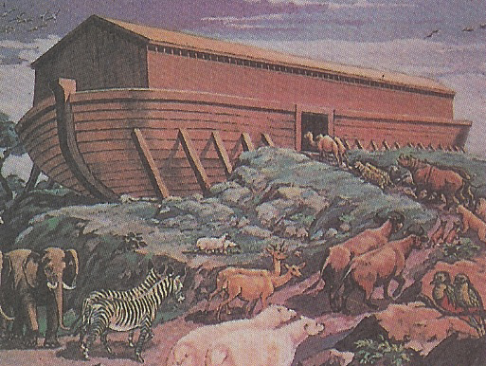
The Value of Righteous Living to:
NOAH
“a just man and perfect in his generations and Noah
walked with God” (Genesis 6:9)
Found “grace in the eyes of the Lord” (Gen 6:8)
While every living substance was destroyed, righteous Noah and his family were saved!
  1 Peter 3:20

Slide 5
The Value of Righteous Living to:
ABRAHAM
“Abraham believed God, and it was accounted to him for righteousness. And he was a friend of God” (James 2:23)
Abraham’s supreme test: His willingness to sacrifice his only son Isaac
(Hebrews 11:17-18)
The Savior came through Abraham’s FAITH!
  Galatians 3:16

Slide 6
The Value of Righteous Living to: the city of SODOM
“the Lord rained brimstone and fire on Sodom and Gomorrah, from the LORD out of the heavens. So He overthrew those cities….” (Genesis 19:24)
Less than 10 righteous
people could be counted!
Sodom and Gomorrah’s wickedness and moral
decay became proverbial
  Romans 9:29

Slide 7
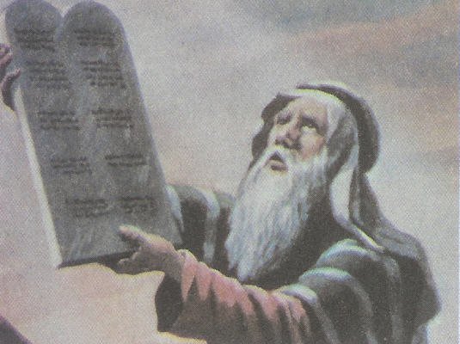
The Value of Righteous Living to:
ISRAEL of Old
“Surely this great nation is a wise and understanding people.” (Deuteronomy 4:6)
Their UNRIGHTEOUSNESS worked their ruin!
God watched over Israel.
The righteous received His blessing
  Deut 11:26-28

Slide 8
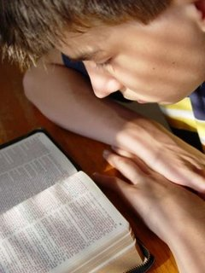
The Value of Righteous Living
TODAY!
Righteousness
Gives access to God
1 Peter 3:12
Proverbs 15:9
Righteousness
Bears good fruit
Matthew 7:17-20
Proverbs 11:30

Slide 9
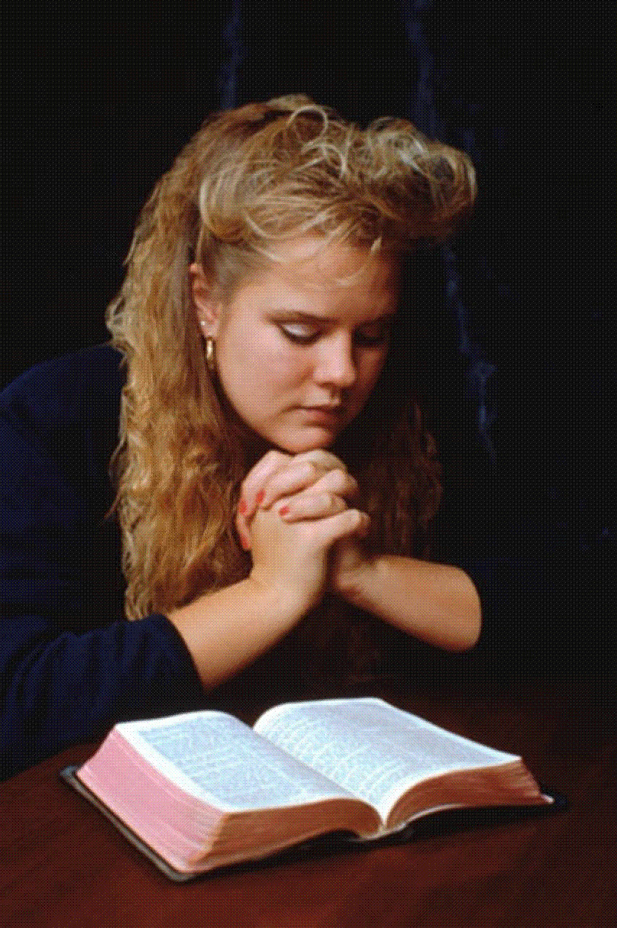
The Value of Righteous Living
TODAY!
Righteousness
Is profitable to others
Matthew 5:13-16
Righteousness
Will be crowned!
2 Timothy 4:7-8
2 Peter 3:13

Slide 10
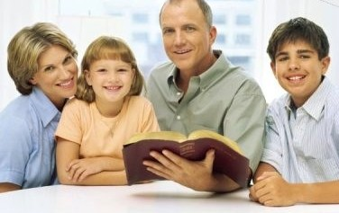
The Value of
Righteous Living
Are you numbered among God’s righteous?
LIVE RIGHTEOUSLY
while we have been given the chance!

